Slide 1
Lecture Presentation
Chapter 7 The Quantum-Mechanical Model of the Atom

Slide 2
The Beginnings of Quantum Mechanics
Until the beginning of the twentieth century it was believed that all physical phenomena were deterministic.
Work done at that time by many famous physicists discovered that for subatomic particles, the present condition does not determine the future condition.
Albert Einstein, Neils Bohr, Louis de Broglie, Max Planck, Werner Heisenberg, P. A. M. Dirac, and Erwin Schrödinger

Slide 3
The Beginnings of Quantum Mechanics
Quantum mechanics forms the foundation of chemistry.
Explains the periodic table
The behavior of the elements in chemical bonding
Provides the practical basis for lasers, computers, and countless other applications

Slide 4
The Behavior of the Very Small
Electrons are incredibly small.
A single speck of dust has more electrons than the number of people who have ever lived on Earth.
Electron behavior determines much of the behavior of atoms.
Directly observing electrons in the atom is impossible; the electron is so small that observing it changes its behavior.
Even shining a light on the electron would affect it.

Slide 5
A Theory That Explains Electron Behavior
The quantum-mechanical model explains the manner in which electrons exist and behave in atoms.
It helps us understand and predict the properties of atoms that are directly related to the behavior of the electrons:
Why some elements are metals and others are nonmetals.
Why some elements gain one electron when forming an anion, whereas others gain two.
Why some elements are very reactive, while others are practically inert.
Why, in other periodic patterns, we see the properties of the elements.

Slide 6
The Nature of Light: Its Wave Nature
Light: a form of electromagnetic radiation
Composed of perpendicular oscillating waves, one for the electric field and one for the magnetic field
An electric field is a region where an electrically charged particle experiences a force.
A magnetic field is a region where a magnetized particle experiences a force.
All electromagnetic waves move through space at the same constant speed.
3.00 × 10⁸ m/s = the speed of light

Slide 7
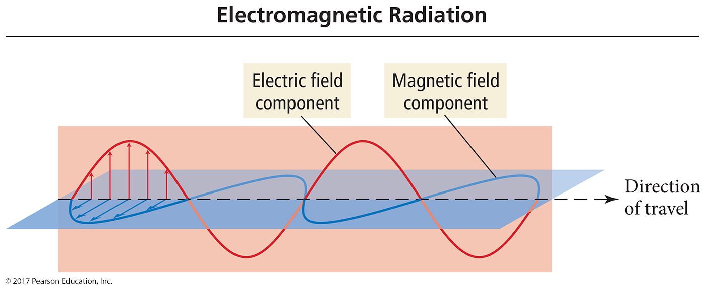
Electromagnetic Radiation

Slide 8
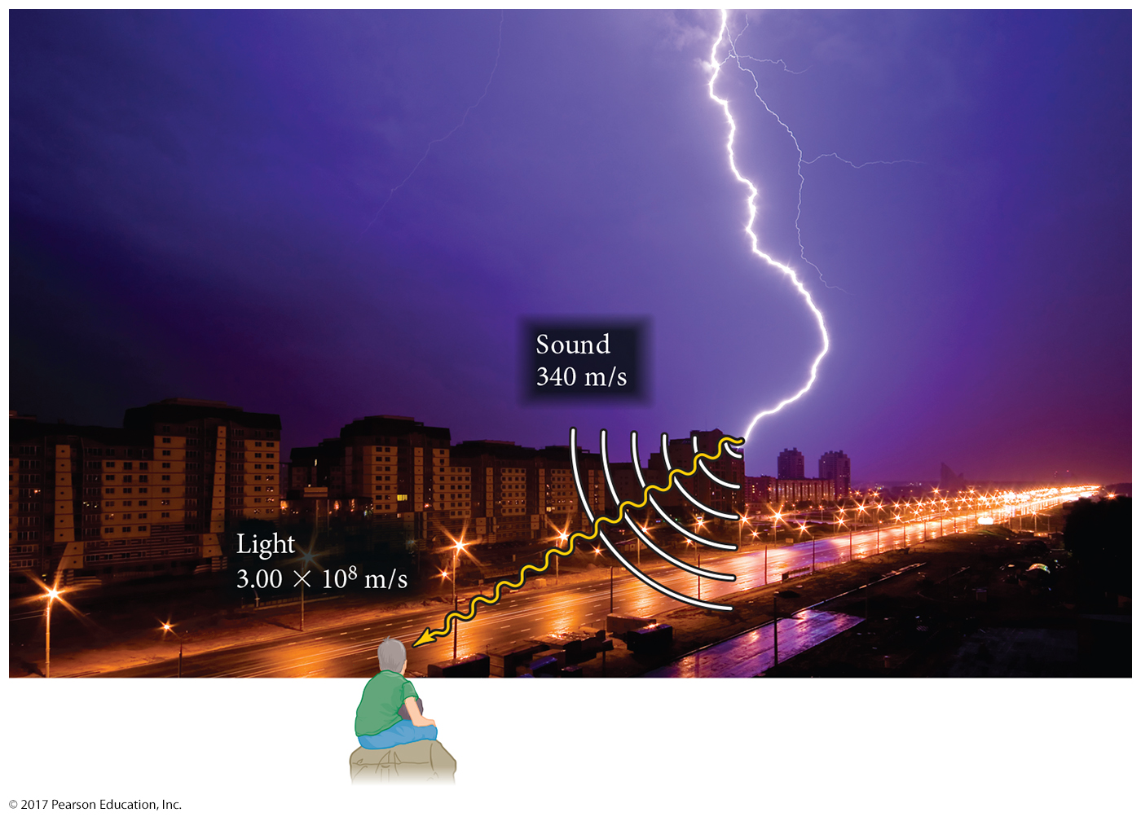
Speed of Energy Transmission

Slide 9
Characterizing Waves
The amplitude is the height of the wave.
The distance from node to crest or node to trough.
The amplitude is a measure of light intensity—the larger the amplitude, the brighter the light.
The wavelength (λ) is a measure of the distance covered by the wave.
The distance from one crest to the next
The distance from one trough to the next, or the distance between alternate nodes

Slide 10
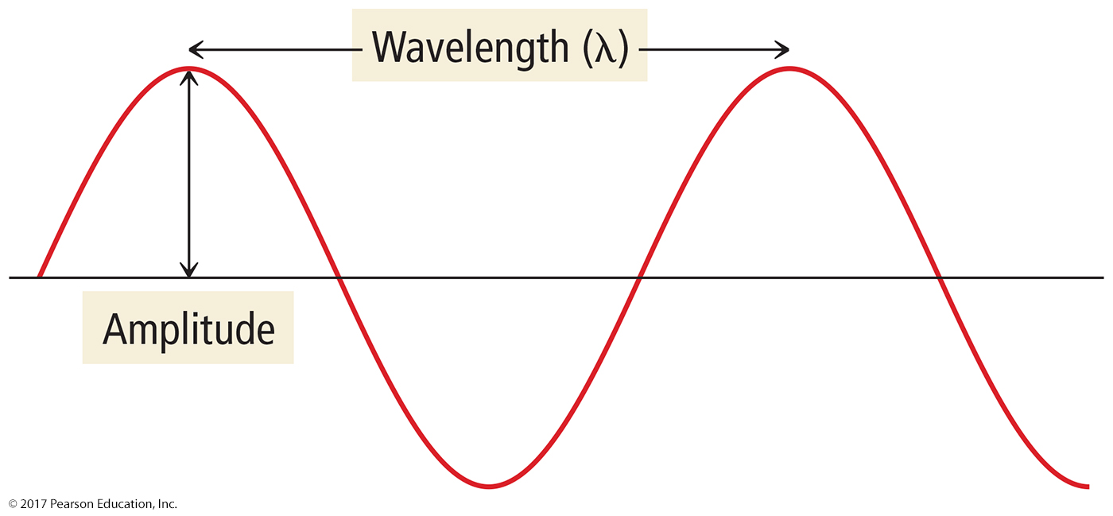
Wave Characteristics

Slide 11
Characterizing Waves
The frequency (ν) is the number of waves that pass a point in a given period of time.
The number of waves = the number of cycles.
Units are hertz (Hz) or cycles/s = s⁻¹ (1 Hz = 1 s⁻¹).
The total energy is proportional to the amplitude of the waves and the frequency.
The larger the amplitude, the more force it has.
The more frequently the waves strike, the more total force there is.

Slide 12
The Relationship between Wavelength and Frequency
For waves traveling at the same speed, the shorter the wavelength, the more frequently they pass.
This means that the wavelength and frequency of electromagnetic waves are inversely proportional.
Because the speed of light is constant, if we know wavelength we can find the frequency, and vice versa.

Slide 13
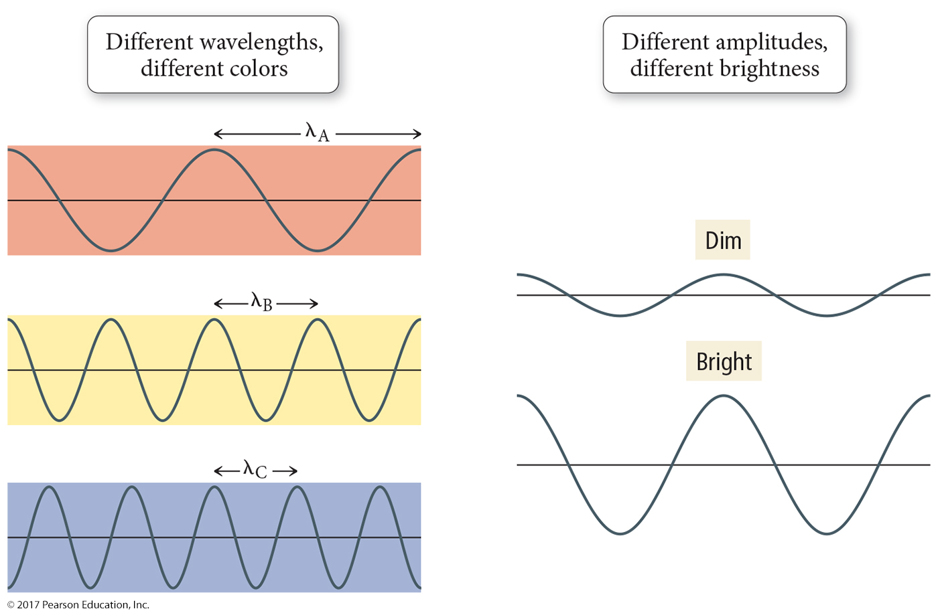
Amplitude and Wavelength

Slide 14
Color
The color of light is determined by its wavelength or frequency.
White light is a mixture of all the colors of visible light.
A spectrum
Red Orange Yellow Green Blue Indigo Violet
When an object absorbs some of the wavelengths of white light and reflects others, it appears colored; the observed color is predominantly the colors reflected.

Slide 15
The Electromagnetic Spectrum
Visible light comprises only a small fraction of all the wavelengths of light, called the electromagnetic spectrum.
Shorter wavelength (high-frequency) light has higher energy.
Radio wave light has the lowest energy.
Gamma ray light has the highest energy.
High-energy electromagnetic radiation can potentially damage biological molecules.
Ionizing radiation

Slide 16
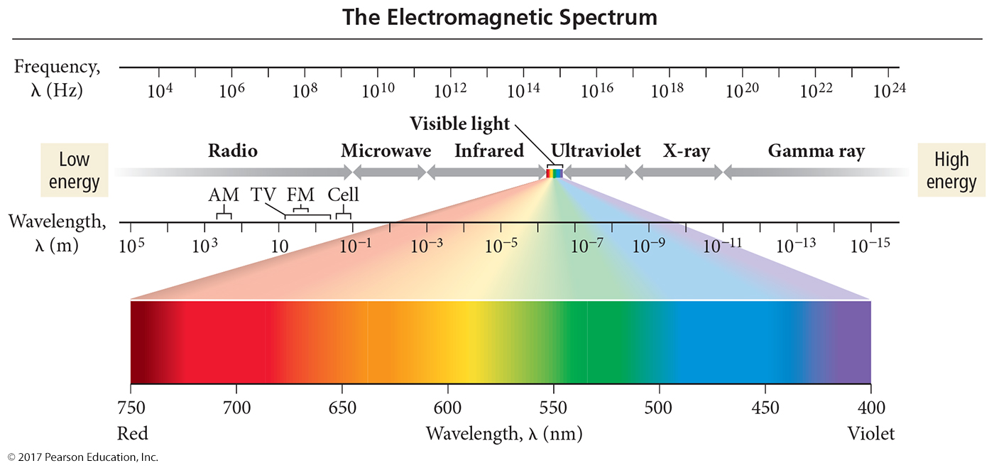
Electromagnetic Spectrum

Slide 17
Continuous Spectrum

Slide 18
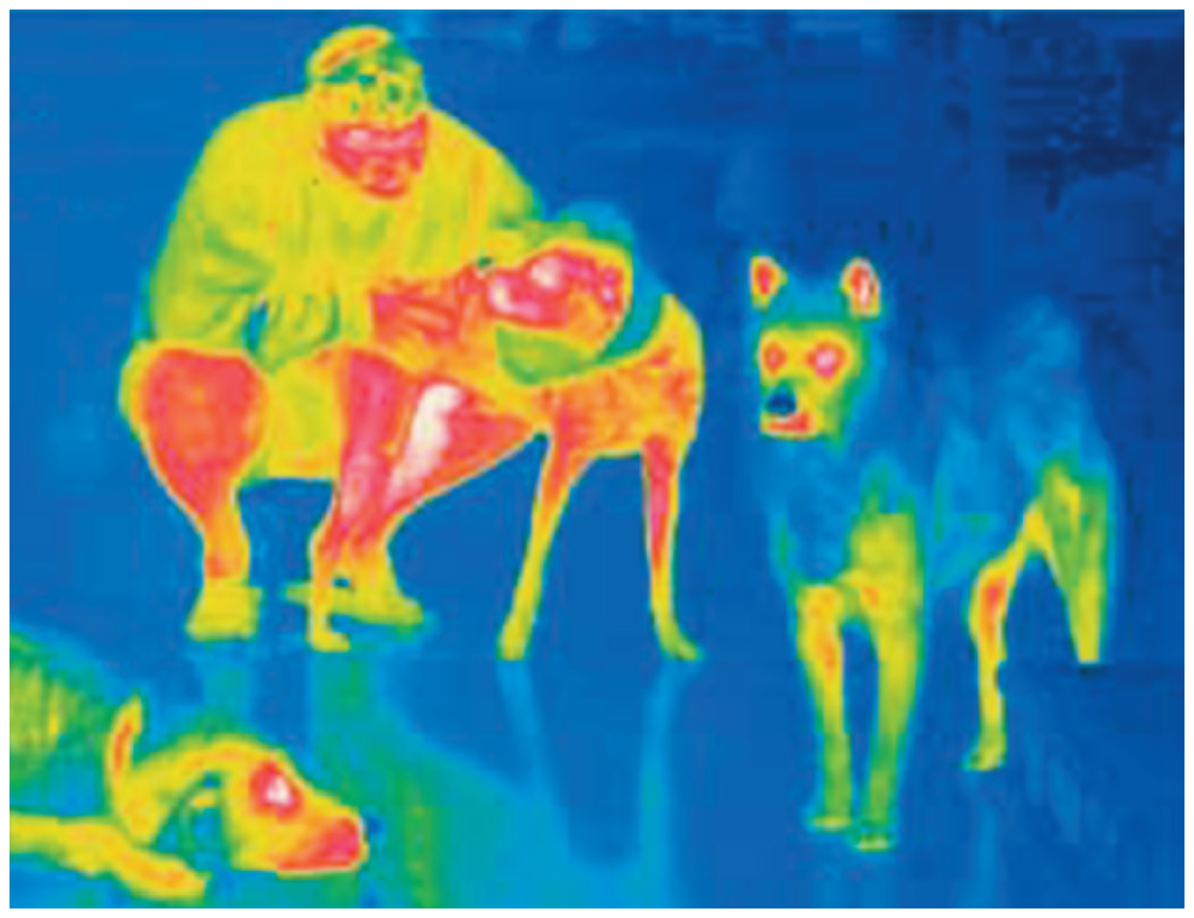
Thermal Imaging Using Infrared Light

Slide 19
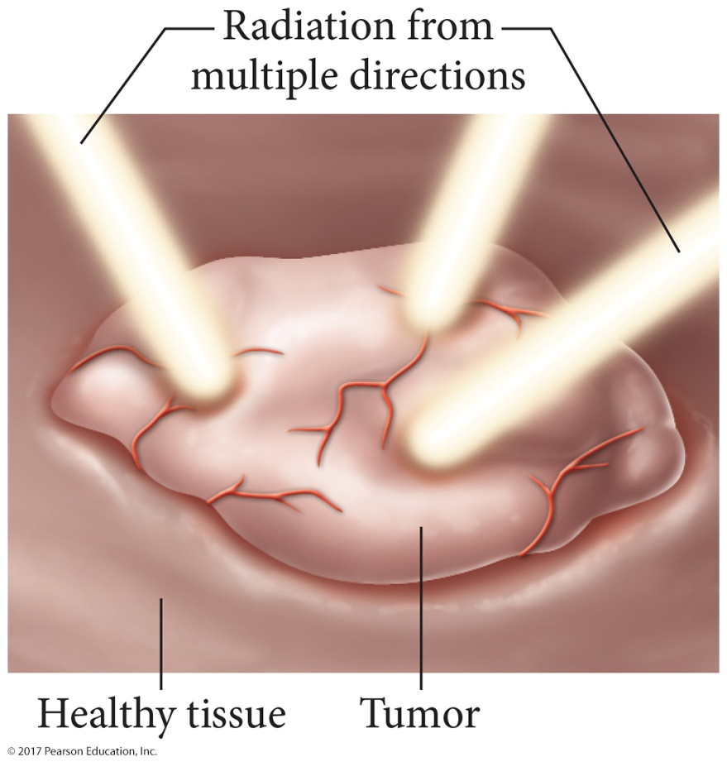
Using High-Energy Radiation to Kill Cancer Cells
During radiation therapy, a tumor is targeted from multiple directions in order to minimize the exposure of healthy cells while maximizing the exposure of cancerous cells.

Slide 20
Interference
The interaction between waves is called interference.
Constructive interference: When waves interact so that they add to make a larger wave, it is called in phase.
Destructive interference: When waves interact so that they cancel each other, it is called out of phase.

Slide 21
Interference

Slide 22
Diffraction
When traveling waves encounter an obstacle or opening in a barrier that is about the same size as the wavelength, they bend around it; this is called diffraction.
Traveling particles do not diffract.
The diffraction of light through two slits separated by a distance comparable to the wavelength results in an interference pattern of the diffracted waves.
An interference pattern is a characteristic of all light waves.

Slide 23
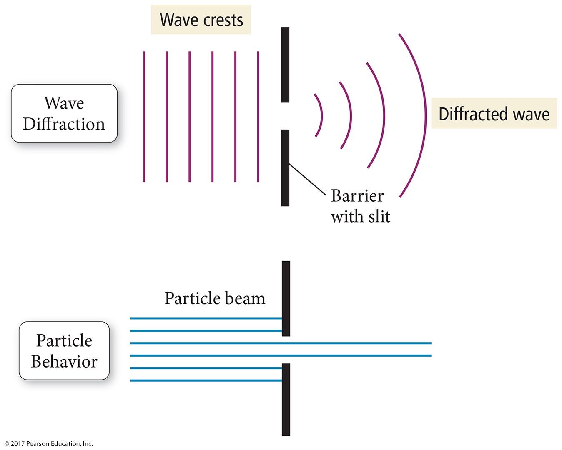
Diffraction

Slide 24
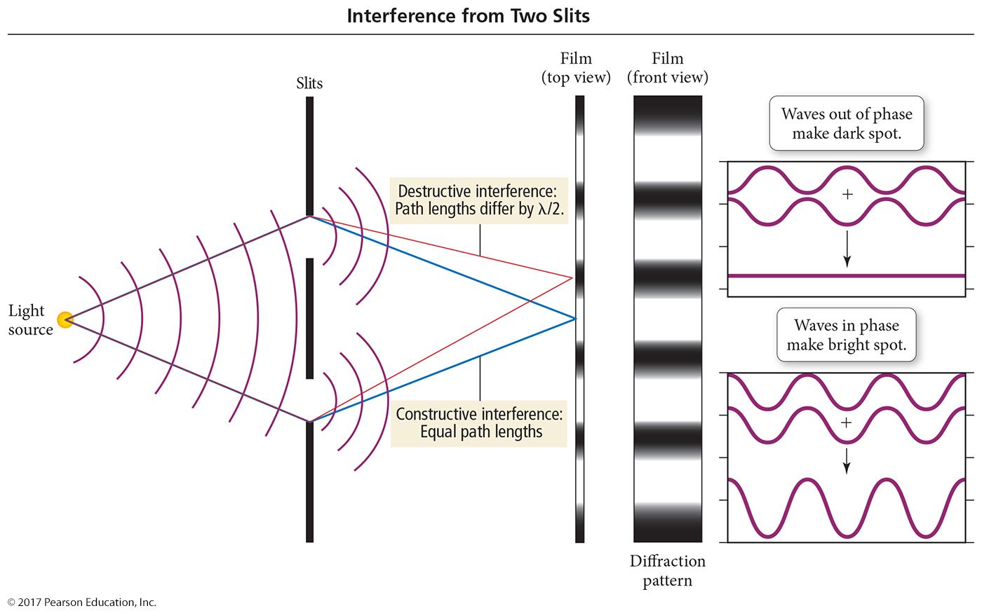
Two-Slit Interference

Slide 25
The Photoelectric Effect
It was observed that many metals emit electrons when a light shines on their surface.
This is called the photoelectric effect.
Classic wave theory attributed this effect to the light energy being transferred to the electron.
According to this theory, if the wavelength of light is made shorter, or the light wave’s intensity made brighter, more electrons should be ejected.
Remember that the energy of a wave is directly proportional to its amplitude and its frequency.
This idea predicts if a dim light were used there would be a lag time before electrons were emitted.
To give the electrons time to absorb enough energy

Slide 26
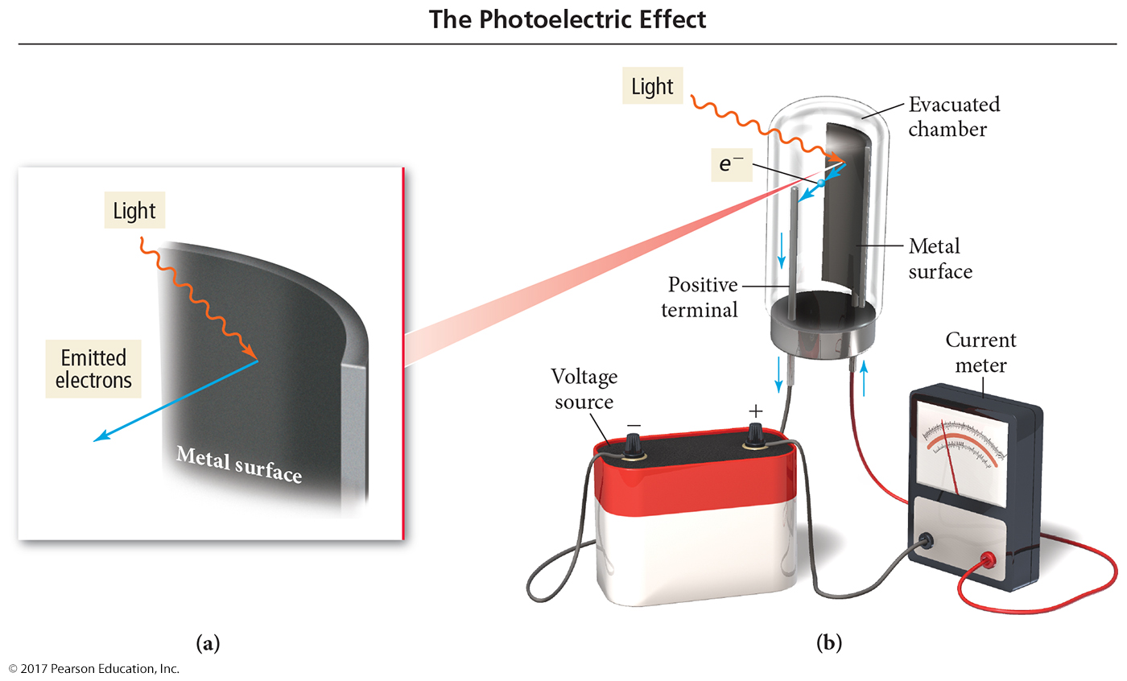
The Photoelectric Effect

Slide 27
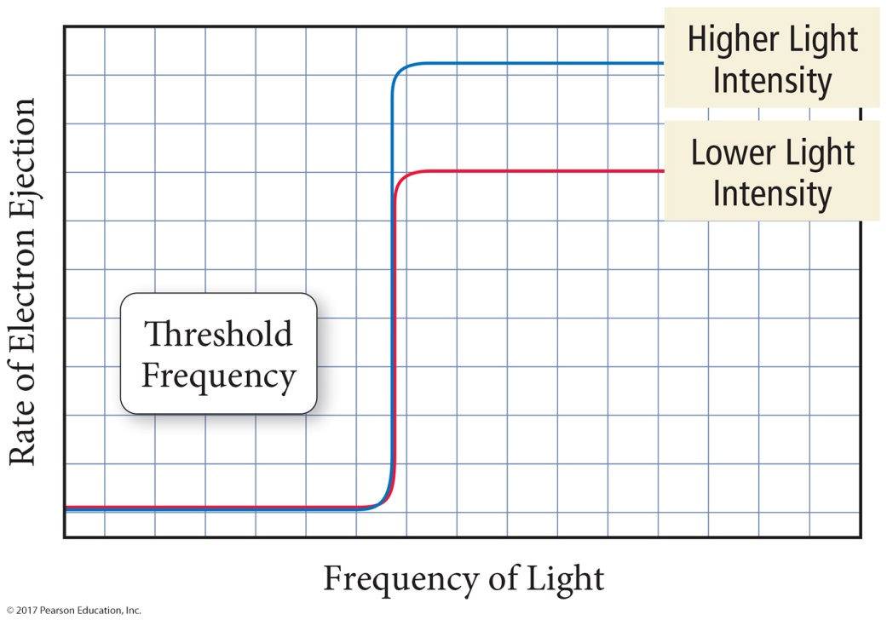
The Photoelectric Effect: The Problem
Experimental observations indicate the following:
A minimum frequency was needed before electrons would be emitted, regardless of the intensity, called the threshold frequency.
High-frequency light from a dim source caused electron emission without any lag time.

Slide 28
Einstein’s Explanation
Einstein proposed that the light energy was delivered to the atoms in packets, called quanta or photons.
The energy of a photon of light is directly proportional to its frequency.
Inversely proportional to its wavelength
The proportionality constant is called Planck’s Constant, (h) and has the value 6.626 × 10⁻³⁴ J ∙ s.

Slide 29
Ejected Electrons
One photon at the threshold frequency gives the electron just enough energy for it to escape the atom.
Binding energy, φ
When irradiated with a shorter wavelength photon, the electron absorbs more energy than is necessary to escape.
This excess energy becomes kinetic energy of the ejected electron.
Kinetic Energy = E_{photon} – E_{binding}
KE = hν − φ

Slide 30
Question
Suppose a metal will eject electrons from its surface when struck by yellow light. What will happen if the surface is struck with ultraviolet light?
No electrons would be ejected.
Electrons would be ejected, and they would have the same kinetic energy as those ejected by yellow light.
Electrons would be ejected, and they would have greater kinetic energy than those ejected by yellow light.
Electrons would be ejected, and they would have lower kinetic energy than those ejected by yellow light.

Slide 31
Spectra
When atoms or molecules absorb energy, that energy is often released as light energy.
Fireworks, neon lights, etc.
When that emitted light is passed through a prism, a pattern of particular wavelengths of light is seen that is unique to that type of atom or molecule; the pattern is called an emission spectrum.
Noncontinuous
Can be used to identify the material
Flame tests

Slide 32
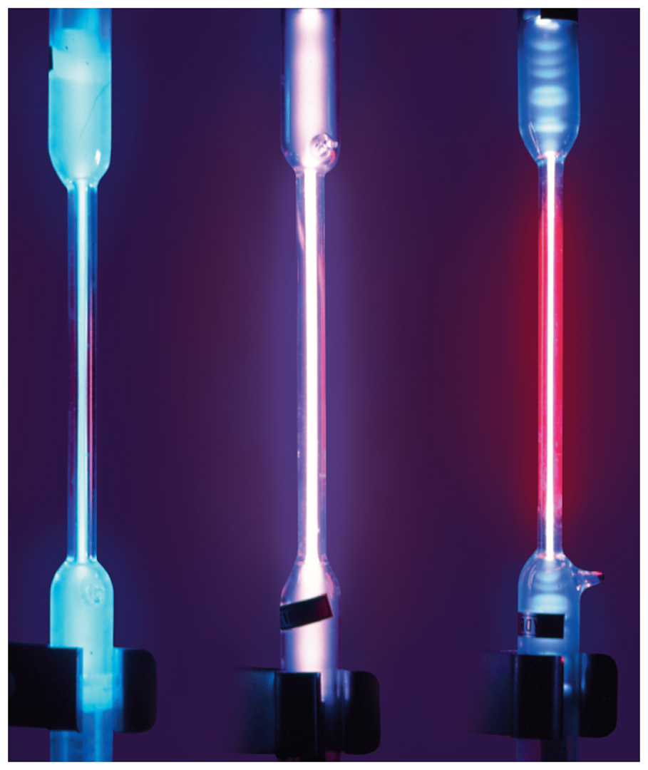
Exciting Gas Atoms to Emit Light
Light is emitted when gas atoms are excited via external energy (e.g., electricity or flame).
Each element emits a characteristic color of light.

Slide 33
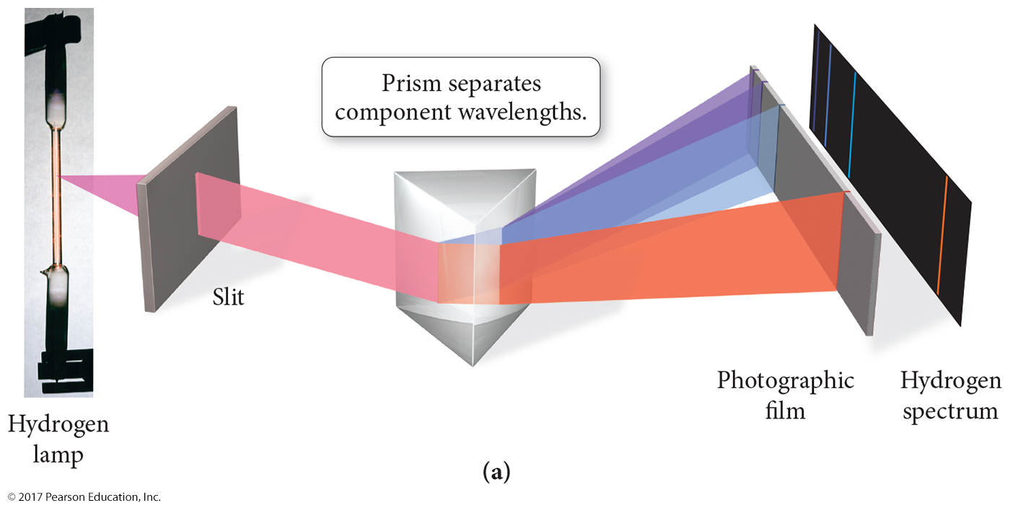
Emission Spectra

Slide 34
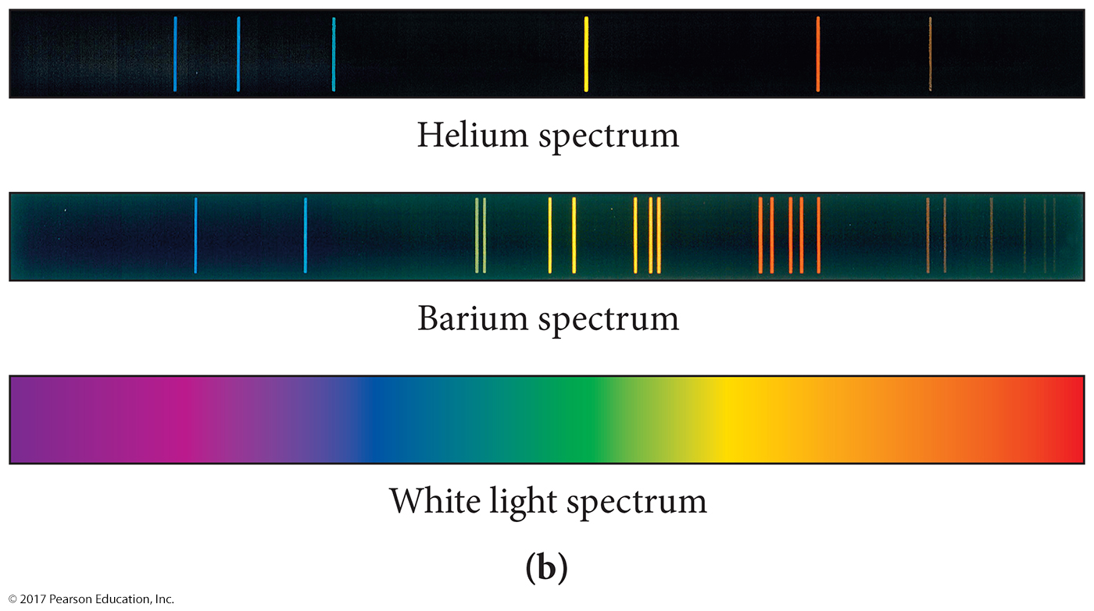
Examples of Spectra

Slide 35
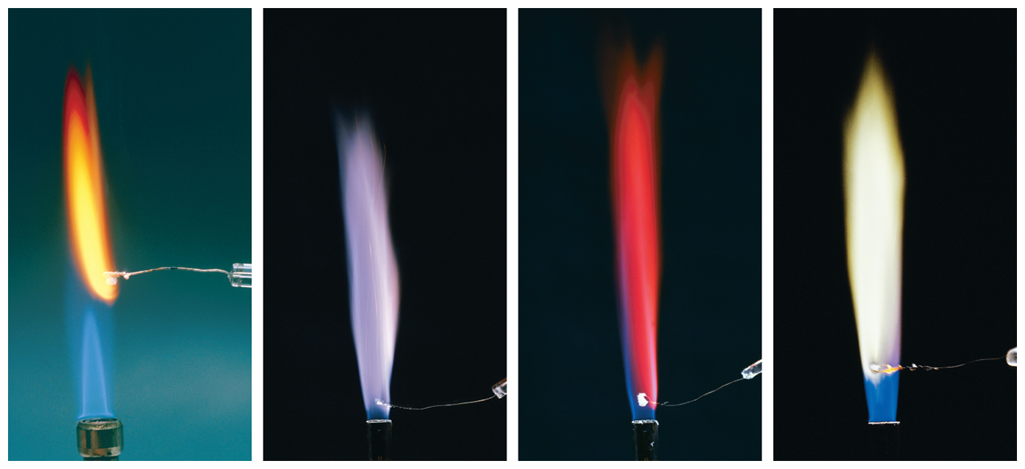
Identifying Elements with Flame Tests
Na
K
Li
Ba

Slide 36
Emission versus Absorption Spectra
Spectra of Mercury

Slide 37
Rydberg’s Spectrum Analysis
Johannes Rydberg (1854–1919)
Rydberg analyzed the spectrum of hydrogen and found that it could be described with an equation that involved an inverse square of integers.

Slide 38
The Bohr Model of the Atom
Neils Bohr (1885–1962)
The nuclear model of the atom does not explain what structural changes occur when the atom gains or loses energy.
Bohr developed a model of the atom to explain how the structure of the atom changes when it undergoes energy transitions.
Bohr’s major idea was that the energy of the atom was quantized and that the amount of energy in the atom was related to the electron’s position in the atom.
Quantized means that the atom could have only very specific amounts of energy.

Slide 39
Bohr’s Model
The electrons travel in orbits that are at a fixed distance from the nucleus.
Stationary states
Therefore, the energy of the electron was proportional to the distance the orbit was from the nucleus.
Electrons emit radiation when they “jump” from an orbit with higher energy down to an orbit with lower energy.
The emitted radiation was a photon of light.
The distance between the orbits determined the energy of the photon of light produced.

Slide 40
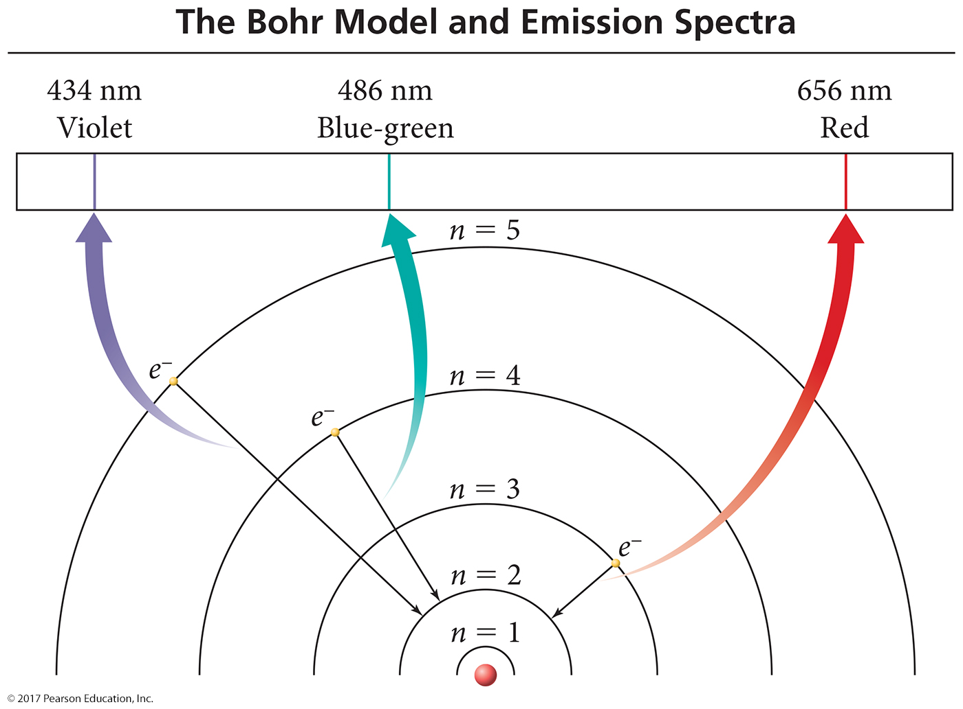
Bohr Model of H Atoms

Slide 41
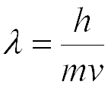
Wave Behavior of Electrons
Louis de Broglie (1892–1987)
De Broglie proposed that particles could have wavelike character.
De Broglie predicted that the wavelength of a particle was inversely proportional to its momentum.
Because it is so small, the wave character of electrons is significant.

Slide 42
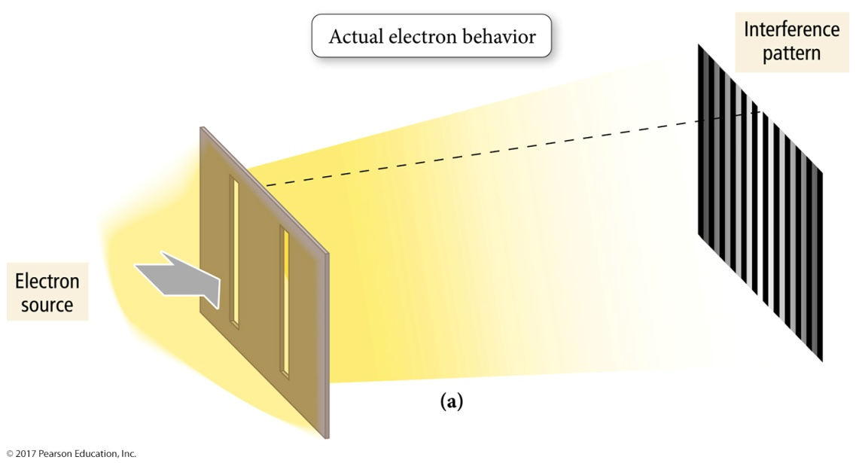
Electron Diffraction
Proof that the electron had wave nature came a few years later with the demonstration that a beam of electrons would produce an interference pattern the same as waves do.
However, electrons actually present an interference pattern, demonstrating they behave like waves.

Slide 43
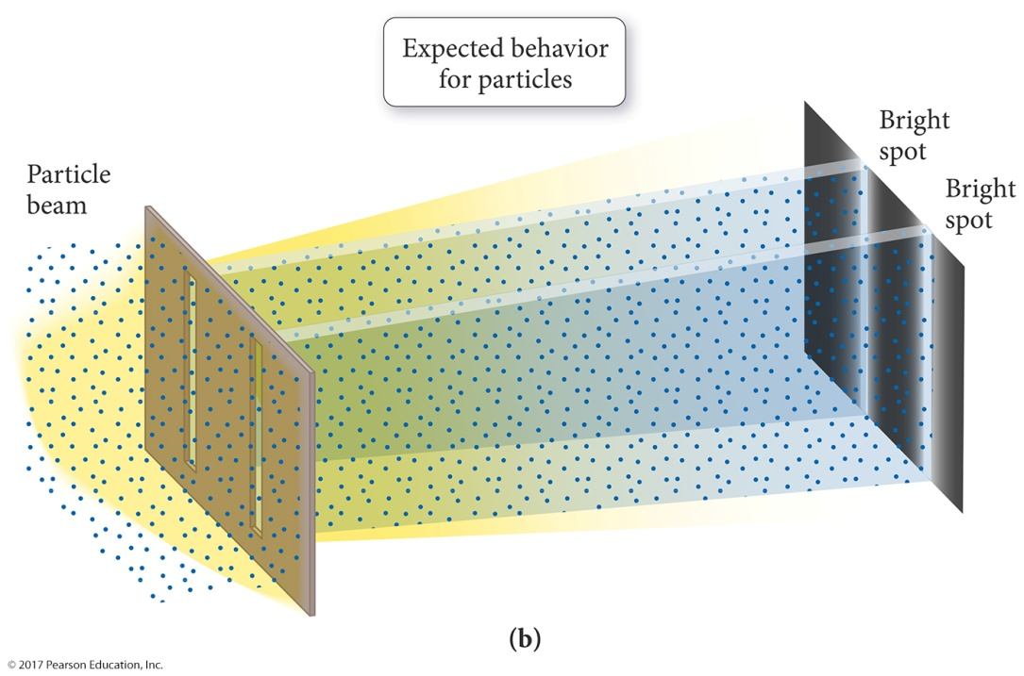
Electron Diffraction
Proof that the electron had wave nature came a few years later with the demonstration that a beam of electrons would produce an interference pattern the same as waves do.
If electrons behave only like particles, there should be only two bright spots on the target.

Slide 44
Complementary Properties
When you try to observe the wave nature of the electron, you cannot observe its particle nature, and vice versa.
Wave nature = interference pattern
Particle nature = position, which slit it is passing through
The wave and particle nature of the electron are complementary properties.
As you know more about one you know less about the other.

Slide 45
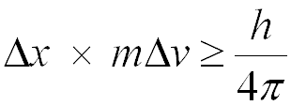
Uncertainty Principle
Heisenberg stated that the product of the uncertainties in both the position and speed of a particle was inversely proportional to its mass.
x = position, Δx = uncertainty in position
v = velocity, Δv = uncertainty in velocity
m = mass
This means that the more accurately you know the position of a small particle, such as an electron, the less you know about its speed, and vice versa.

Slide 46
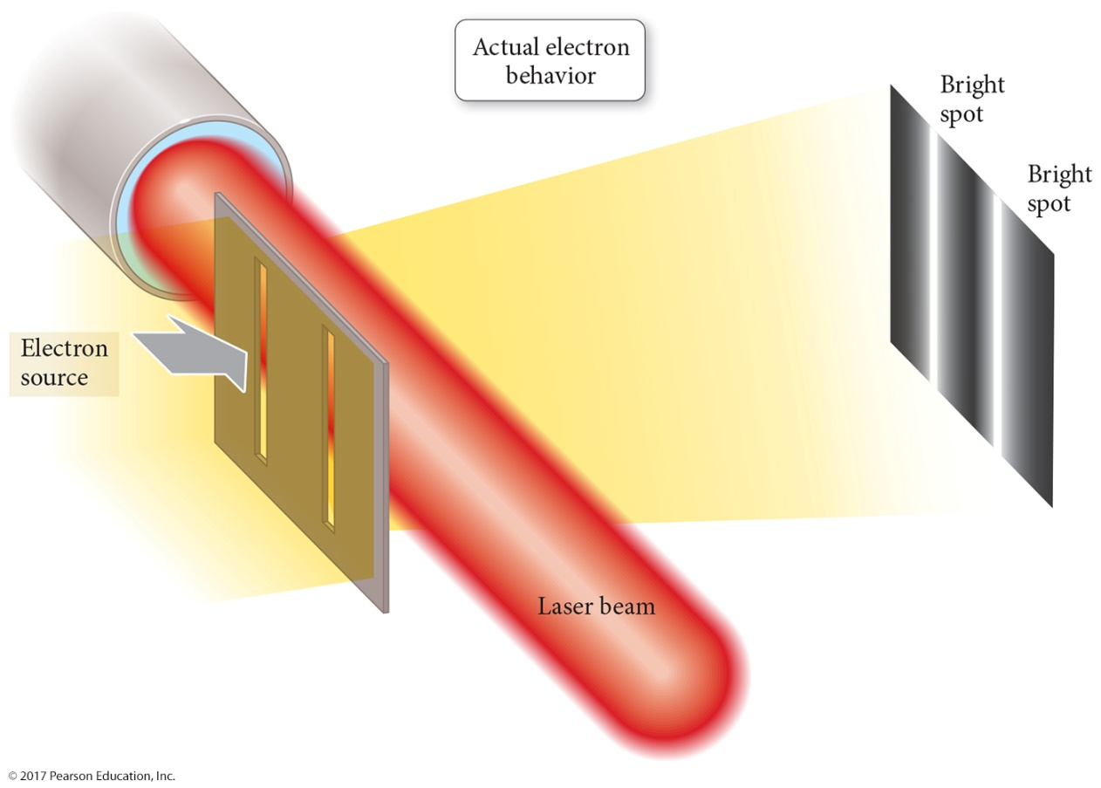
Uncertainty Principle Demonstration
Any experiment designed to observe the electron results in detection of a single electron particle and no interference pattern.

Slide 47
Determinacy versus Indeterminacy
According to classical physics, particles move in a path determined by the particle’s velocity, position, and forces acting on it.
Determinacy = definite, predictable future
Because we cannot know both the position and velocity of an electron, we cannot predict the path it will follow.
Indeterminacy = indefinite future, can predict only probability
The best we can do is to describe the probability an electron will be found in a particular region using statistical functions.

Slide 48
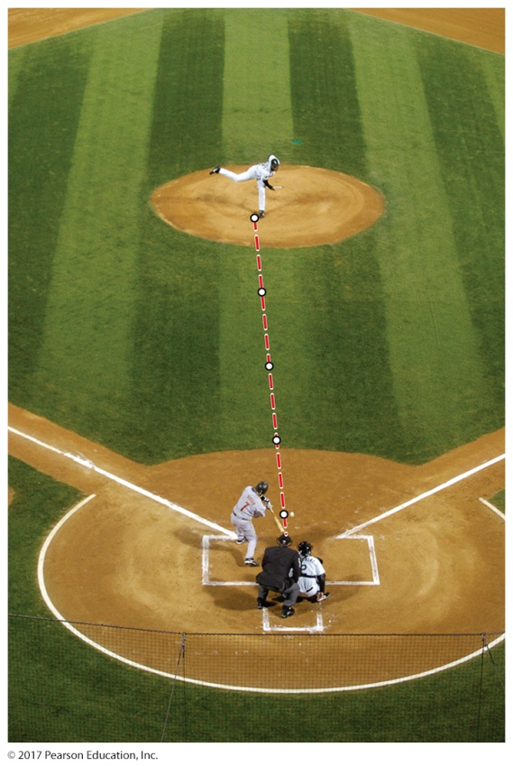
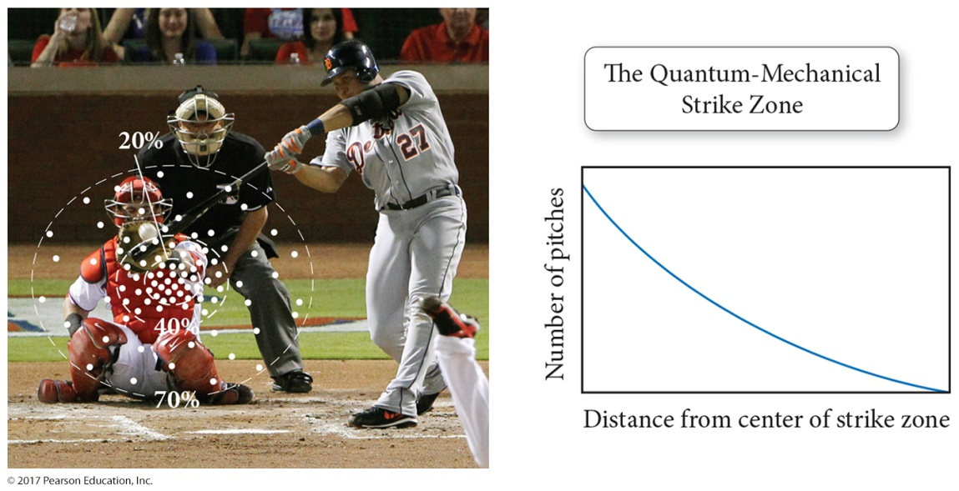
Trajectory versus Probability

Slide 49
Electron Energy
Electron energy and position are complementary.
KE = ½mv²
For an electron with a given energy, the best we can do is describe a region in the atom of high probability of finding it.
Many of the properties of atoms are related to the energies of the electrons.

Slide 50
Schrödinger’s Equation
Schrödinger’s equation allows us to calculate the probability of finding an electron with a particular amount of energy at a particular location in the atom.
Solutions to Schrödinger’s equation produce many wave functions, Ψ.
A plot of distance versus Ψ² represents an orbital, a probability distribution map of a region where the electron is likely to be found.

Slide 51
Solutions to the Wave Function, Ψ
Calculations show that the size, shape, and orientation in space of an orbital are determined to be three integer terms in the wave function.
Added to quantize the energy of the electron
These integers are called quantum numbers.
Principal quantum number, n
Angular momentum quantum number, l
Magnetic quantum number, m_{l}

Slide 52
Principal Quantum Number, n
Characterizes the energy of the electron in a particular orbital
Corresponds to Bohr’s energy level
n can be any integer ≥ 1.
The larger the value of n, the more energy the orbital has.
Energies are defined as being negative.
An electron would have E = 0 when it escapes the atom.
The larger the value of n, the larger the orbital.
As n gets larger, the amount of energy between orbitals gets smaller.

Slide 53
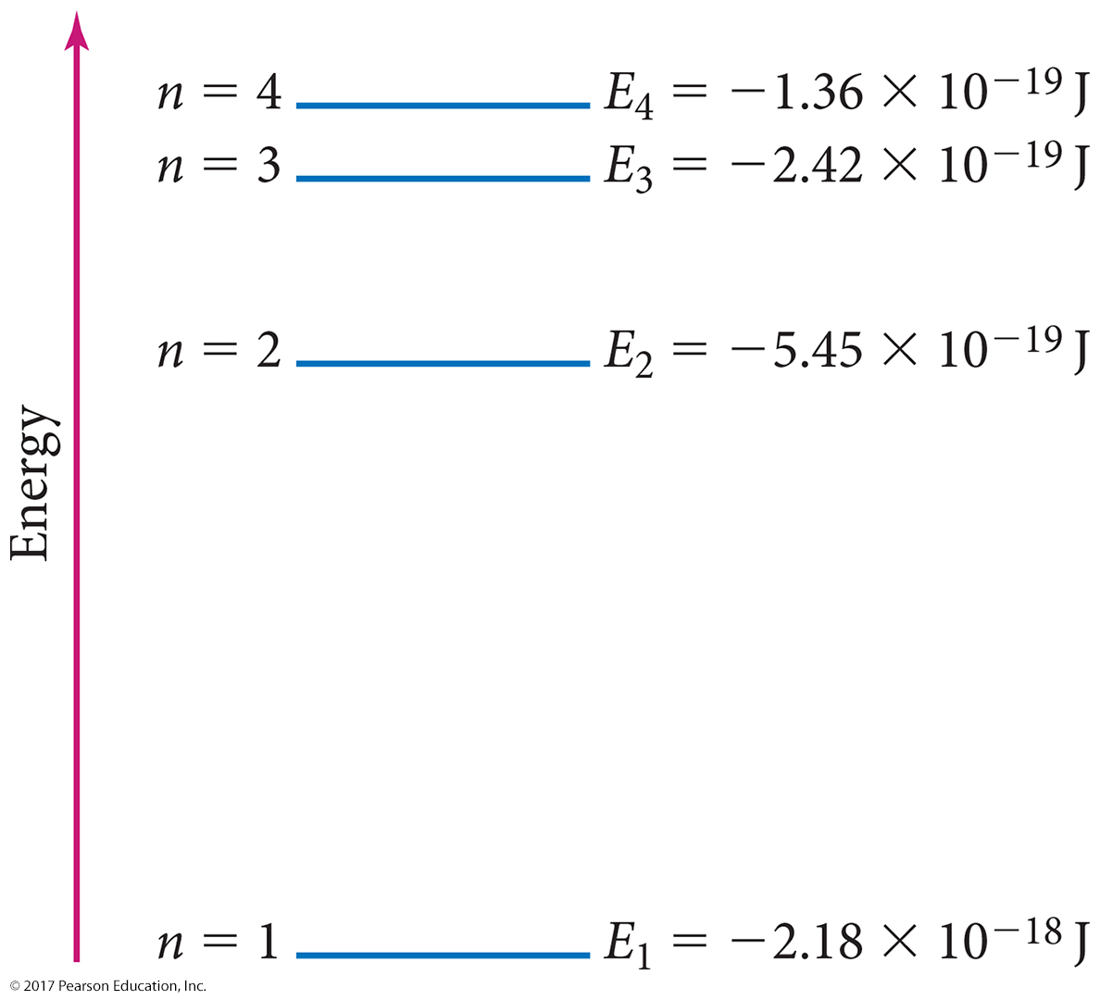
Principal Energy Levels in Hydrogen

Slide 54
Angular Momentum Quantum Number, l
The angular momentum quantum number determines the shape of the orbital.
l can have integer values from 0 to (n – 1).
Each value of l is called by a particular letter that designates the shape of the orbital.
s orbitals are spherical.
p orbitals are like two balloons tied at the knots.
d orbitals are mainly like four balloons tied at the knots.
f orbitals are mainly like eight balloons tied at the knots.

Slide 55
Angular Momentum Quantum Number, l

Slide 56
Magnetic Quantum Number, m_{l}
The magnetic quantum number is an integer that specifies the orientation of the orbital.
The direction in space the orbital is aligned relative to the other orbitals
Values are integers from −l to +l
Including zero
Gives the number of orbitals of a particular shape
When l = 2, the values of m_{l} are −2, −1, 0, +1, +2, which means there are five orbitals with l = 2.

Slide 57
Describing an Orbital
Each set of n, l, and m_{l} describes one orbital.
Orbitals with the same value of n are in the same principal energy level.
Also called the principal shell
Orbitals with the same values of n and l are said to be in the same sublevel.
Also called a subshell

Slide 58
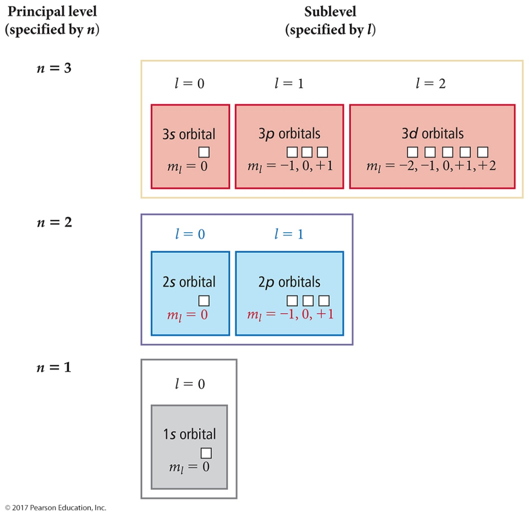
Energy Levels and Sublevels
The n = 2 principal energy level contains two sublevels:
The l = 0: 2s sublevel with one orbital with m_{l} = 0
The l = 1: 2p sublevel with three p orbitals with m_{l} = −1, 0, +1

Slide 59
Energy Levels and Sublevels
In general,
the number of sublevels within a level = n.
the number of orbitals within a sublevel = 2l + 1.
the number of orbitals in a level = n².

Slide 60
Atomic Spectroscopy Explained
Each wavelength in the spectrum of an atom corresponds to an electron transition between orbitals.
When an electron is excited, it transitions from an orbital in a lower energy level to an orbital in a higher energy level.
When an electron relaxes, it transitions from an orbital in a higher energy level to an orbital in a lower energy level.
When an electron relaxes, a photon of light is released whose energy equals the energy difference between the orbitals.

Slide 61
Electron Transitions
To transition to a higher energy state, the electron must gain the correct amount of energy corresponding to the difference in energy between the final and initial states.
Electrons in high energy states are unstable and tend to lose energy and transition to lower energy states.
Each line in the emission spectrum corresponds to the difference in energy between two energy states.

Slide 62
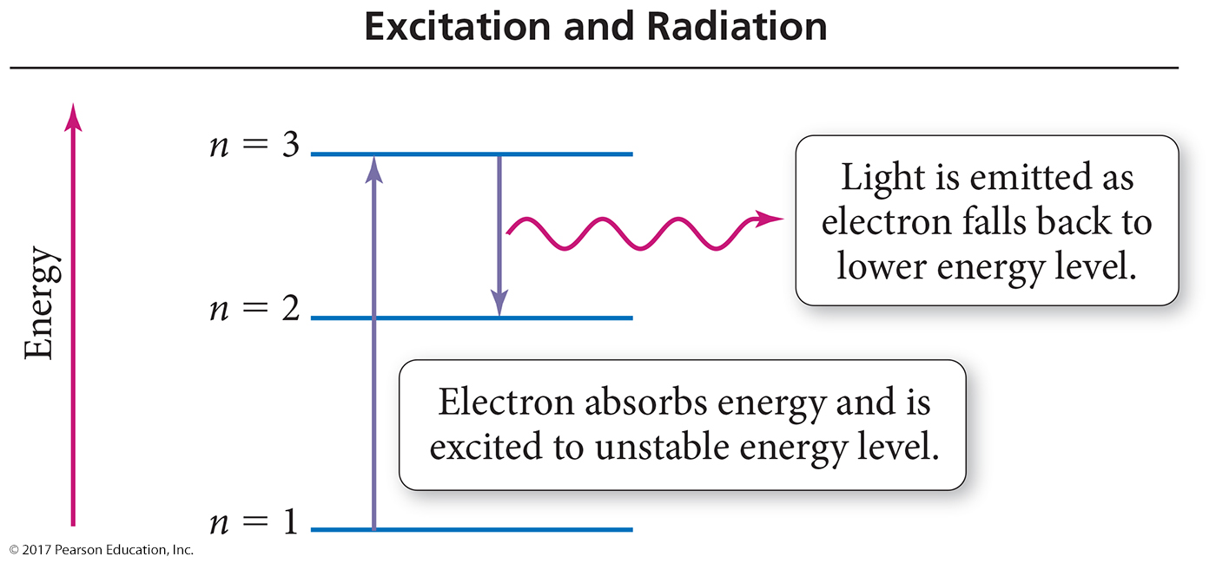
Quantum Leaps

Slide 63
Predicting the Spectrum of Hydrogen
The wavelengths of lines in the emission spectrum of hydrogen can be predicted by calculating the difference in energy between any two states.
For an electron in energy state n, there are (n – 1) energy states to which it can transition. Therefore, it can generate (n – 1) lines.
Both the Bohr and quantum mechanical models can predict these lines very accurately for a one-electron system.

Slide 64
Energy Transitions in Hydrogen
The energy of a photon released is equal to the difference in energy between the two levels between which the electron is jumping.
It can be calculated by subtracting the energy of the initial state from the energy of the final state.
ΔE_{electron} = E_{final state} − E_{initial state}
E_{emitted photon} = −ΔE_{electron}

Slide 65
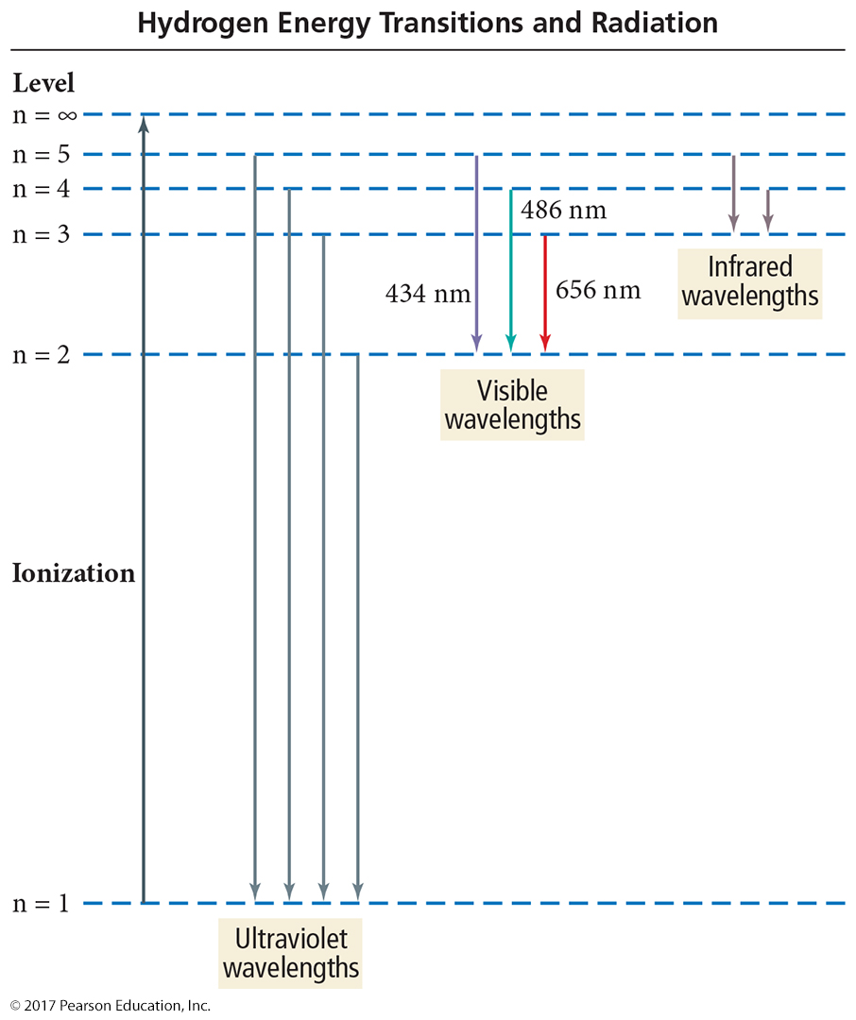
Hydrogen Energy Transitions and Radiation

Slide 66
Probability and Radial Distribution Functions
ψ ² is the probability density.
The probability of finding an electron at a particular point in space
For s orbital maximum at the nucleus
Decreases as you move away from the nucleus
The radial distribution function represents the total probability at a certain distance from the nucleus.
Maximum at most probable radius
Nodes in the functions are where the probability drops to 0.

Slide 67
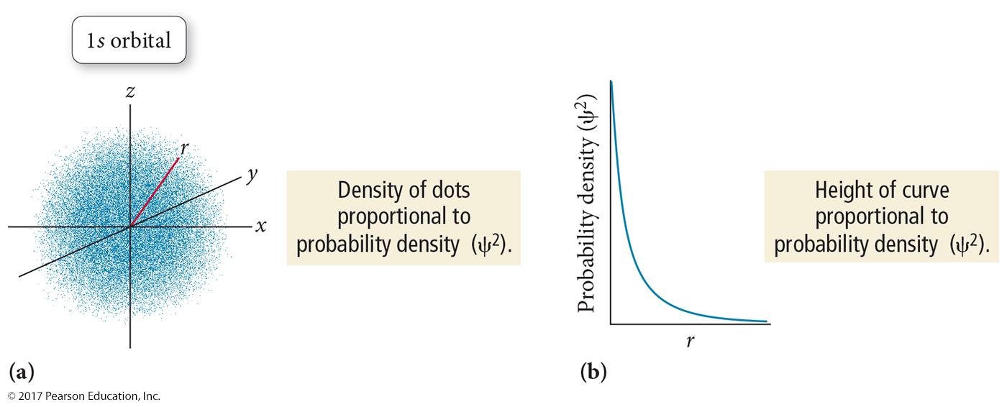
Probability Density for s Orbitals (l = 0)
The probability density function represents the total probability of finding an electron at a particular point in space.

Slide 68
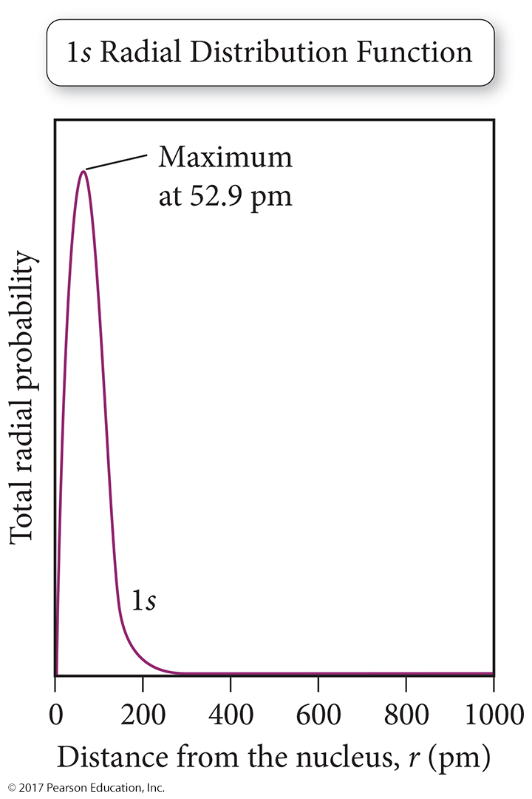
Radial Distribution Function
The radial distribution function represents the total probability of finding an electron within a thin spherical shell at a distance r from the nucleus.
The probability at a point decreases with increasing distance from the nucleus, but the volume of the spherical shell increases.
The net result is a plot that indicates the most probable distance of the electron in a 1s orbital of H is 52.9 pm.

Slide 69
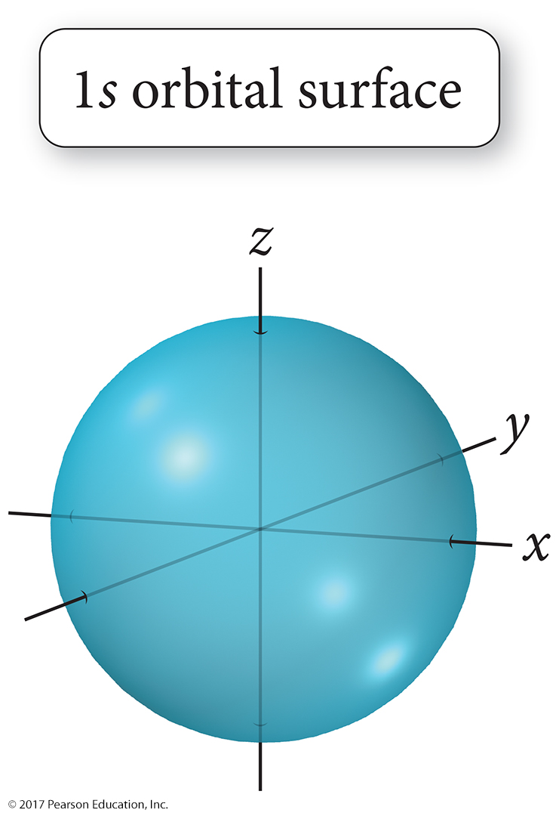
l = 0, the s Orbital
Each principal energy level has one s orbital.
Lowest energy orbital in a principal energy state
Spherical
Number of nodes = (n – 1)

Slide 70
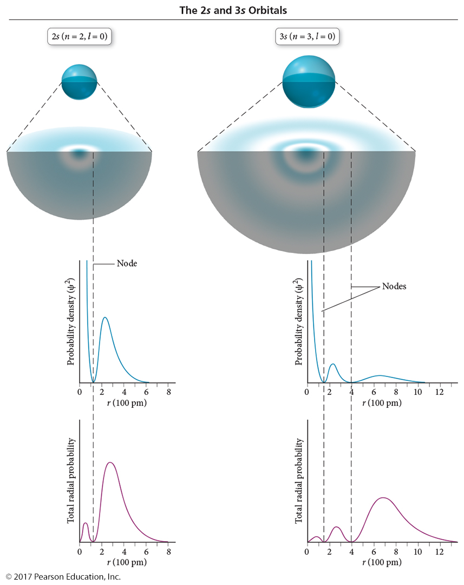
Probability Densities and Radial Distributions for 2s and 3s Orbitals

Slide 71
l = 1, p orbitals
Each principal energy state above n = 1 has three p orbitals.
m_{l} = −1, 0, +1
Each of the three orbitals points along a different axis.
p_{x}, p_{y}, p_{z}
The second-lowest energy orbitals in a principal energy state
Two-lobed
One node at the nucleus; total of n nodes

Slide 72
p Orbitals (l = 1)

Slide 73
l = 2, d Orbitals
Each principal energy state above n = 2 has five d orbitals.
m_{l} = −2, − 1, 0, +1, +2
Four of the five orbitals are aligned in a different plane.
The fifth is aligned with the z axis, d_{z squared}.
d_{xy}, d_{yz}, d_{xz}, d_{x squared – y squared}
The third-lowest energy orbitals in a principal energy level
Mainly four-lobed
One is two-lobed with a toroid
Planar nodes
Higher principal levels also have spherical nodes.

Slide 74
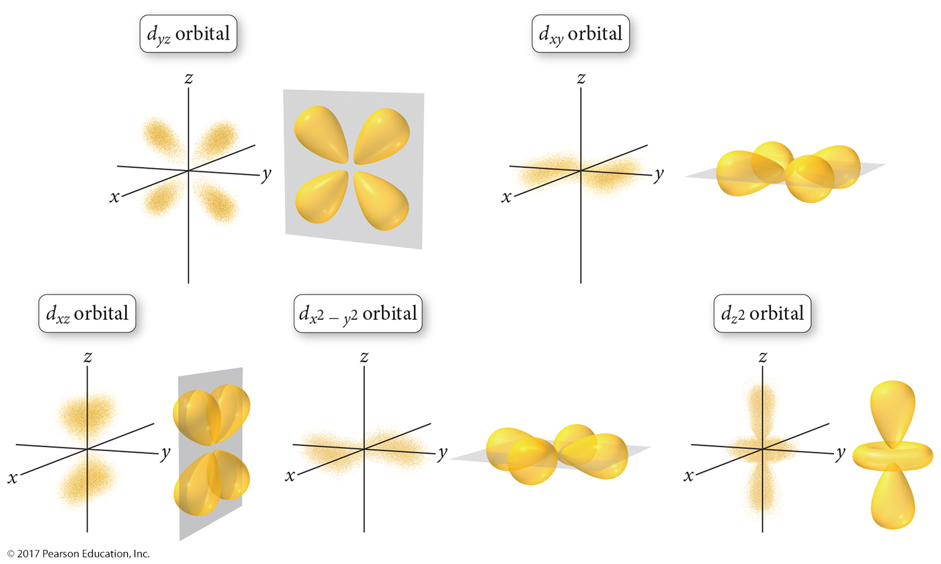
d Orbitals (l = 2)

Slide 75
l = 3, f Orbitals
Each principal energy state above n = 3 has seven d orbitals.
m_{l} = −3, −2, −1, 0, +1, +2, +3
The fourth-lowest energy orbitals in a principal energy state
Mainly eight-lobed
Some two-lobed with a toroid
Planar nodes
Higher principal levels also have spherical nodes.

Slide 76
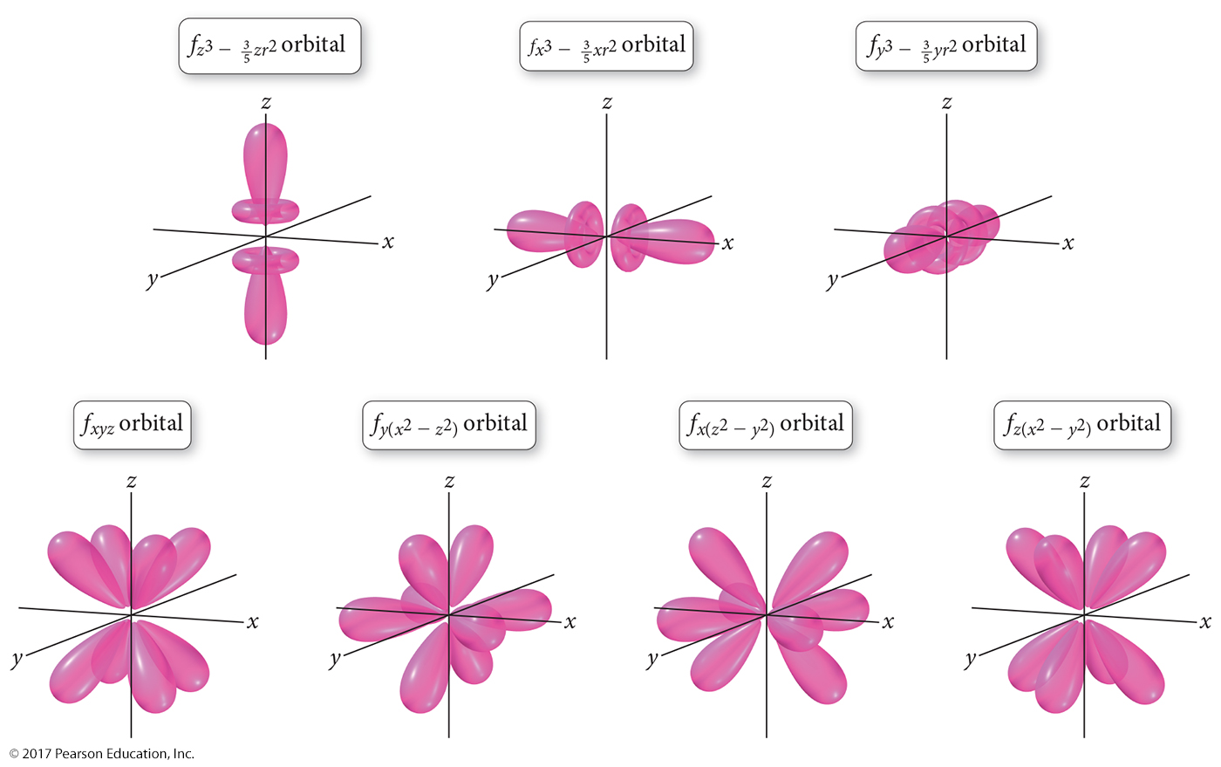
f Orbitals (l = 3)

Slide 77
The Phase of an Orbital
Orbitals are determined from mathematical wave functions.
A wave function can have positive or negative values.
As well as nodes where the wave function = 0
The sign of the wave function is called its phase.
When orbitals interact, their wave functions may be in phase (same sign) or out of phase (opposite signs).
This is important in bonding, as will be examined in a later chapter.

Slide 78
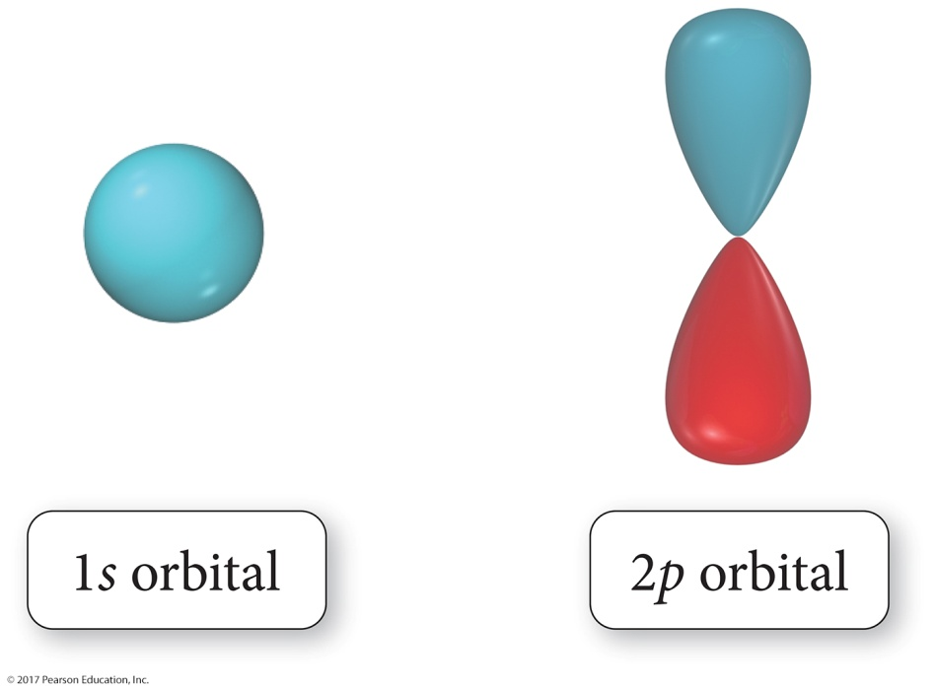
Phases

Slide 79
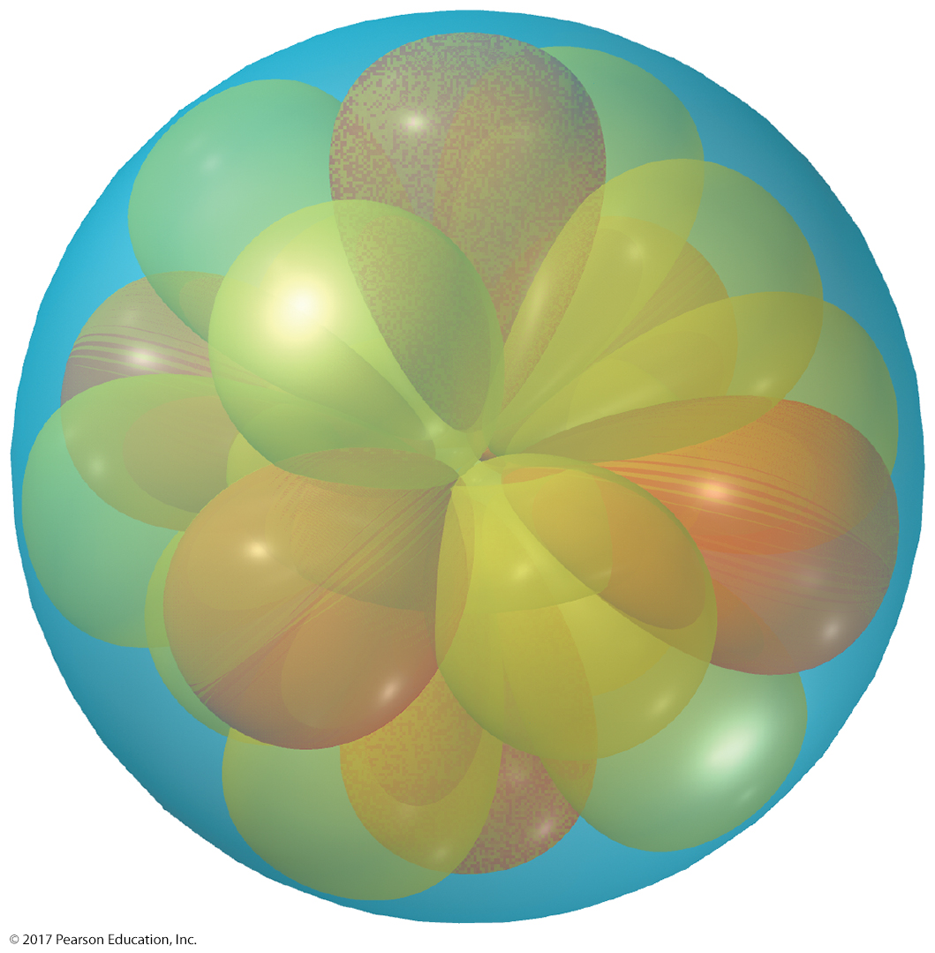
Why Are Atoms Spherical?

