Slide 1
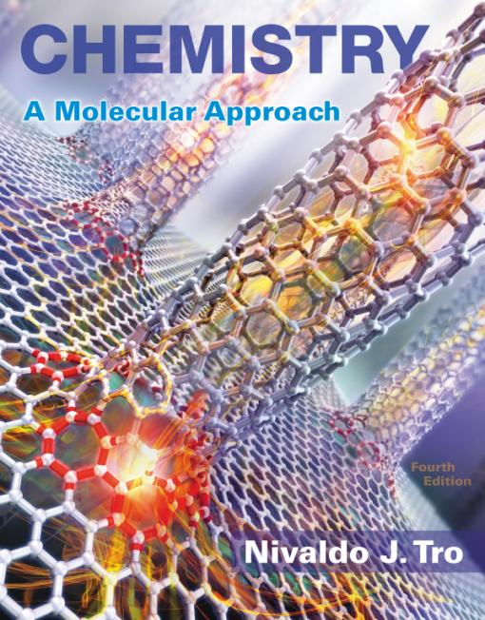
Lecture Presentation
Chapter 19 Electrochemistry

Slide 2
Pulling the Plug on the Power Grid
The power grid distributes centrally generated electricity throughout the country to homes and businesses.
The average U.S. household currently consumes about 1000 kWh of electricity per month.
Some companies are developing small, fuel-cell power plants, about the size of a refrigerator.
Similar fuel cells can power cars.
Fuel cells are based on oxidation–reduction reactions.
2 H₂(g) + O₂(g) → 2 H₂O(l)

Slide 3
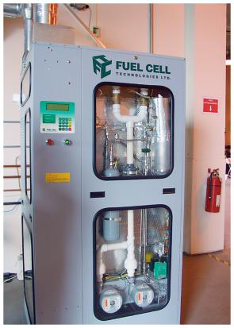
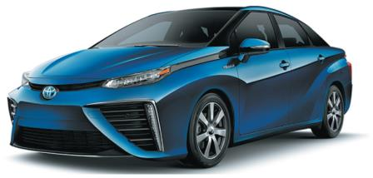
Electricity from Chemistry
In a hydrogen–oxygen fuel cell, the hydrogen and oxygen are separated, forcing electrons to travel through an external wire.
The moving electrons constitute an electrical current.
A fuel cell employs the electron-gaining tendency of oxygen and the electron-losing tendency of hydrogen to force electrons to move through a wire, creating electricity.

Slide 4
Oxidation–Reduction
Reactions where electrons are transferred from one atom to another are called oxidation–reduction reactions.
Redox reactions for short
Atoms that lose electrons are being oxidized; atoms that gain electrons are being reduced.
Increase in oxidation state is oxidation; decrease in oxidation state is reduction.
2 Na(s) + Cl₂(g) → 2 Na⁺Cl–(s)
Na → Na⁺ + 1 e– oxidation,
Na is going from 0 to +1 oxidation state
Cl₂ + 2 e– → 2 Cl– reduction,
Cl is going from 0 to –1 oxidation state

Slide 5
Half-Reactions
We generally split the redox reaction into two separate half-reactions—reactions involving just oxidation or reduction, as on the previous slide.
The oxidation half-reaction has electrons as products.
The reduction half-reaction has electrons as reactants.
3 Cl₂ + I⁻ + 3 H₂O → 6 Cl⁻ + IO₃⁻ + 6 H⁺
0 −1 +1 −2 −1 +5 −2 +1
Oxidation: I⁻ → IO₃⁻ + 6 e⁻
Reduction: Cl₂ + 2 e⁻ → 2 Cl⁻

Slide 6
Balancing Redox Reactions by the Half-Reaction Method
This method is a helpful way to balance complex redox reactions in solution.
The reaction is broken down into two half-reactions, one for oxidation and another for reduction.
Each half-reaction is balanced individually, for both mass and charge.
The two half-reactions are added back together to get the overall balanced equation.

Slide 7
Balancing Redox Reactions
1. Assign oxidation states.
a) Determine the element oxidized and the element reduced.
Write oxidation and reduction half-reactions.
3. Balance the mass of half-reactions.
a) First balance elements other than H and O.
b) Balance O by adding H₂O where O is needed.
c) Balance H by adding H⁺ where H is needed.
d) If the reaction is in a basic solution, neutralize H⁺ with OH⁻.
Balance charge of half-reactions by adding electrons.
Make the number of electrons in both half-reactions the same by multiplying one or both by a small whole number.
6. Add half-reactions, and cancel like terms.
7. Check by counting atoms and total charge.

Slide 8
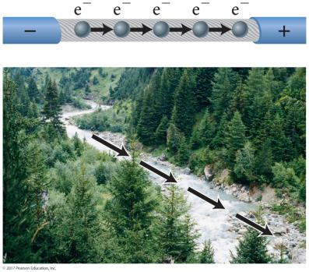
Electrical Current
Electrons flow through a conductor in response to an electrical potential difference similar to water flowing downhill in response to a difference in gravitational potential energy.
Electric current—the amount of electric charge that passes a point in a given period of time
Whether as electrons flowing through a wire, or ions flowing through a solution

Slide 9
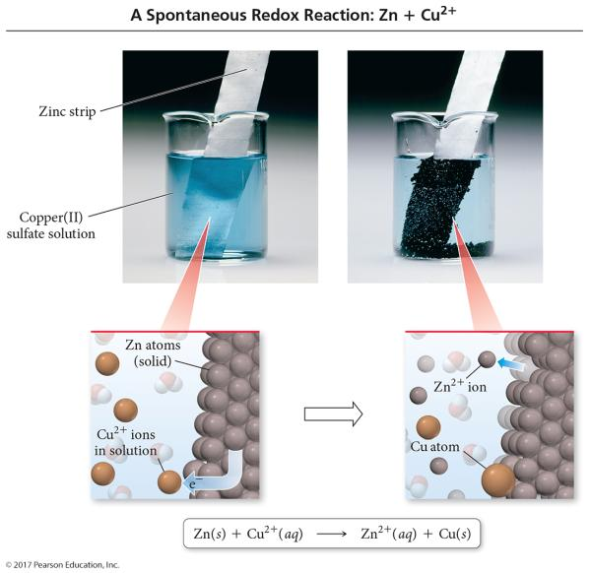
Electric Current Flowing Directly between Atoms

Slide 10
Electrical Current
Current is the number of electrons that flow through the system per second.
Unit = ampere (or amp, A)
1 A of current = 1 coulomb of charge flowing each second
1 A = 6.242 × 10¹⁸ electrons per second

Slide 11
Potential Difference
The difference in potential energy between the reactants and products is the potential difference.
Unit = volt
1 V = 1 J of energy per coulomb of charge
The voltage needed to drive electrons through the external circuit
The amount of force pushing the electrons through the wire is called the electromotive force, emf.

Slide 12
Cell Potential
The difference in potential energy between the anode and the cathode in a voltaic cell is called the cell potential.
The cell potential depends on the relative ease with which the oxidizing agent is reduced at the cathode and the reducing agent is oxidized at the anode.
The cell potential under standard conditions is called the standard emf, E°_{cell}.
25 °C, 1 atm for gases, 1 M concentration of solution
Sum of the cell potentials for the half-reactions

Slide 13
Electrochemical Cells
Oxidation and reduction half-reactions are kept separate in half-cells.
Electron flow through a wire along with ion flow through a solution constitutes an electric circuit.
It requires a conductive solid electrode to allow the transfer of electrons.
Through external circuit
Metal or graphite
Requires ion exchange between the two half-cells of the system.
Electrolyte

Slide 14
Electrodes and Salt Bridge
Anode
Electrode where oxidation always occurs
More negatively charged electrode in voltaic cell
Cathode
Electrode where reduction always occurs
More positively charged electrode in voltaic cell
Salt bridge is an inverted, U-shaped tube containing a strong electrolyte and connecting the two half-cells.

Slide 15
Electrodes
Typically
The anode is made of the metal that is oxidized.
The cathode is made of the same metal as is produced by the reduction.
If the redox reaction involves the oxidation or reduction of an ion to a different oxidation state, or the oxidation or reduction of a gas, we may use an inert electrode.
An inert electrode is one that not does participate in the reaction but just provides a surface on which the transfer of electrons can take place.

Slide 16
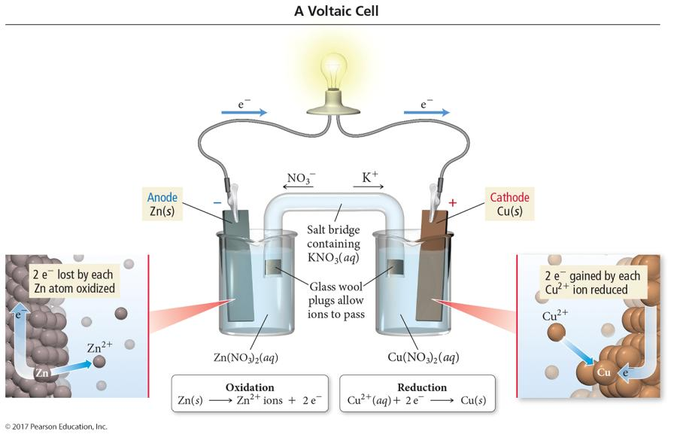
Voltaic Cell

Slide 17
Cell Notation
Shorthand representation of an electrochemical cell
Oxidation half-cell on the left, reduction half-cell on the right, separated by two vertical lines
Substances in different phases are separated by a single vertical line, which represents the boundary between the phases.
Single | = phase barrier
If multiple species are in same phase, a comma is used rather than |.
Often use an inert electrode
Double line || = salt bridge
Electrode | electrolyte || electrolyte | electrode

Slide 18
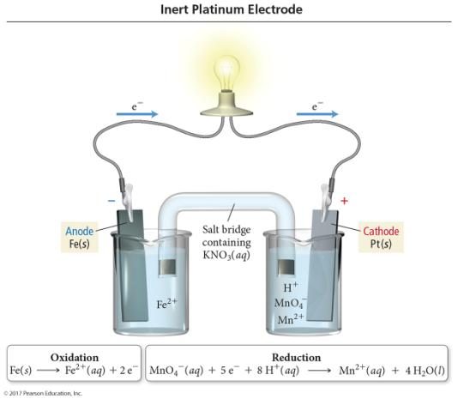
Electrochemical Cell Notation
Because the half-reaction involves reducing the Mn oxidation state from +7 to +2, we use an electrode that will provide a surface for the electron transfer without reacting with the MnO₄⁻.
Platinum works well because it is extremely nonreactive and conducts electricity.
Fe(s) | Fe²⁺(aq) || MnO₄–(aq), Mn²⁺(aq), H⁺(aq) | Pt(s)

Slide 19
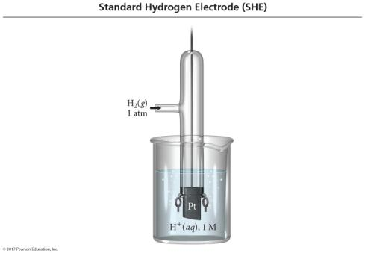
Standard Reduction Potential
We cannot measure the absolute tendency of a half-reaction; we can measure it only relative to another half-reaction.
We select as a standard half-reaction the reduction of H⁺ to H₂ under standard conditions, which we assign a potential difference = 0 v.
Standard hydrogen electrode, SHE

Slide 20
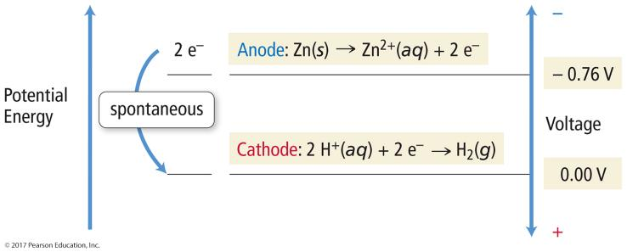
Cell Potential
A half-reaction with a strong tendency to occur has a large positive half-cell potential.
When two half-cells are connected, the electrons will flow so that the half-reaction with the stronger tendency will occur.

Slide 21
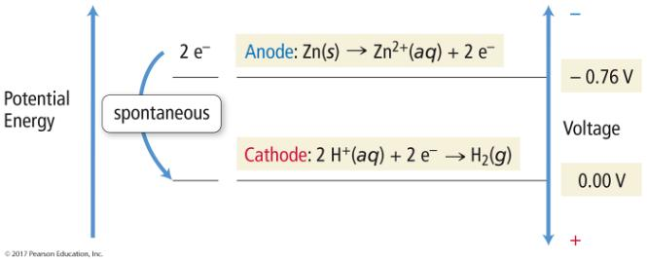
Which Way Will Electrons Flow?
Under standard conditions, zinc has a stronger tendency to oxidize than copper.
Zn → Zn²⁺ + 2 e⁻ E°= +0.76
Cu → Cu²⁺ + 2 e⁻ E°= −0.34

Slide 22
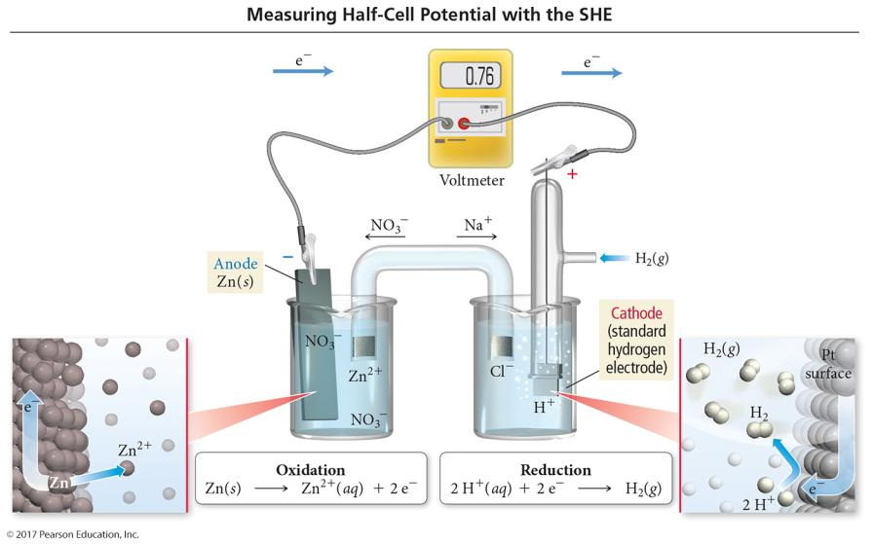
Measuring Electrode Potential

Slide 23
Half-Cell Potentials
SHE reduction potential is defined to be exactly 0 V.
Standard reduction potentials compare the tendency for a particular reduction half-reaction to occur relative to the reduction of H⁺ to H₂.
Under standard conditions
Half-reactions with a stronger tendency toward reduction than the SHE have a positive value for E°_{red}.
Half-reactions with a stronger tendency toward oxidation than the SHE have a negative value for E°_{red}.
For an oxidation half-reaction, E°_{oxidation} = − E°_{reduction}.
E°_{call} = − E°_{reduction} – E°_{oxidation}

Slide 24
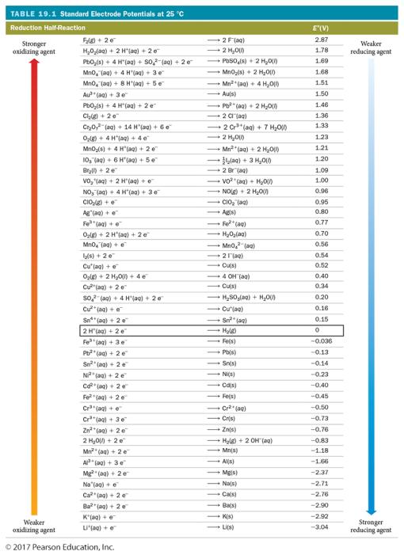

Slide 25
Calculating Cell Potentials under Standard Conditions
E°_{cell} = E°_{reduction} – E°_{oxidation}
When adding E° values for the half-cells, if you need to multiply the half-reactions to balance the equation, do not multiply the half-cell E° values.

Slide 26
Tendencies from the Table of Standard Reduction Potentials
Higher on the table of standard reduction potentials, the stronger tendency for the reactant to be reduced
Lower on the table of standard reduction potentials, the stronger tendency for the product to be oxidized

Slide 27
Predicting Spontaneity of Redox Reactions
Substances listed at the top of Table 19.1 tend to undergo reduction; they are good oxidizing agents.
Substances listed near the bottom of Table 19.1 tend to undergo oxidation; they are good reducing agents.
Any reduction reaction in Table 19.1 is spontaneous when paired with the reverse of any of the reactions listed below it on the table.
Cu²⁺(aq) + 2 e⁻ → Cu(s) E°_{red} = +0.34 V
Zn²⁺(aq) + 2 e⁻ → Zn(s) E°_{red} = −0.76 V
Zn(s) + Cu²⁺(aq) → Zn²⁺(aq) + Cu(s) spontaneous
Cu(s) + Zn²⁺(aq) → Cu²⁺(aq) + Zn(s) nonspontaneous

Slide 28
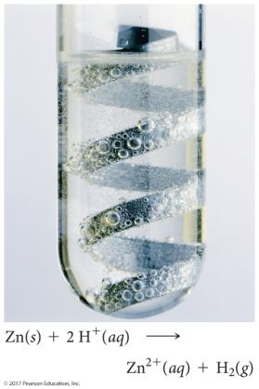
Predicting Whether a Metal Will Dissolve in Acid
Metals whose reduction half-reactions are listed below the reduction of H⁺ to H₂ in Table 19.1 dissolve in acids.
Metals listed above H⁺ to H₂ in Table 19.1 do not dissolve in acids.
Almost all metals will dissolve in HNO₃.
Having N reduced rather than H
Au and Pt dissolve in HNO₃ + HCl
NO₃⁻(aq) + 4 H⁺(aq) + 3 e⁻ → NO(g) + 2 H₂O(l)

Slide 29
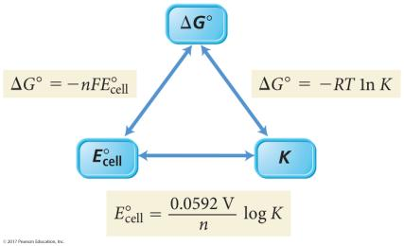
E°_{cell}, ΔG°, and K
For a spontaneous reaction, one that proceeds in the forward direction with the chemicals in their standard states
ΔG° < 0 (negative)
E° > 0 (positive)
K > 1
ΔG° = −nFE°_{cell}
n = the number of electrons
F = Faraday’s constant = 96,485 C/mol e⁻

Slide 30
Relationship between E°_{cell} and K
•
•
•
Substituting values for R, F, and 298.15K for T, and converting to log instead of ln, we get
•

Slide 31
Cell Potential under Nonstandard Conditions
This equation, known as the Nernst equation, helps us determine the cell potential at nonstandard conditions.

Slide 32
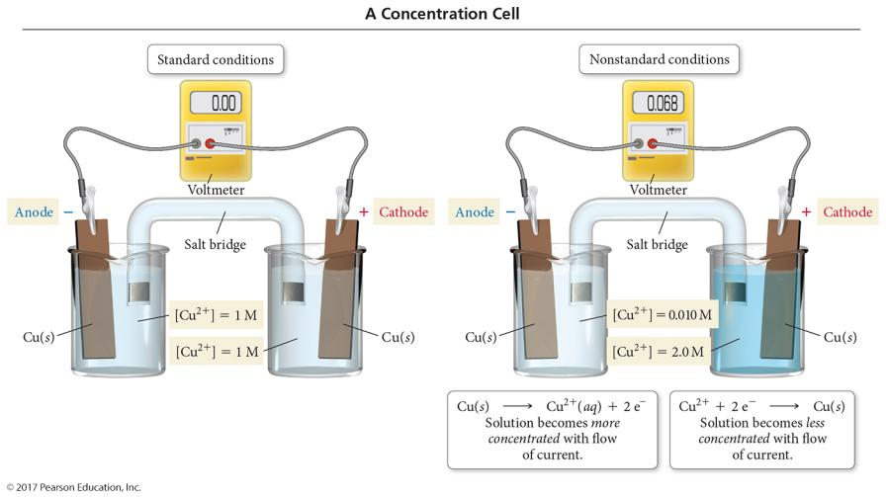
Concentration Cells

Slide 33
Concentration Cells
It is possible to get a spontaneous reaction when the oxidation and reduction reactions are the same, as long as the electrolyte concentrations are different.
Calculating cell potential using the Nernst equation helps us determine the direction of spontaneity in the cell.
Electrons will flow from the electrode in the less concentrated solution to the electrode in the more concentrated solution.
Oxidation of the electrode in the less concentrated solution will increase the ion concentration in the solution; the less concentrated solution has the anode.
Reduction of the solution ions at the electrode in the more concentrated solution reduces the ion concentration; the more concentrated solution has the cathode.

Slide 34
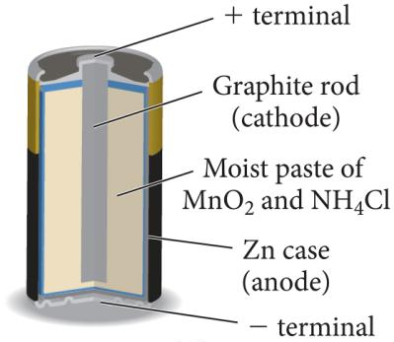
Dry-Cell Batteries
Anode = Zn (or Mg)
Zn(s) → Zn²⁺(aq) + 2 e⁻
Cathode = graphite rod
MnO₂ is reduced.
2 MnO₂(s) + 2 NH₄⁺(aq) + 2 H₂O(l) + 2 e⁻
→ 2 NH₄OH(aq) + 2 Mn(O)OH(s)
Cell voltage = 1.5 V

Slide 35
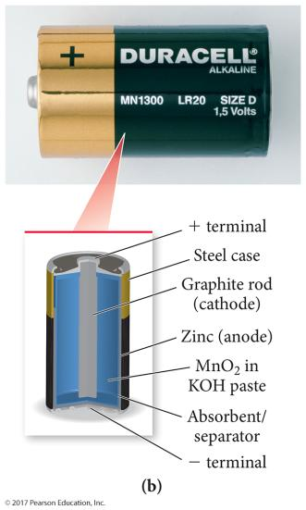
Alkaline Dry-Cell Batteries
Same basic cell as acidic dry cell, except electrolyte is alkaline KOH paste
Anode = Zn (or Mg)
Zn(s) → Zn²⁺(aq) + 2 e⁻
Cathode = graphite or brass rod
MnO₂ is reduced.
2 MnO₂(s) + 2 NH₄⁺(aq) + 2 H₂O(l) + 2 e⁻
→ 2 NH₄OH(aq) + 2 Mn(O)OH(s)
Cell voltage = 1.54 V
Longer shelf life than acidic dry cells, longer working time, and little corrosion of zinc

Slide 36
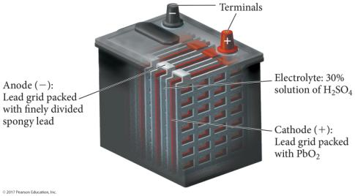
Lead Storage Battery
Six electrochemical cells in series, each producing 2 V for a total of 12 V
Electrolyte = 30% H₂SO₄
Anode: Pb(s) + SO₄²⁻(aq) → PbSO₄(s) + 2 e⁻
Cathode: Pb coated with PbO₂
PbO₂ is reduced.
PbO₂(s) + 4 H⁺(aq) + SO₄²⁻(aq) + 2 e⁻ → PbSO₄(s) + 2 H₂O(l)

Slide 37
NiCad Battery
Electrolyte is concentrated KOH solution.
Anode: Cd(s); cathode: NiO(OH)(s)
Cd is oxidized; NiO₂ is reduced.
Cd(s) + 2 OH⁻(aq) → Cd(OH)₂(s) + 2 e⁻ E° = 0.81 V
NiO₂(s) + 2 H₂O(l) + 2 e⁻ → Ni(OH)₂(s) + 2OH⁻ E° = 0.49 V
Cell voltage = 1.30 V
Rechargeable, long life, light; however, recharging incorrectly can lead to battery breakdown

Slide 38
Ni-MH Battery
Electrolyte is concentrated KOH solution.
Anode: metal alloy with dissolved hydrogen
Cathode: Ni coated with NiO₂
Oxidation of H from H⁰ to H⁺; NiO₂ is reduced.
M ∙ H(s) + OH⁻(aq) → M(s) + H₂O(l) + e⁻ E° = 0.89 V
NiO₂(s) + 2 H₂O(l) + 2 e⁻ → Ni(OH)₂(s) + 2OH⁻ E° = 0.49 V
Cell voltage = 1.30 V
Rechargeable, long life, light, more environmentally friendly than NiCad, greater energy density than NiCad

Slide 39
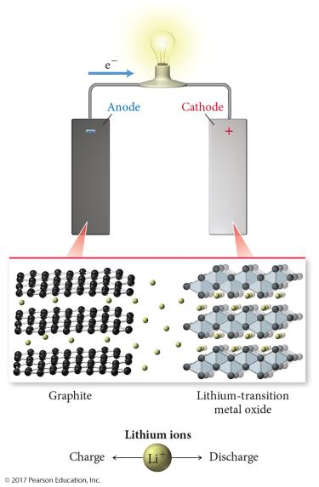
Lithium-Ion Battery
Electrolyte is concentrated KOH solution.
Anode: graphite impregnated with Li ions
Cathode: Li—transition metal oxide
Reduction of transition metal
Works on Li ion migration from anode to cathode causing a corresponding migration of electrons from anode to cathode
Rechargeable, long life, very light, more environmentally friendly, greater energy density

Slide 40
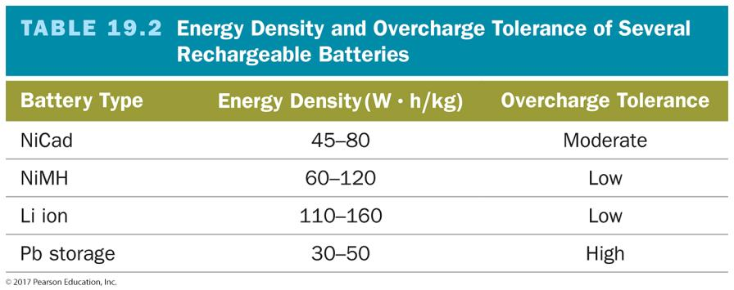

Slide 41
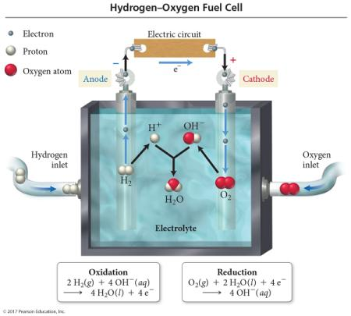
Fuel Cells
Like batteries in which reactants are constantly being added
So it never runs down!
Anode and cathode both Pt -coated metal
Electrolyte is OH– solution.
Anode reaction
2 H₂ + 4 OH– → 4 H₂O(l) + 4 e⁻
Cathode reaction
O₂ + 4 H₂O + 4 e⁻ → 4 OH–

Slide 42
Driving Nonspontaneous Reactions
In all cells, whether voltaic or electrolytic, oxidation occurs at the anode, and reduction occurs at the cathode.
Voltaic cells—Spontaneous reaction generates electricity.
Anode is the source of electrons and has a (−) charge.
Cathode draws electrons and has a (+) charge.
Electrolytic cells—nonspontaneous reaction driven by external electrical current

Slide 43
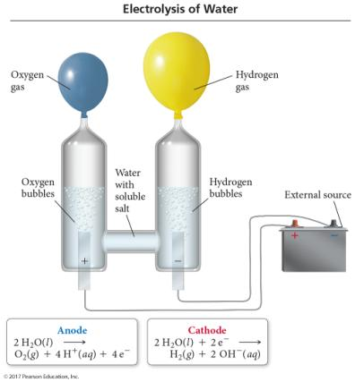
Electrolysis
Electrolysis is the process of using electrical current to drive nonspontaneous reaction.
Electrolysis is carried out in an electrolytic cell.
Electrolytic cells can be used to separate compounds into their elements.

Slide 44
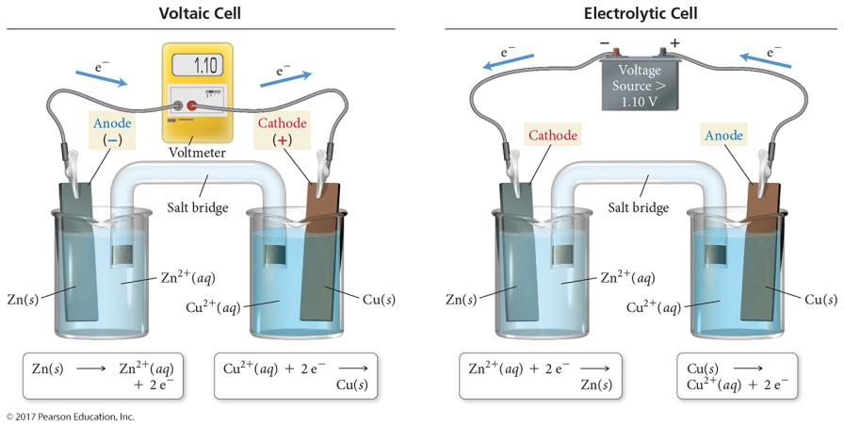
Voltaic versus Electrolytic Cells

Slide 45
Electrolytic Cells
Electrons are drawn away from the anode, which must be connected to the positive terminal of the external power source (anode +).
Electrons are forced to the cathode, which must be connected to the negative terminal of the power source (cathode -).
The reaction that takes place is the nonspontaneous process.
2 H₂(g) + O₂(g) → 2 H₂O(l) spontaneous
2 H₂O(l) → 2 H₂(g) + O₂(g) electrolysis

Slide 46
Electrolytic Cells
The electrical energy is supplied by a direct-current power supply, a battery or DC power supply.
Some electrolysis reactions require more voltage than E_{cell} predicts. This is called the overvoltage.

Slide 47
Electrolysis of Pure Compounds
The compound must be in a molten (liquid) state.
Electrodes are normally graphite.
Cations are reduced.
Anions are oxidized.

Slide 48
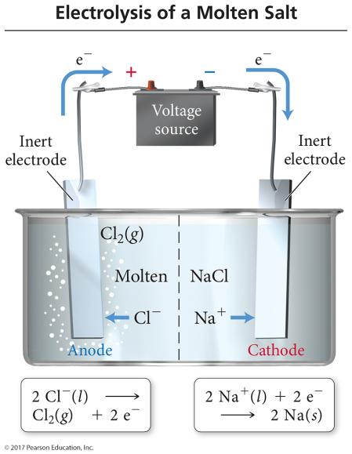
Electrolysis of NaCl(l)

Slide 49
Mixtures of Ions
When more than one cation is present, the cation that is easiest to reduce will be reduced first at the cathode.
Least negative or most positive E°_{red}
When more than one anion is present, the anion that is easiest to oxidize will be oxidized first at the anode.
Least negative or most positive E°_{ox}

Slide 50
Electrolysis of Aqueous Solutions
Possible cathode reactions
Reduction of cation to metal
Reduction of water to H₂
2 H₂O + 2 e⁻ → H₂ + 2 OH⁻ E°= −0.83 V at stand. cond.
E°= −0.41 V at pH 7
Possible anode reactions
Oxidation of anion to element
Oxidation of H₂O to O₂
2 H₂O → O₂ + 4 e⁻ + 4H⁺ E°= −1.23 V at stand. cond.
E°= −0.82 V at pH 7
Oxidation of electrode
Particularly Cu
Graphite doesn’t oxidize.
Half-reactions that lead to least negative E_{cell} will occur.
Unless overvoltage changes the conditions

Slide 51
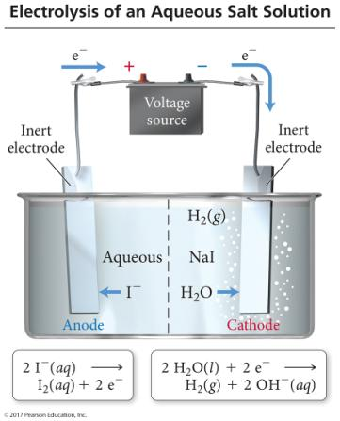
Electrolysis of NaI(aq) with Inert Electrodes
Possible oxidations
2 I⁻ → I₂ + 2 e⁻ E° = −0.54 V
2 H₂O → O₂ + 4 e ⁻ + 4 H⁺ E° = −0.82 V
Oxidation with more negative E°
2 I⁻ → I₂ + 2 e⁻ E° = −0.54 V
2 H₂O → O₂ + 4 e⁻ + 4 H⁺ E° = −0.82 V

Slide 52
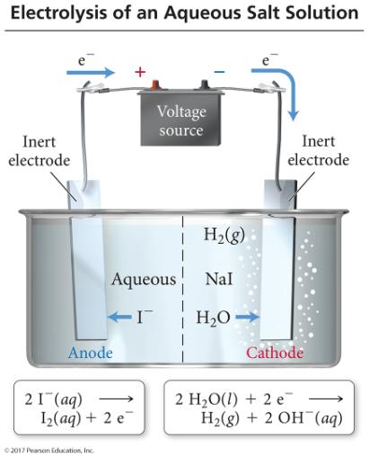
Electrolysis of NaI(aq) with Inert Electrodes
Possible reductions
Na⁺ + 1 e⁻ → Na⁰ E° = −2.71 V
2 H₂O + 2 e⁻ → H₂ + 2 OH⁻
E° = −0.41 V
Reduction with greatest E°
Na⁺ + 1 e⁻ → Na⁰ E° = −2.71 V
2 H₂O + 2 e⁻ → H₂ + 2 OH⁻
E° = −0.41 V

Slide 53
Electrolysis of NaI(aq) with Inert Electrodes
Overall reaction
2 I⁻(aq) + 2 H₂O(l) → I₂(aq) + H₂(g) + 2 OH⁻(aq)

Slide 54
Stoichiometry of Electrolysis
In an electrolytic cell, the amount of product made is related to the number of electrons transferred.
Essentially, the electrons are a reactant.
The number of moles of electrons that flow through the electrolytic cell depends on the current and length of time.
1 amp = 1 coulomb of charge/second
1 mole of e⁻ = 96,485 coulombs of charge
Faraday’s constant

Slide 55
Corrosion
Corrosion is the undesirable, spontaneous, gradual oxidation of a metal by oxidizing agents in the environment.
Mainly O₂
A metal must usually be reduced to extract it from its ore. In corrosion, the metal is oxidized back to its more natural state.

Slide 56
Reduction of O₂
O₂ is very easy to reduce in moist conditions.
O₂(g) + 2 H₂O(l) + 4 e⁻ → 2 OH⁻(aq) Eº = 0.40 V
O₂ is even easier to reduce under acidic conditions.
O₂(g) + 4 H+ + 4 e⁻ → 2 H₂O(l) Eº = 1.23 V
Because the reduction of most metal ions lies below O₂ on the table of standard reduction potentials, the oxidation of those metals by O₂ is spontaneous.

Slide 57
Corrosion of Iron: Rusting
At the anodic regions, Fe(s) is oxidized to Fe²⁺.
The electrons travel through the metal to a cathodic region where O₂ is reduced.
In acidic solution from gases dissolved in the moisture
The Fe²⁺ ions migrate through the moisture to the cathodic region where they are further oxidized to Fe³⁺, which combines with the oxygen and water to form rust.
Rust is hydrated iron(III) oxide, Fe₂O₃ • nH₂O.
Moisture must be present. Water is a reactant.
Ion flow is required between cathodic and anodic regions.
Electrolytes promote rusting.
Enhance current flow
Acids promote rusting.
Lowering pH will lower Eº_{red} of O₂.

Slide 58
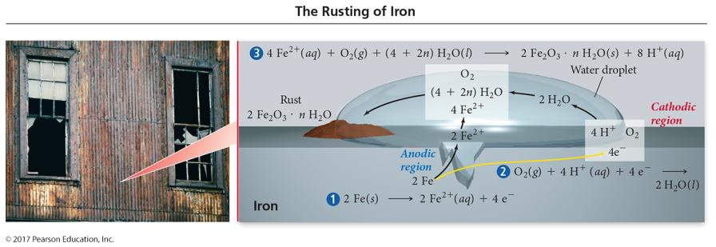
Corrosion of Iron: Rusting

Slide 59
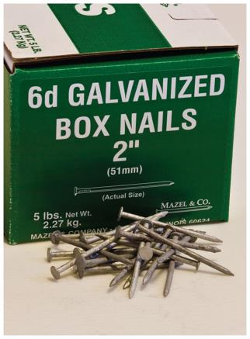
Preventing Corrosion
One way to reduce or slow corrosion is to coat the metal surface to keep it from contacting corrosive chemicals in the environment.
Paint
Some metals, such as Al, form an oxide that strongly attaches to the metal surface, preventing the rest of the metal from corroding.
Another method to protect a metal is to attach it to a more reactive metal that is cheap.
Sacrificial electrode
Galvanized nails

Slide 60
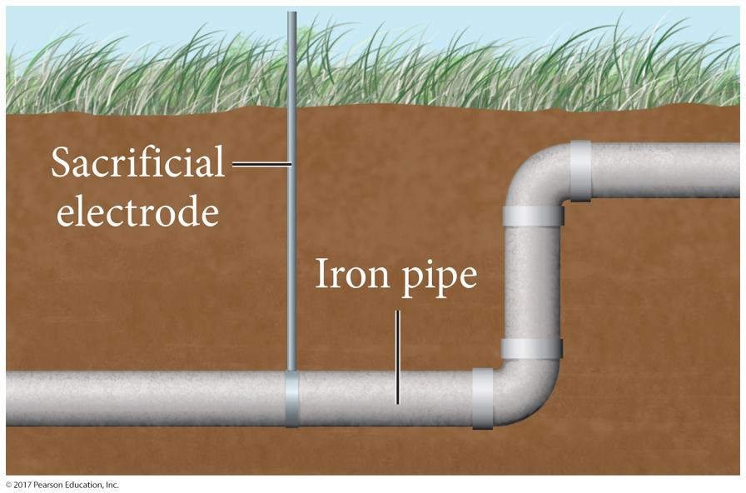
Sacrificial Anode

