Slide 1
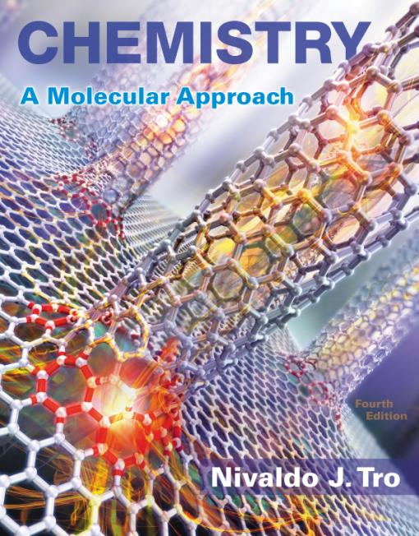
Lecture Presentation
Chapter 13 Solutions

Slide 2
Thirsty Seawater
Drinking seawater can cause dehydration.
Seawater
is a homogeneous mixture of salts with water.
contains higher concentrations of salts than the salt content of your cells.
As seawater passes through your body, it pulls water out of your cells, due mainly to nature’s tendency toward spontaneous mixing.
This reduces your cells’ water level and usually results in diarrhea as this extra liquid flows out with the seawater.

Slide 3
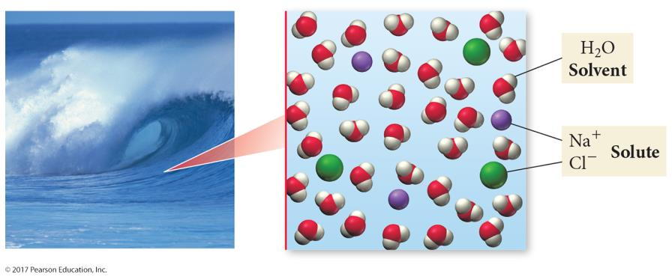
Seawater

Slide 4
Solutions
The majority component of a solution is called the solvent.
The minority component is called the solute.
Solutions form in part because of intermolecular forces.
The particles of the solute interact with the particles of the solvent through intermolecular forces.

Slide 5
Seawater
Drinking seawater will dehydrate you and give you diarrhea.
The cell wall acts as a barrier to the solute moving, so the only way for the seawater and the cell solution to have uniform mixing is for water to flow out of the cells of your intestine and into your digestive tract.

Slide 6
Homogeneous Mixtures
A mixture of two or more substances
Composition may vary from one sample to another
Appears to be one substance, though really contains multiple materials
Most homogeneous materials we encounter are actually solutions.
For example, air and seawater
Nature has a tendency toward spontaneous mixing.
Generally, uniform mixing is more energetically favorable.

Slide 7
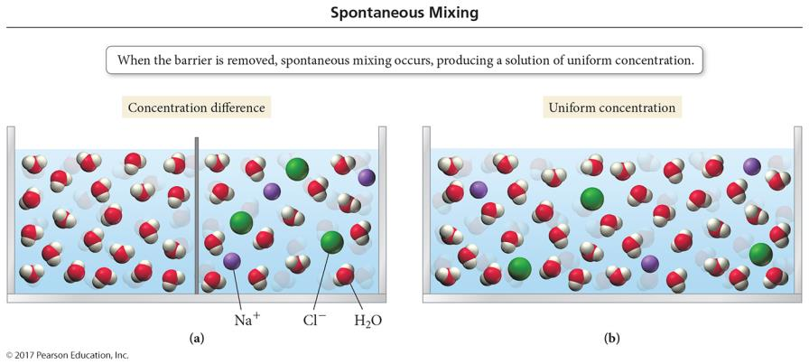
Spontaneous Mixing
When solutions with different solute concentrations come in contact, they spontaneously mix to result in a uniform distribution of solute throughout the solution.

Slide 8
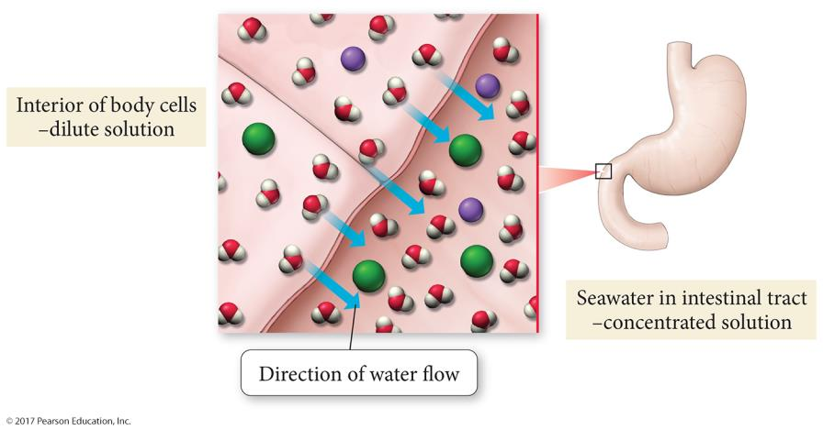
Seawater

Slide 9
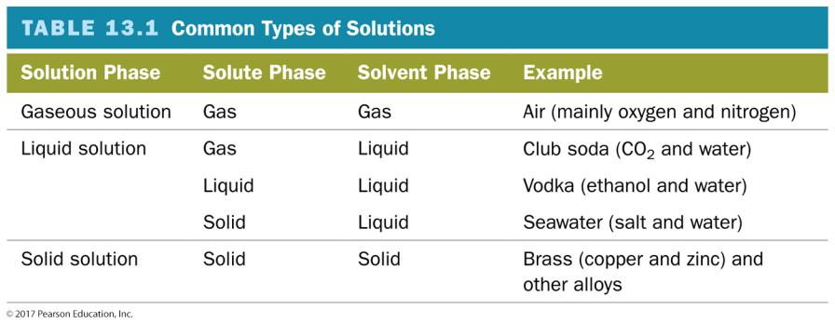
Common Types of Solutions
A solution may be composed of a solid and a liquid or any other combination.

Slide 10
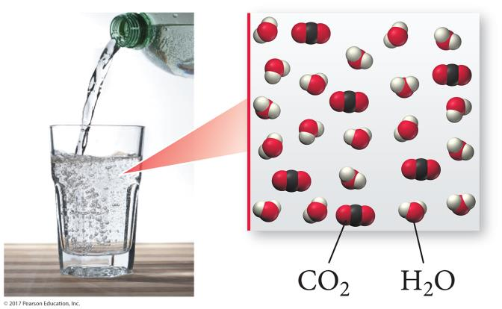
Common Types of Solutions
In aqueous solutions, water is the solvent.

Slide 11
Solubility
When one substance (solute) dissolves in another (solvent) it is said to be soluble.
Salt is soluble in water.
Bromine is soluble in methylene chloride.
When one substance does not dissolve in another it is said to be insoluble.
Oil is insoluble in water.
The solubility of one substance in another depends on
nature’s tendency toward mixing, and
the types of intermolecular attractive forces.

Slide 12
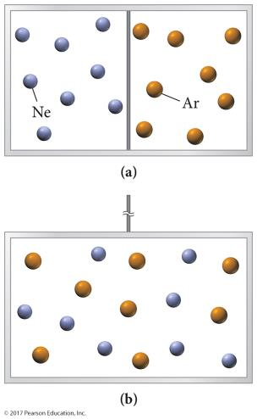
Nature’s Tendency Toward Mixing: Entropy
Many physical systems tend toward lower potential energy.
But, formation of a solution does not necessarily lower the potential energy of the system.
When two ideal gases are put into the same container, they spontaneously mix, even though the difference in attractive forces is negligible.
The gases mix because the energy of the system is lowered through the release of entropy.

Slide 13
Mixing and the Solution Process Entropy
Entropy is the measure of energy dispersal in a system.
Energy has a spontaneous drive to spread out over as large a volume as it is allowed.
By each gas expanding to fill the container, the gases’ energy is dispersed over a larger volume.

Slide 14
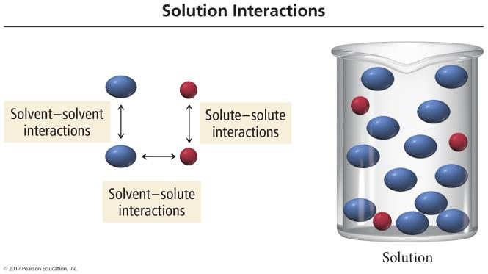
Solutions: Effect of Intermolecular Forces
Energy changes in the formation of most solutions also involve differences in attractive forces between the particles.

Slide 15
Relative Interactions and Solution Formation
When the solute-to-solvent attractions are weaker than the sum of the solute-to-solute and solvent-to-solvent attractions, the solution will form only if the energy difference is small enough to be overcome by the increase in entropy from mixing.

Slide 16
Solutions: Effect of Intermolecular Forces
For the solvent and solute to mix you must overcome
all of the solute–solute attractive forces, or
some of the solvent–solvent attractive forces.
Both processes are endothermic.
At least some of the energy to do this comes from making new solute–solvent attractions, which is exothermic.

Slide 17
Solution Interactions

Slide 18
Solubility
The maximum amount of solute that can be dissolved in a given amount of solvent is called the solubility.
There is usually a limit to the solubility of one substance in another.
Gases are always soluble in each other.
Two liquids that are mutually soluble are said to be miscible.
Alcohol and water are miscible.
Oil and water are immiscible.
The solubility of one substance in another varies with temperature and pressure.

Slide 19
Will It Dissolve?
Chemist’s rule of thumb: like dissolves like.
A chemical will dissolve in a solvent if it has a similar structure to the solvent.
Polar molecules and ionic compounds will be more soluble in polar solvents.
Nonpolar molecules will be more soluble in nonpolar solvents.

Slide 20
Heat of Solution
When some compounds, such as NaOH, dissolve in water, a lot of heat is released.
The container gets hot.
When other compounds, such as NH₄NO₃, dissolve in water, heat is absorbed from the surroundings.
The container gets cold.
Why is this?

Slide 21
Energetics of Solution Formation: The Enthalpy of Solution
To make a solution you must
overcome all attractions among the solute particles; therefore, ΔH_{solute} is endothermic.
overcome some attractions among solvent molecules; therefore, ΔH_{solvent} is endothermic.
form new attractions among solute particles and solvent molecules; therefore, ΔH_{mix} is exothermic.
The overall ΔH for making a solution depends on the relative sizes of the ΔH for these three processes.
ΔH_{sol'n} = ΔH_{solute} + ΔH_{solvent} + ΔH_{mix}

Slide 22
Solution Process
STEP 1: Separating the solute into its constituent particles

Slide 23
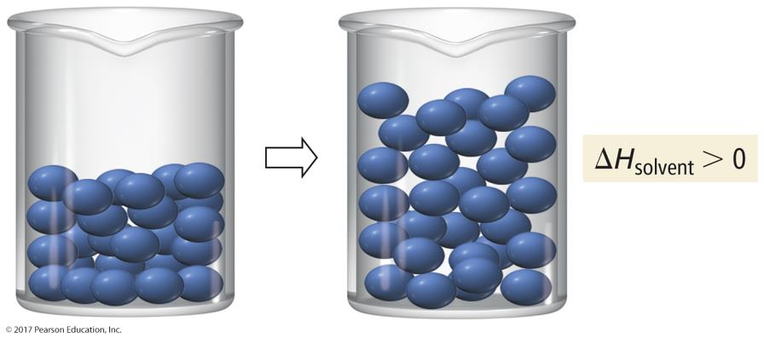
Solution Process
STEP 2: Separating the solvent particles from each other to make room for the solute particles

Slide 24
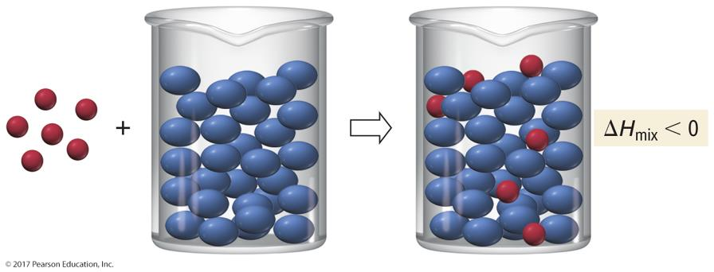
Solution Process
STEP 3: Mixing the solute particles with the solvent particles

Slide 25
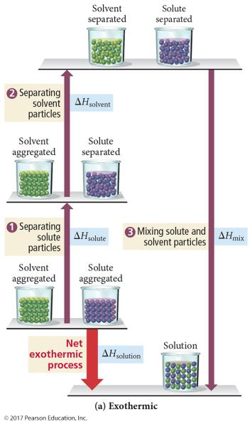
Energetics of Solution Formation
If the total energy cost for breaking attractions between particles in the pure solute and pure solvent is less than the energy released in making the new attractions between the solute and solvent, the overall process will be exothermic.

Slide 26
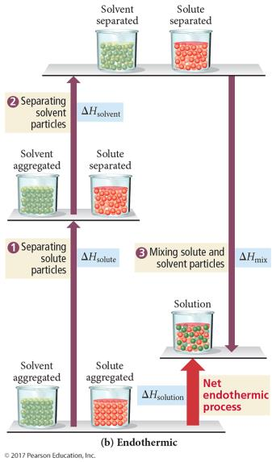
Energetics of Solution Formation
If the total energy cost for breaking attractions between particles in the pure solute and pure solvent is greater than the energy released in making the new attractions between the solute and solvent, the overall process will be endothermic.

Slide 27
Heats of Hydration
For aqueous solutions of ionic compounds, the energy added to overcome the attractions between water molecules and the energy released in forming attractions between the water molecules and ions is combined into a term called the heat of hydration.
Attractive forces between ions = lattice energy
ΔH_{solute} = −ΔH_{lattice energy}
Attractive forces in water = H bonds
Attractive forces between ion and water = ion–dipole
ΔH_{hydration} = heat released when one mole of gaseous ions dissolves in water = ΔH_{solvent} + ΔH_{mix}

Slide 28
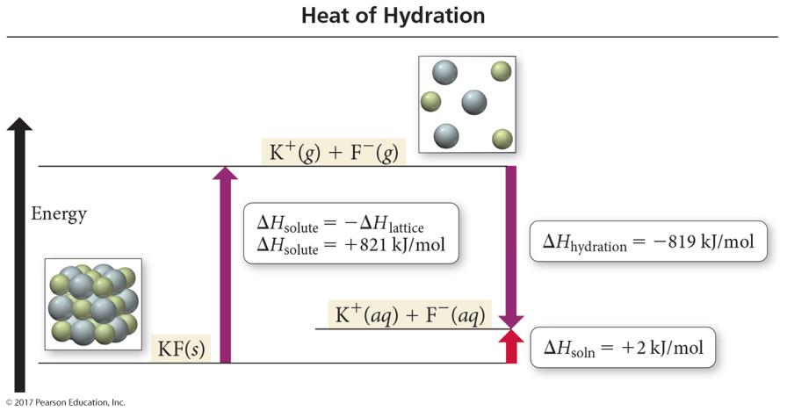
Heat of Hydration
ΔH_{solution} = ΔH_{hydration}− ΔH_{lattice energy}

Slide 29
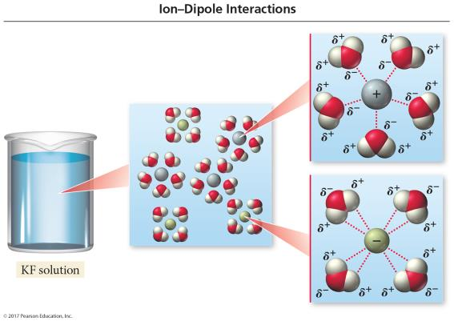
Ion–Dipole Interactions
When ions dissolve in water they become hydrated.
Each ion is surrounded by water molecules.
The formation of these ion–dipole attractions causes the heat of hydration to be very exothermic.

Slide 30
Heats of Solution for Ionic Compounds
For an aqueous solution of an ionic compound, the ΔH_{solution} is the difference between the heat of hydration and the lattice energy.
ΔH_{solution} = ΔH_{solute}+ ΔH_{solvent} + ΔH_{mix}
ΔH_{solution} = −ΔH_{lattice energy}+ ΔH_{solvent} + ΔH_{mix}
ΔH_{solution} = ΔH_{hydration}− ΔH_{lattice energy}
ΔH_{solution} = −ΔH_{lattice energy} + ΔH_{hydration}

Slide 31
Comparing Heat of Solution to Heat of Hydration
Because the lattice energy is always exothermic, the size and sign on the ΔH_{sol’n} tells us something about ΔH_{hydration}.
If the heat of solution is large and exothermic, then the amount of energy it costs to separate the ions is less than the energy released from hydrating the ions.
ΔH_{hydration} > ΔH_{solute} when ΔH_{sol’n} is (−).
If the heat of solution is large and endothermic, then the amount of energy it costs to separate the ions is more than the energy released from hydrating the ions.
ΔH_{hydration} < ΔH_{solute} when ΔH_{sol’n} is (+).

Slide 32
Solution Equilibrium
The dissolution of a solute in a solvent is an equilibrium process.
Initially, when there is no dissolved solute, the only process possible is dissolution.
Shortly after some solute is dissolved, solute particles can start to recombine to reform solute molecules, but when the rate of dissolution >> the rate of deposition, the solute continues to dissolve.
Eventually, the rate of dissolution = the rate of deposition—the solution is saturated with solute, and no more solute will dissolve.

Slide 33
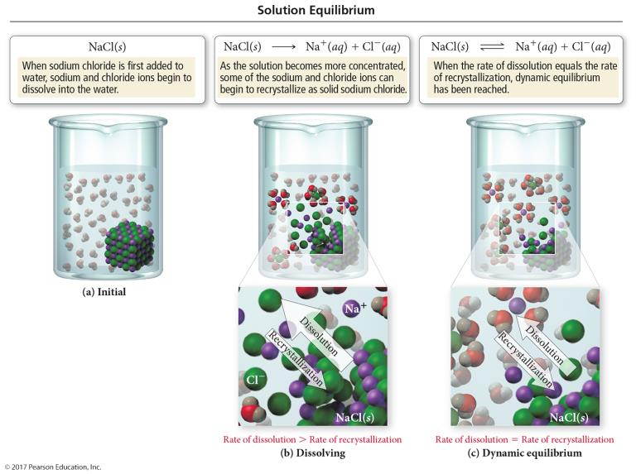
Solution Equilibrium

Slide 34
Solubility Limit
A solution that has the solute and solvent in dynamic equilibrium is said to be saturated.
If you add more solute it will not dissolve.
The saturation concentration depends on the temperature and pressure of gases.
A solution that has less solute than saturation is said to be unsaturated.
More solute will dissolve at this temperature.
A solution that has more solute than saturation is said to be supersaturated.

Slide 35
How Can You Make a Solvent Hold More Solute?
Solutions can be made saturated at non-room conditions and then can be allowed to come to room conditions slowly.
For some solutes, instead of coming out of solution when the conditions change, they get stuck between the solvent molecules, and the solution becomes supersaturated.
Supersaturated solutions are unstable and lose all the solute above saturation when disturbed.
For example, shaking a carbonated beverage

Slide 36
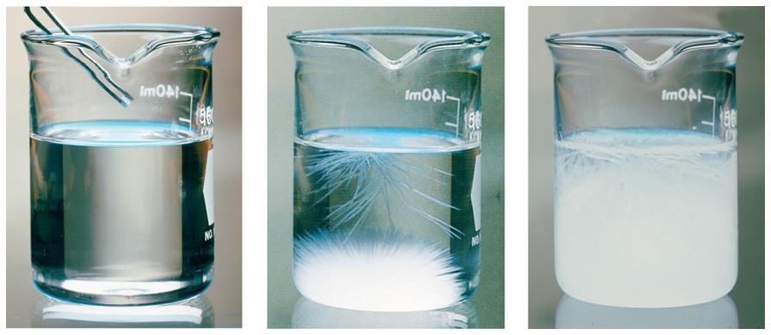
Adding a Crystal of NaC₂H₃O₂ to a Supersaturated Solution

Slide 37
Temperature Dependence of Solubility of Solids in Water
Solubility is generally given in grams of solute that will dissolve in 100 g of water.
For most solids, the solubility of the solid increases as the temperature increases.
When ΔH_{solution} is endothermic
Solubility curves can be used to predict whether a solution with a particular amount of solute dissolved in water is saturated (on the line), unsaturated (below the line), or supersaturated (above the line).

Slide 38
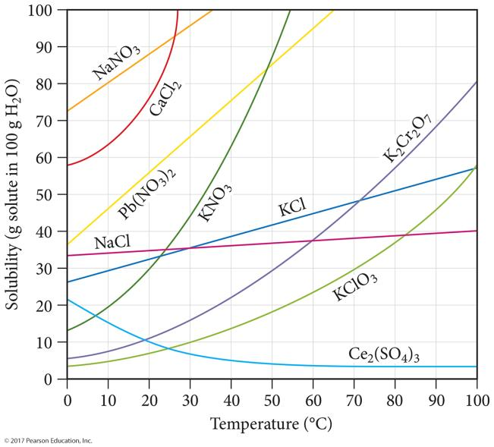
Solubility Curves

Slide 39
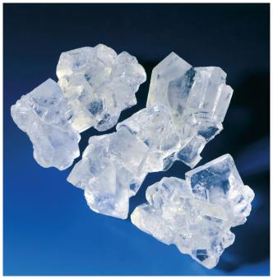
Purification by Recrystallization
One of the common operations performed by a chemist is removing impurities from a solid compound.
One method of purification involves dissolving a solid in a hot solvent until the solution is saturated.
As the solution slowly cools, the solid crystallizes out, leaving impurities behind.

Slide 40
Temperature Dependence of Solubility of Gases in Water
Gases generally have lower solubility in water than ionic or polar covalent solids because most are nonpolar molecules.
Gases with high solubility usually are actually reacting with water.
For all gases, the solubility of the gas decreases as the temperature increases.
The ΔH_{solution} is exothermic because you do not need to overcome solute–solute attractions.

Slide 41
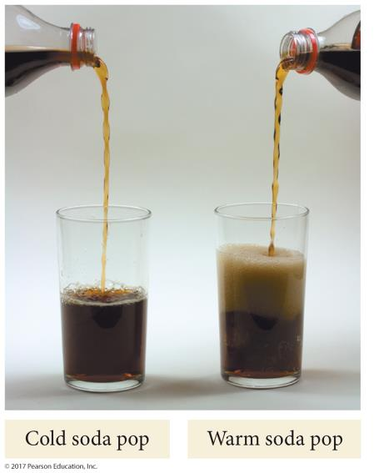
Temperature Dependence of Solubility of Gases in Water

Slide 42
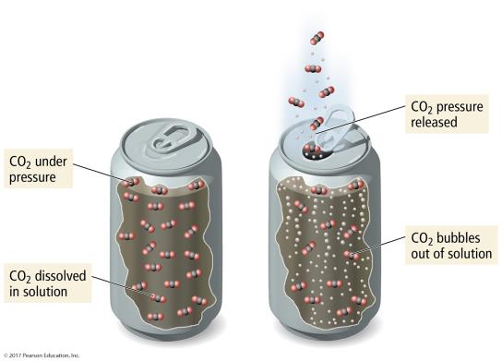
Pressure Dependence of Solubility of Gases in Water
The larger the partial pressure of a gas in contact with a liquid, the more soluble the gas is in the liquid.

Slide 43
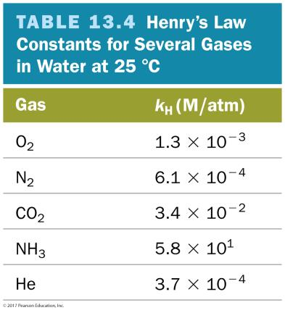
Henry’s Law
The solubility of a gas (S_{gas}) is directly proportional to its partial pressure, (P_{gas}).
S_{gas} = k_{H}P_{gas}
k_{H} is called the Henry’s law constant.

Slide 44
Concentrations
Solutions have variable composition.
To describe a solution, you need to describe the components and their relative amounts.
The terms dilute and concentrated can be used as qualitative descriptions of the amount of solute in solution.
Concentration = amount of solute in a given amount of solution.
Occasionally per amount of solvent

Slide 45
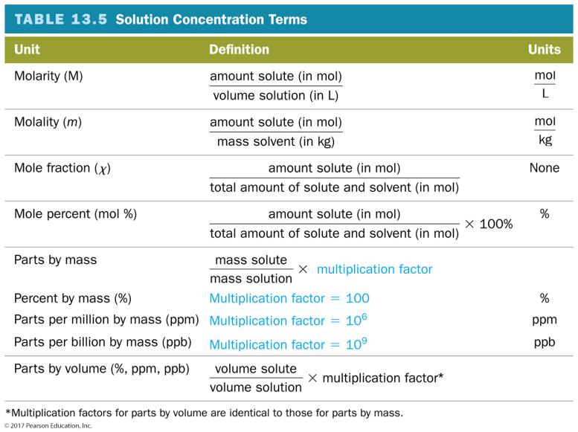
Concentrations

Slide 46
Preparing a Solution
Need to know amount of solution and concentration of solution.
Calculate the mass of solute needed.
Start with an amount of solution.
Use concentration as a conversion factor.
5% by mass ⇒ 5 g solute ≡ 100 g solution
“Dissolve the grams of solute in enough solvent to total the total amount of solution.”

Slide 47
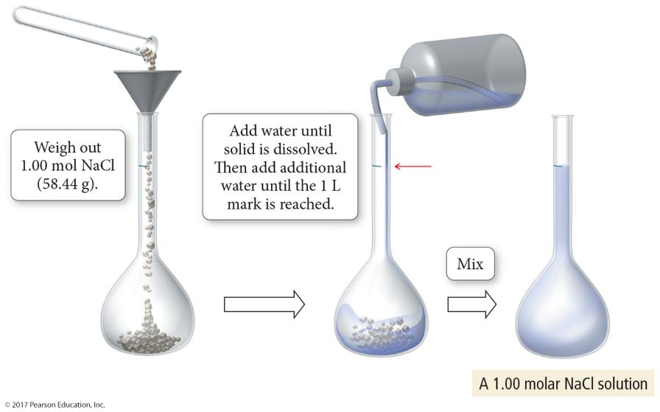
Preparing a Solution

Slide 48
Solution Concentration: Molarity
Moles of solute per 1 liter of solution
Describes how many molecules of solute in each liter of solution
If a sugar solution concentration is 2.0 M,
1 liter of solution contains 2.0 moles of sugar.
2 liters = 4.0 moles sugar.
0.5 liters = 1.0 mole sugar.

Slide 49
Solution Concentration: Molality, m
Moles of solute per 1 kilogram of solvent
Defined in terms of amount of solvent, not solution
Like the others
Does not vary with temperature
Because based on masses, not volumes

Slide 50
Parts Solute in Parts Solution
Parts can be measured by mass or volume.
Parts are generally measured in the same units.
By mass in grams, kilograms, lbs., etc.
By volume in mL, L, gallons, etc.
Mass and volume combined in grams and mL

Slide 51
Parts Solute in Parts Solution
Percentage = parts of solute in every 100 parts solution
If a solution is 0.9% by mass, then there are 0.9 grams of solute in every 100 grams of solution (or 0.9 kg solute in every 100 kg solution).
Parts per million = parts of solute in every 1 million parts solution
If a solution is 36 ppm by volume, then there are 36 mL of solute in 1 million mL of solution.

Slide 52
PPM
Grams of solute per 1,000,000 g of solution
mg of solute per 1 kg of solution
1 liter of water = 1 kg of water
For aqueous solutions, we often approximate the kg of the solution as the kg or L of water.
For dilute solutions, the difference in density between the solution and pure water is usually negligible.

Slide 53
Parts per Billion Concentration
Notes:
53

Slide 54
Solution Concentrations: Mole Fraction, X_{A}
The mole fraction is the fraction of the moles of one component in the total moles of all the components of the solution.
Total of all the mole fractions in a solution = 1.
Unitless
The mole percentage is the percentage of the moles of one component in the total moles of all the components of the solution.
= mole fraction × 100%

Slide 55
Converting Concentration Units
Write the given concentration as a ratio.
Separate the numerator and denominator.
Separate into the solute part and solution part.
Convert the solute part into the required unit.
Convert the solution part into the required unit.
Use the definitions to calculate the new concentration units.

Slide 56
Colligative Properties
Colligative properties are properties whose values depend only on the number of solute particles and not on what they are.
Value of the property depends on the concentration of the solution.
The difference in the value of the property between the solution and the pure substance is generally related to the different attractive forces and solute particles occupying solvent molecules’ positions.
Notes:
56

Slide 57
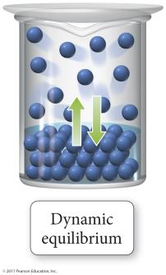
Vapor Pressure of Solutions
The vapor pressure of a solvent above a solution is lower than the vapor pressure of the pure solvent.
The solute particles replace some of the solvent molecules at the surface.
The pure solvent establishes a liquid vapor equilibrium.

Slide 58
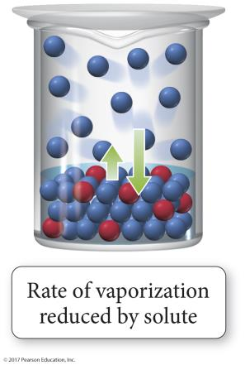
Vapor Pressure of Solutions
Addition of a nonvolatile solute reduces the rate of vaporization, decreasing the amount of vapor.

Slide 59
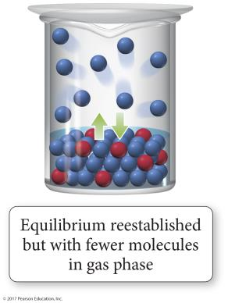
Vapor Pressure of Solutions
Eventually, equilibrium is reestablished but with a smaller number of vapor molecules; therefore, the vapor pressure will be lower.

Slide 60
Thirsty Solutions Revisited
A concentrated solution will draw solvent molecules toward it due to the natural drive for materials in nature to mix.
Similarly, a concentrated solution will draw pure solvent vapor into it due to this tendency to mix.
The result is reduction in vapor pressure.

Slide 61
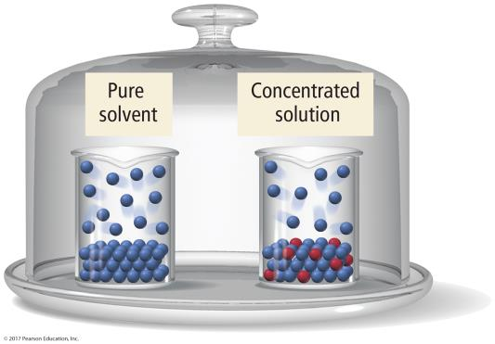
Thirsty Solutions
Beakers with equal liquid levels of pure solvent and a solution are placed in a bell jar. Solvent molecules evaporate from each one and fill the bell jar, establishing an equilibrium with the liquids in the beakers.

Slide 62
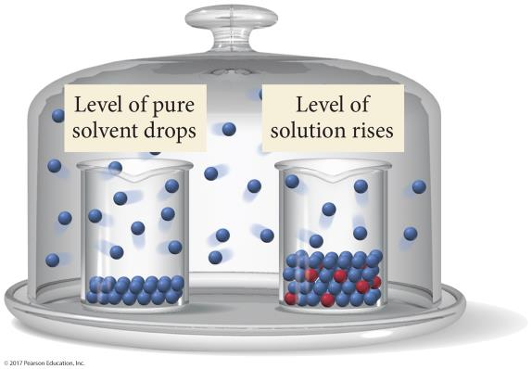
Thirsty Solutions
When equilibrium is established, the liquid level in the solution beaker is higher than the solution level in the pure solvent beaker; the thirsty solution grabs and holds solvent vapor more effectively.

Slide 63
Raoult’s Law
The vapor pressure of a volatile solvent above a solution is equal to its normal vapor pressure, P°, multiplied by its mole fraction in the solution.
P_{solvent in solution} = χ_{solvent}∙P°
Because the mole fraction is always less than 1, the vapor pressure of the solvent in solution will always be less than the vapor pressure of the pure solvent.

Slide 64
Vapor Pressure Lowering
The vapor pressure of a solvent in a solution is always lower than the vapor pressure of the pure solvent.
The vapor pressure of the solution is directly proportional to the amount of the solvent in the solution.
The difference between the vapor pressure of the pure solvent and the vapor pressure of the solvent in solution is called the vapor pressure lowering.
ΔP = P°_{solvent} − P_{solution} = χ_{solute} ∙ P°_{solvent}

Slide 65
Raoult’s Law for Volatile Solute
When both the solvent and the solute can evaporate, both molecules will be found in the vapor phase.
The total vapor pressure above the solution will be the sum of the vapor pressures of the solute and solvent.
For an ideal solution
P_{total} = P_{solute} + P_{solvent}
The solvent decreases the solute vapor pressure in the same way the solute decreased the solvent’s.
P_{solute} = χ_{solute}∙P°_{solute} and P_{solvent} = χ_{solvent} ∙P°_{solvent}

Slide 66
Ideal versus Nonideal Solutions
In ideal solutions, the made solute–solvent interactions are equal to the sum of the broken solute–solute and solvent–solvent interactions.
Ideal solutions follow Raoult’s law.
Effectively, the solute is diluting the solvent.
If the solute–solvent interactions are stronger or weaker than the broken interactions, the solution is nonideal.

Slide 67
Vapor Pressure of a Nonideal Solution
When the solute–solvent interactions are stronger than the solute–solute + solvent–solvent, the total vapor pressure of the solution will be less than predicted by Raoult’s law, because the vapor pressures of the solute and solvent are lower than ideal.
When the solute–solvent interactions are weaker than the solute–solute + solvent–solvent, the total vapor pressure of the solution will be more than predicted by Raoult’s law.

Slide 68
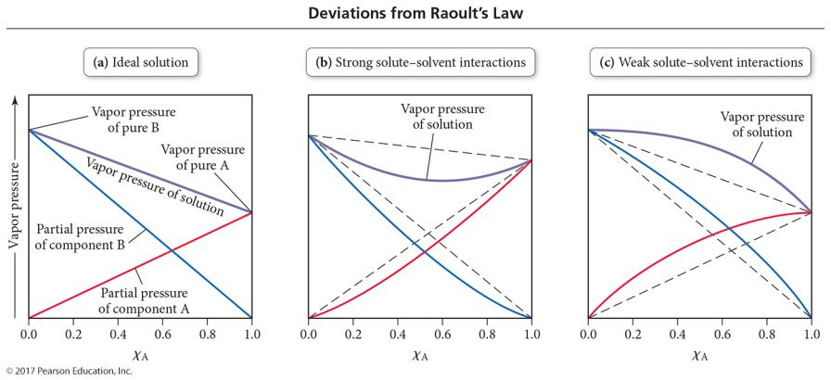
Deviations from Raoult’s Law

Slide 69
Other Colligative Properties Related to Vapor Pressure Lowering
Vapor pressure lowering occurs at all temperatures.
This results in the temperature required to boil the solution being higher than the boiling point of the pure solvent.
This also results in the temperature required to freeze the solution being lower than the freezing point of the pure solvent.

Slide 70
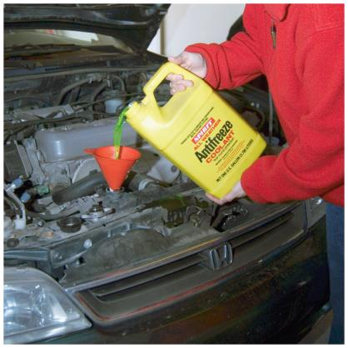
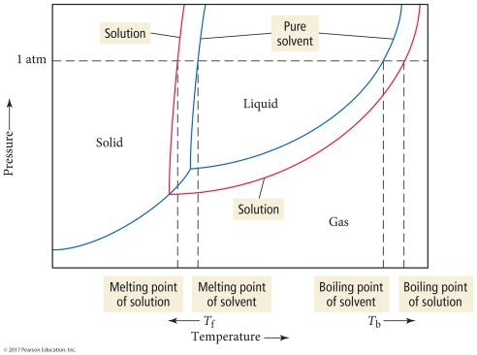
Freezing Point Depression and Boiling Point Elevation

Slide 71
Freezing Point Depression
The freezing point of a solution is lower than the freezing point of the pure solvent.
Therefore, the melting point of the solid solution is lower.
The difference between the freezing point of the solution and the freezing point of the pure solvent is directly proportional to the molal concentration of solute particles.
(FP_{solvent} – FP_{solution}) = ΔT_{f} = m∙K_{f}
The proportionality constant is called the freezing point depression constant, K_{f}.
The value of K_{f} depends on the solvent.
The units of K_{f} are °C/m.

Slide 72
K_{f} and K_{b}

Slide 73
Boiling Point Elevation
The boiling point of a solution is higher than the boiling point of the pure solvent.
For a nonvolatile solute
The difference between the boiling point of the solution and boiling point of the pure solvent is directly proportional to the molal concentration of solute particles.
(BP_{solution} – BP_{solvent}) = ΔT_{b} = m∙K_{b}
The proportionality constant is called the boiling point elevation constant, K_{b}.
The value of K_{b} depends on the solvent.
The units of K_{b} are °C/m.

Slide 74
Osmosis
Osmosis is the flow of solvent from a solution of low concentration into a solution of high concentration.
The solutions may be separated by a semipermeable membrane.
A semipermeable membrane allows solvent, but not solute, to flow through it.

Slide 75
Osmotic Pressure
The amount of pressure needed to keep osmotic flow from taking place is called the osmotic pressure.
The osmotic pressure, Π, is directly proportional to the molarity of the solute particles.
R = 0.08206 (atm∙L)/(mol∙K)
Notes:
75

Slide 76
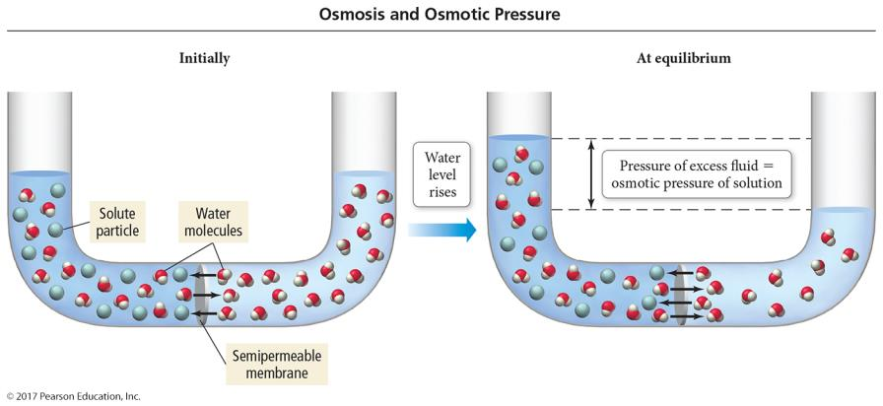
An Osmosis Cell

Slide 77
Van’t Hoff Factor
Ionic compounds produce multiple solute particles for each formula unit.
The theoretical van’t Hoff factor, i, is the ratio of moles of solute particles to moles of formula units dissolved.
The measured van’t Hoff factor is generally less than the theoretical due to ion pairing in solution.
Therefore, the measured van’t Hoff factors often cause the ΔT to be smaller than one might expect.

Slide 78
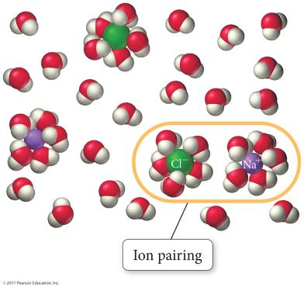
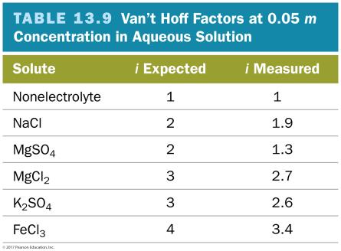
Colligative Properties of Strong Electrolyte Solutions

Slide 79
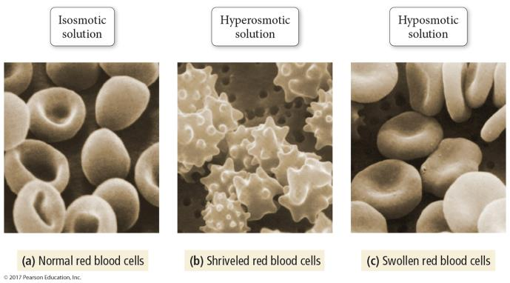
Colligative Properties and Medical Solutions
An isosmotic solution has the same osmotic pressure as the solution inside the cell; as a result, there is no net flow of water into or out of the cell.

Slide 80
Colligative Properties and Medical Solutions
A hyperosmotic solution has a higher osmotic pressure than the solution inside the cell; as a result there is a net flow of water out of the cell, causing it to shrivel.

Slide 81
Colligative Properties and Medical Solutions
A hyposmotic solution has a lower osmotic pressure than the solution inside the cell; as a result, there is a net flow of water into the cell, causing it to swell.

Slide 82
Mixtures
Solutions = homogeneous
Suspensions = heterogeneous, separate on standing
Colloids = heterogeneous, do not separate on standing
Particles can coagulate.
Cannot pass through semipermeable membrane
Hydrophilic
Stabilized by attraction for solvent (water)
Hydrophobic
Stabilized by charged surface repulsions
Show the Tyndall effect and Brownian motion.

Slide 83
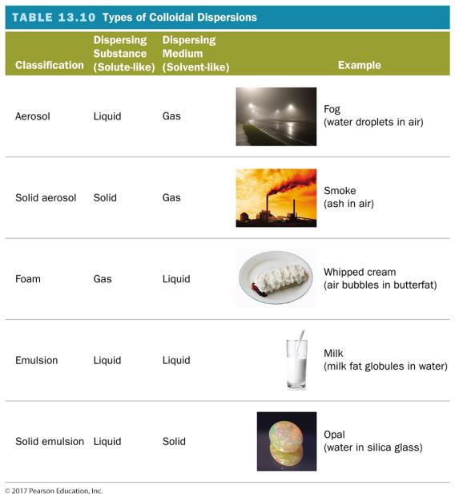
Types of Colloidal Suspensions

Slide 84
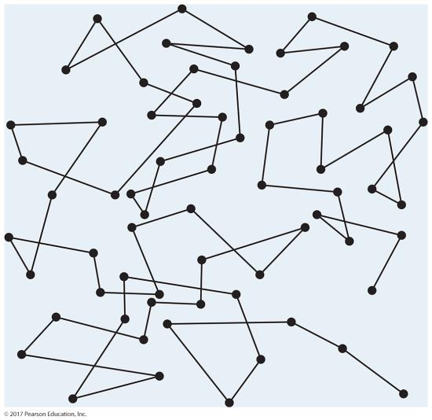
Brownian Motion

Slide 85
Soaps
Soap is a fatty acid salt that forms a colloid because of its unique structure.
One end of the molecule is ionic, the “head,” and the other end is very nonpolar, the “tail.”
Hydrophilic head and hydrophobic tail
This unique structure allows soaps to help oily substances be attracted to water.
Micelle formation
Emulsification

Slide 86
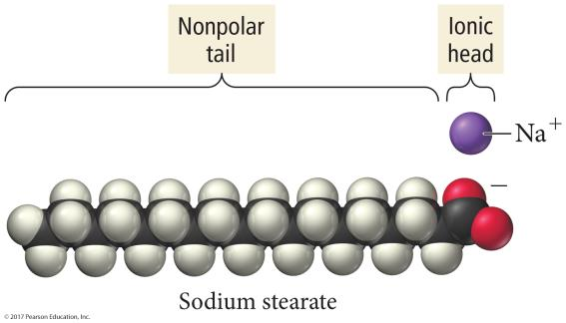
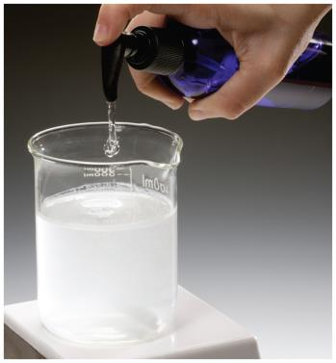
Soap

Slide 87
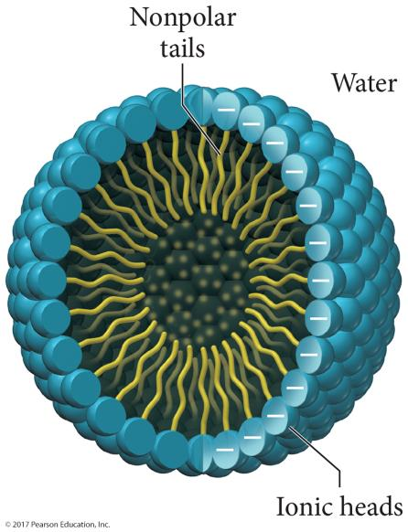
Soap

Slide 88
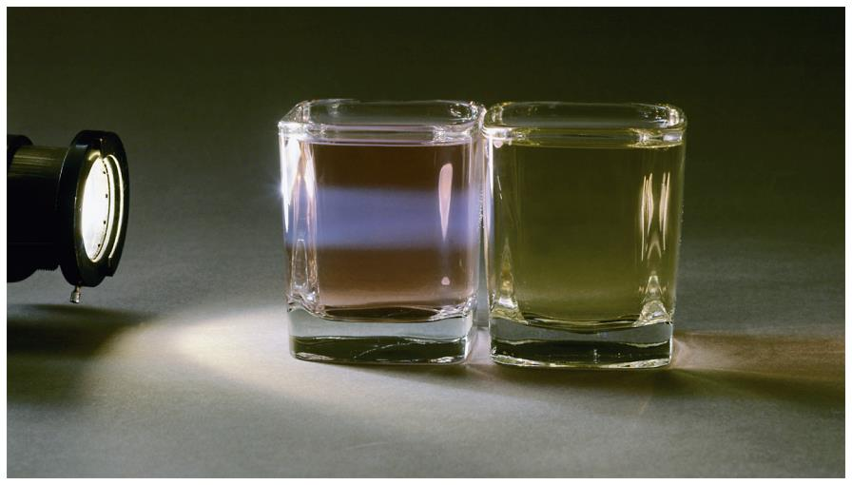
The Tyndall Effect

Slide 89
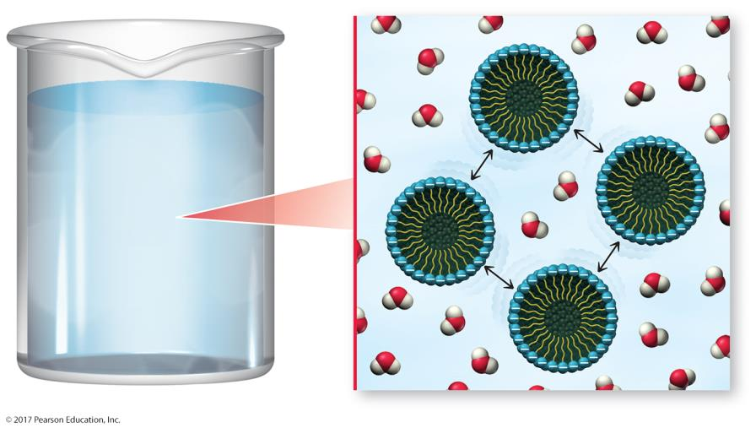
Micelle Repulsions

