Slide 1
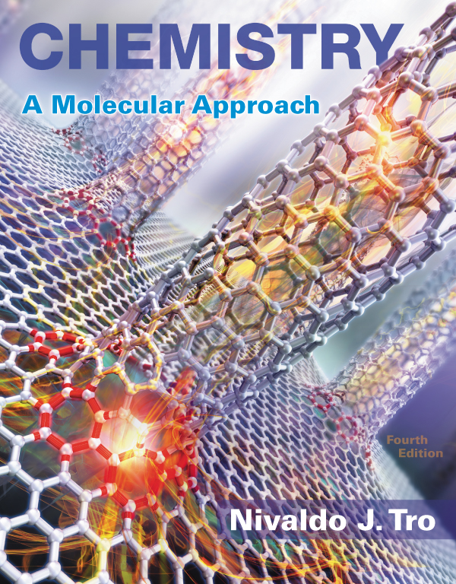
Lecture Presentation
Chapter 2 Atoms and Elements

Slide 2
If You Cut a Piece of Graphite
If you cut a piece of graphite from the tip of a pencil into smaller and smaller pieces, how far could you go? Could you divide it forever?
Cutting the graphite from a pencil tip into smaller and smaller pieces (far smaller than the eye could see) would eventually yield individual carbon atoms.

Slide 3
If You Cut a Piece of Graphite
The word atom comes from the Greek atomos, meaning “indivisible.”
You cannot divide a carbon atom into smaller pieces and still have carbon.
Atoms compose all ordinary matter: If you want to understand matter, you must begin by understanding atoms.

Slide 4
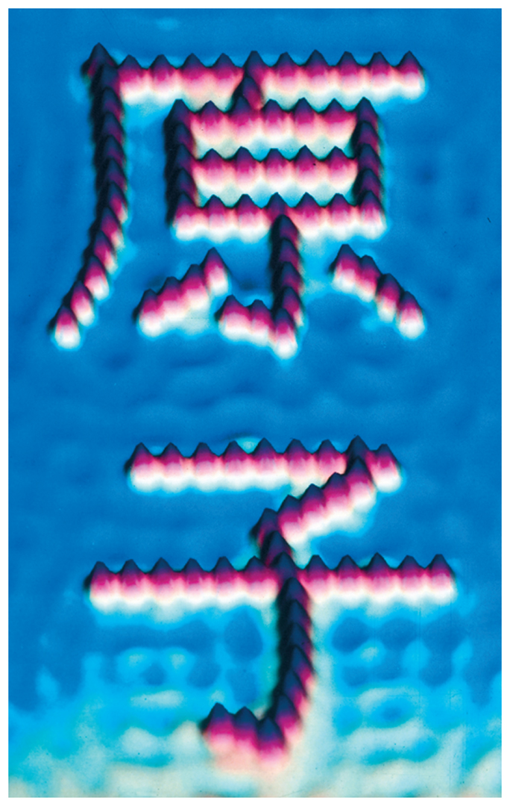
Imaging and Moving Individual Atoms
Scanning tunneling microscopy (STM) is a technique that can image, and even move, individual atoms and molecules.
The image below, obtained by STM, shows iron atoms (red) on a copper surface (blue).

Slide 5
Imaging and Moving Individual Atoms
In spite of their small size, atoms are the key to connecting the macroscopic and microscopic worlds.
An atom is the smallest identifiable unit of an element.
There are about
91 different, naturally occurring elements, and
over 20 synthetic elements (elements not found in nature).

Slide 6
Early Ideas about the Building Blocks of Matter
Leucippus (fifth century B.C.) and his student Democritus (460–370 B.C.) were the first to propose that matter was composed of small, indestructible particles.
Democritus wrote, “Nothing exists except atoms and empty space; everything else is opinion.”
They proposed that many different kinds of atoms existed, each different in shape and size, and that they moved randomly through empty space.

Slide 7
Early Building Blocks of Matter Ideas
Plato and Aristotle did not embrace the atomic ideas of Leucippus and Democritus.
They held that
matter had no smallest parts.
different substances were composed of various proportions of fire, air, earth, and water.

Slide 8
Early Building Blocks of Matter Ideas
Later, the scientific approach became the established way to learn about the physical world.
An English chemist, John Dalton (1766–1844), offered convincing evidence that supported the early atomic ideas of Leucippus and Democritus.

Slide 9
Modern Atomic Theory and the Laws That Led to It
The theory that all matter is composed of atoms grew out of observations and laws.
The three most important laws that led to the development and acceptance of the atomic theory were
the law of conservation of mass,
the law of definite proportions, and
the law of multiple proportions.

Slide 10
The Law of Conservation of Mass
Antoine Lavoisier formulated the law of conservation of mass, which states that in a chemical reaction, matter is neither created nor destroyed.
Hence, when a chemical reaction occurs, the total mass of the substances involved in the reaction does not change.

Slide 11
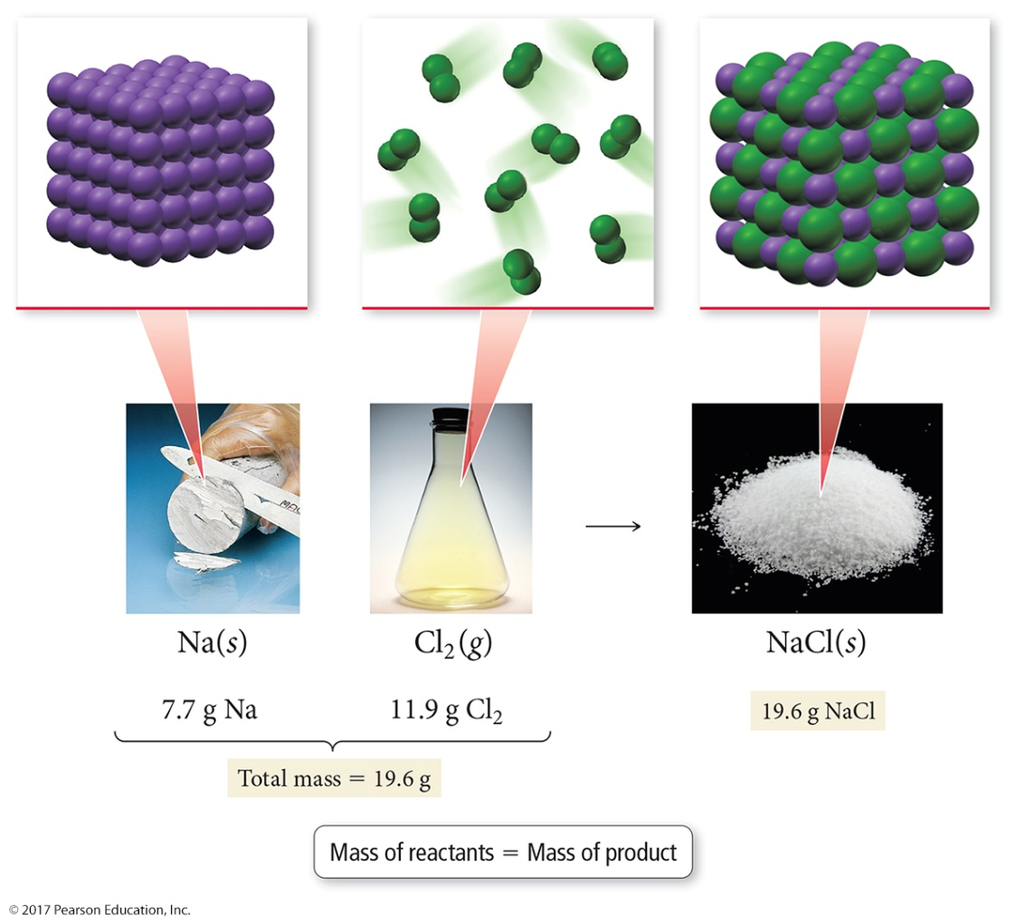
The Law of Conservation of Mass
This law is consistent with the idea that matter is composed of small, indestructible particles.

Slide 12
The Law of Definite Proportions
In 1797, a French chemist, Joseph Proust, made observations on the composition of compounds.
He summarized his observations in the law of definite proportions.
All samples of a given compound, regardless of their source or how they were prepared, have the same proportions of their constituent elements.

Slide 13
The Law of Definite Proportions
The law of definite proportions is sometimes called the law of constant composition.
For example, the decomposition of 18.0 g of water results in 16.0 g of oxygen and 2.0 g of hydrogen, or an oxygen-to-hydrogen mass ratio of the following:

Slide 14
The Law of Multiple Proportions
In 1804, John Dalton published his law of multiple proportions.
When two elements (call them A and B) form two different compounds, the masses of element B that combine with 1 g of element A can be expressed as a ratio of small whole numbers.
An atom of A combines with either one, two, three, or more atoms of B (AB₁, AB₂, AB₃, etc.).

Slide 15
The Law of Multiple Proportions
Carbon monoxide and carbon dioxide are two compounds composed of the same two elements: carbon and oxygen.
The mass ratio of oxygen to carbon in carbon dioxide is 2.67:1; therefore, 2.67 g of oxygen reacts with 1 g of carbon.
In carbon monoxide, however, the mass ratio of oxygen to carbon is 1.33:1, or 1.33 g of oxygen to every 1 g of carbon.

Slide 16
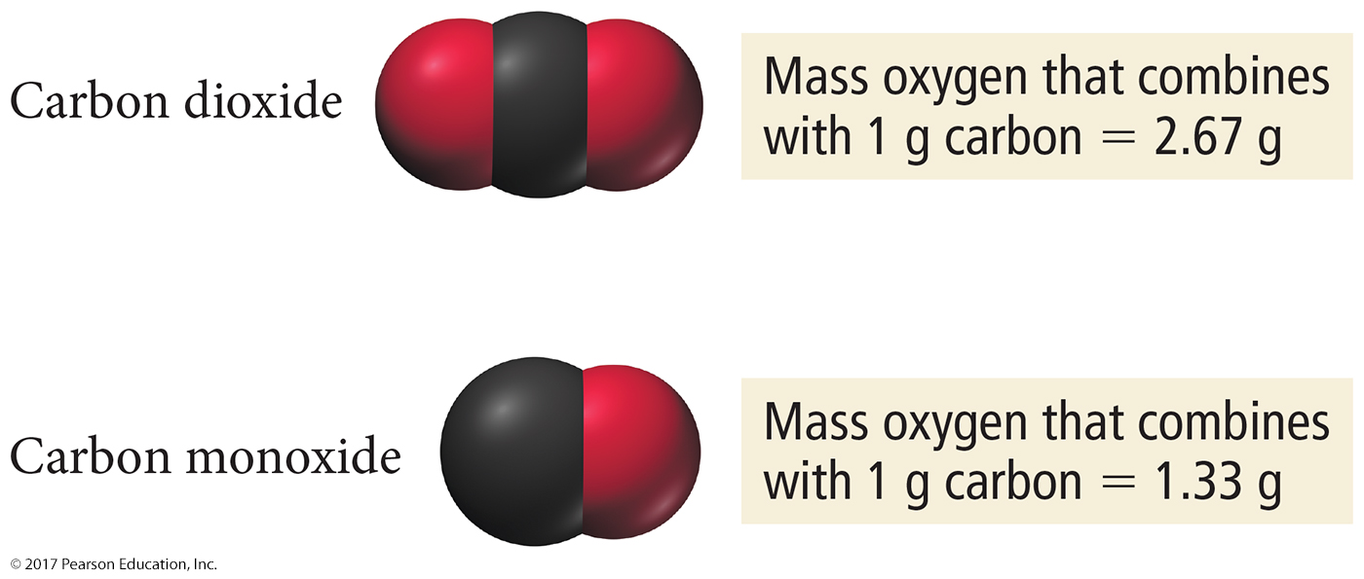
The Law of Multiple Proportions
The ratio of these two masses is itself a small whole number.

Slide 17
John Dalton and the Atomic Theory
Dalton’s atomic theory explained the laws as follows:
1. Each element is composed of tiny, indestructible particles called atoms.
2. All atoms of a given element have the same mass and other properties that distinguish them from the atoms of other elements.
3. Atoms combine in simple, whole-number ratios to form compounds.
4. Atoms of one element cannot change into atoms of another element. In a chemical reaction, atoms only change the way that they are bound together with other atoms.

Slide 18
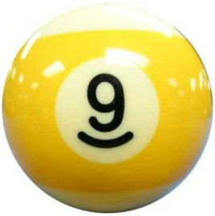
John Dalton and the Atomic Theory

Slide 19
The Discovery of the Electron
J. J. Thomson (1856–1940) conducted cathode ray experiments.
Thomson constructed a partially evacuated glass tube called a cathode ray tube.
He found that a beam of particles, called cathode rays, traveled from the negatively charged electrode (called the cathode) to the positively charged one (called the anode).

Slide 20
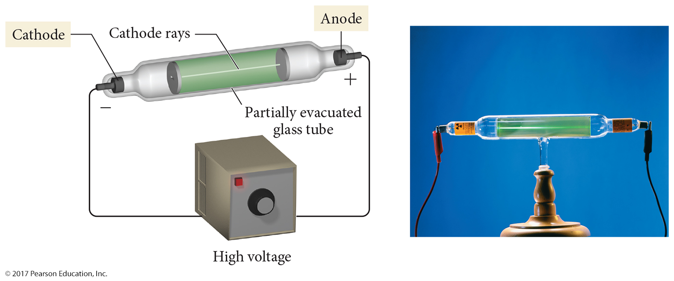
The Discovery of the Electron

Slide 21
The Discovery of the Electron
Thomson found that the particles that compose the cathode ray have the following properties:
They travel in straight lines.
They are independent of the composition of the material from which they originate (the cathode).
They carry a negative electrical charge.

Slide 22
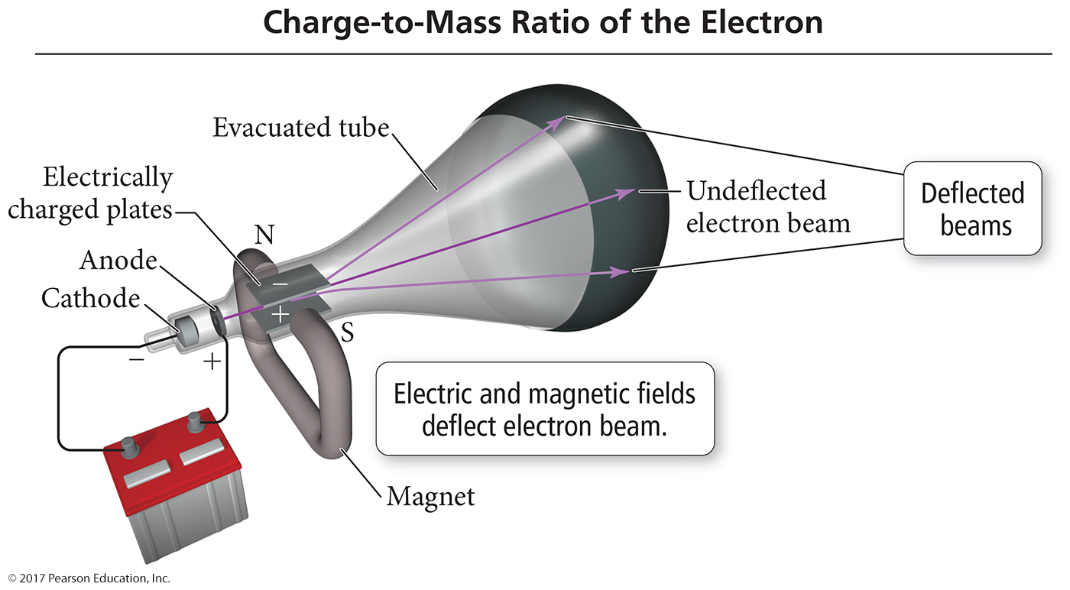
The Discovery of the Electron
J. J. Thomson measured the charge-to-mass ratio of the cathode ray particles by deflecting them using electric and magnetic fields, as shown in the figure.
The value he measured was –1.76 × 10³ coulombs (C) per gram.

Slide 23
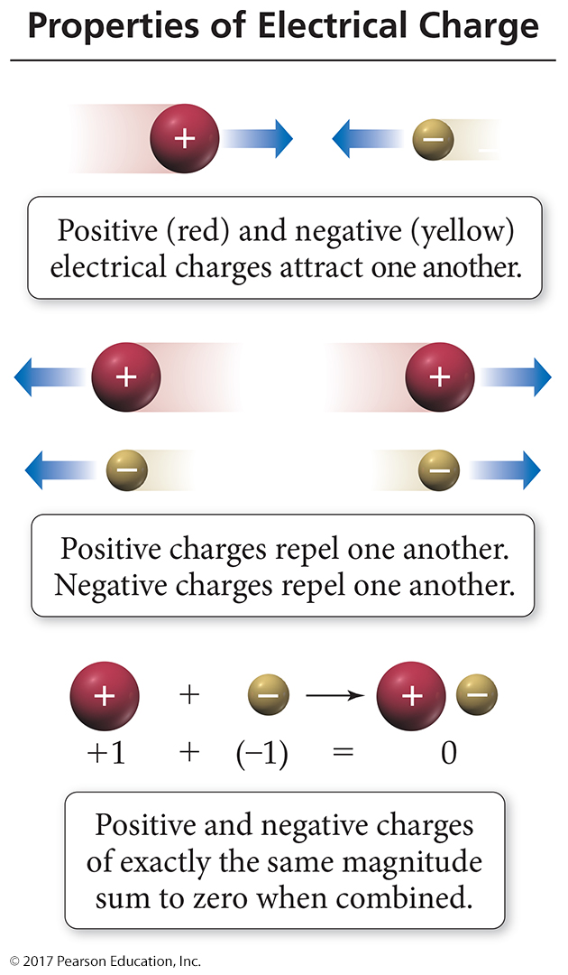
The Discovery of the Electron
J. J. Thomson had discovered the electron, a negatively charged, low-mass particle present within all atoms.

Slide 24
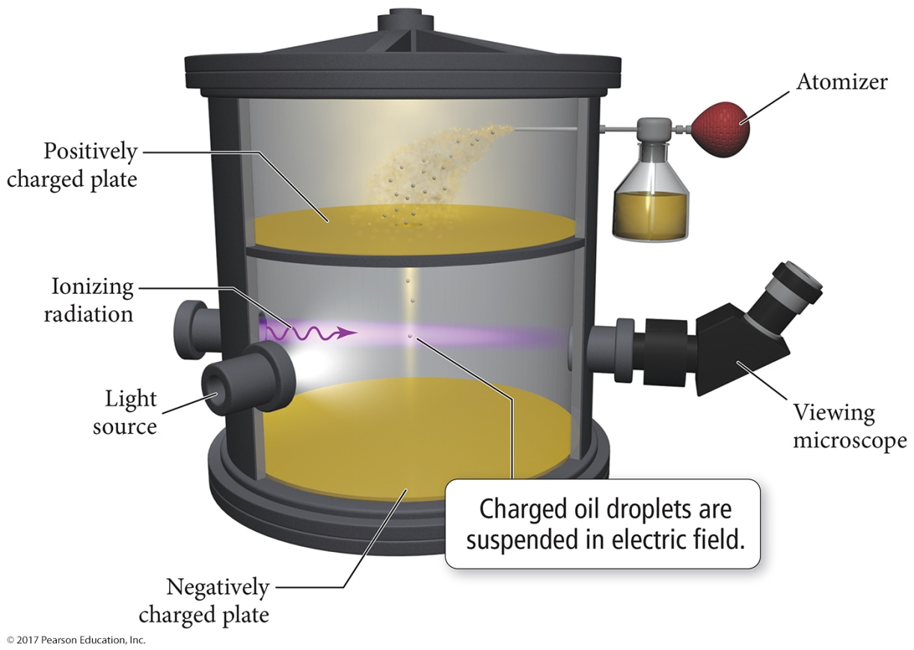
Millikan’s Oil Drop Experiment: The Charge of the Electron
American physicist Robert Millikan (1868–1953) performed his now famous oil drop experiment in which he deduced the charge of a single electron.

Slide 25
Millikan’s Oil Drop Experiment
By measuring the strength of the electric field required to halt the free fall of the drops, and by figuring out the masses of the drops themselves (determined from their radii and density), Millikan calculated the charge of each drop.
The measured charge on any drop was always a whole-number multiple of –1.96 × 10^{–19}, the fundamental charge of a single electron.

Slide 26
Millikan’s Oil Drop Experiment
With this number in hand, and knowing Thomson’s mass-to-charge ratio for electrons, we can deduce the mass of an electron:

Slide 27
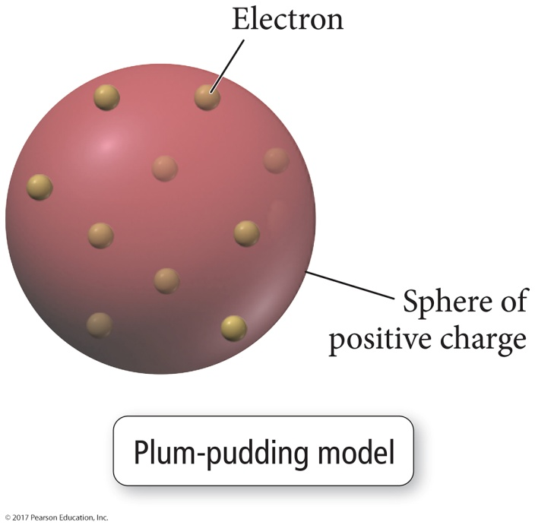
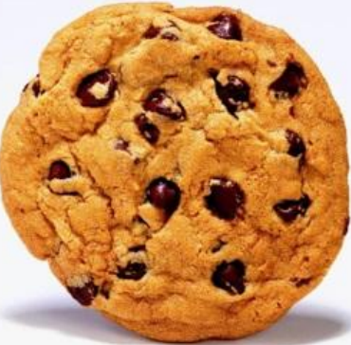
The Structure of the Atom
J. J. Thomson proposed that the negatively charged electrons were small particles held within a positively charged sphere.
This model, the most popular of the time, became known as the plum-pudding model.
Analogy

Slide 28
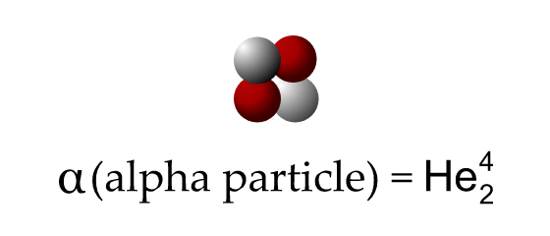
Rutherford’s Gold Foil Experiment
In 1909, Ernest Rutherford (1871–1937), who had worked under Thomson and subscribed to his plum-pudding model, performed an experiment in an attempt to confirm Thomson’s model.
In the experiment, Rutherford directed the positively charged alpha particles at an ultra thin sheet of gold foil.
Proton
Neutron

Slide 29
Rutherford’s Gold Foil Experiment

Slide 30
Rutherford’s Gold Foil Experiment
The Rutherford experiment gave an unexpected result. The majority of particles did pass directly through the foil, but some particles were deflected, and some (approximately 1 in 20,000) even bounced back.
Rutherford created a new model—a modern version of which is shown in Figure 2.6 alongside the plum-pudding model—to explain his results.

Slide 31
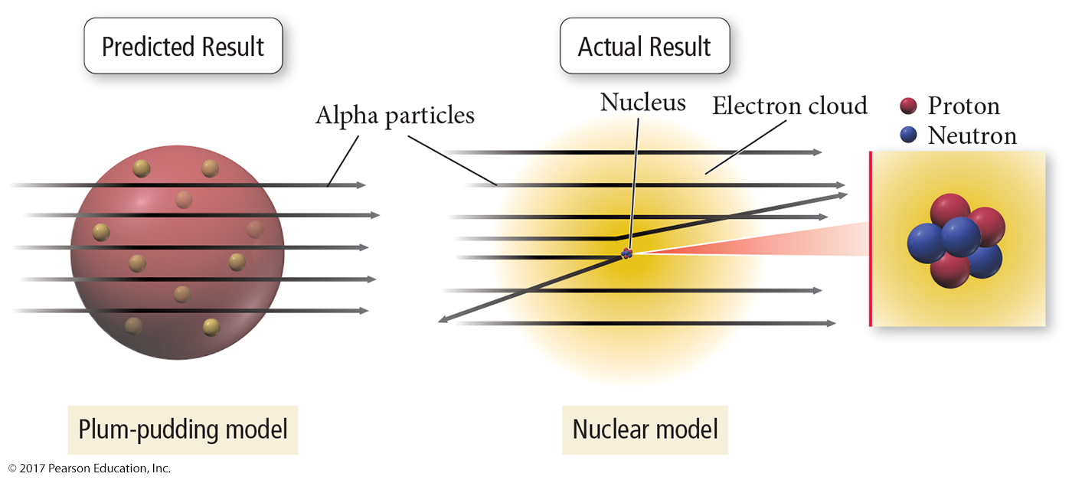
Rutherford’s Gold Foil Experiment
He concluded that matter must not be as uniform as it appears. It must contain large regions of empty space dotted with small regions of very dense matter.

Slide 32
Rutherford’s Gold Foil Experiment
Building on this idea, he proposed the nuclear theory of the atom, with three basic parts:
Most of the atom’s mass and all of its positive charge are contained in a small core called a nucleus.
Most of the volume of the atom is empty space, throughout which tiny, negatively charged electrons are dispersed.
There are as many negatively charged electrons outside the nucleus as there are positively charged particles (named protons) within the nucleus, so that the atom is electrically neutral.

Slide 33
The Neutrons
Although Rutherford’s model was highly successful, scientists realized that it was incomplete.
Later work by Rutherford and one of his students, British scientist James Chadwick (1891–1974), demonstrated that the previously unaccounted for mass was due to neutrons, neutral particles within the nucleus.

Slide 34
The Neutrons
The mass of a neutron is similar to that of a proton.
However, a neutron has no electrical charge.
The helium atom is four times as massive as the hydrogen atom because it contains two protons and two neutrons.
Hydrogen, on the other hand, contains only one proton and no neutrons.

Slide 35
Subatomic Particles
All atoms are composed of the same subatomic particles:
Protons
Neutrons
Electrons
Protons and neutrons, as we saw earlier, have nearly identical masses.
The mass of the proton is 1.67262 × 10^{–27} kg.
The mass of the neutron is 1.67493 × 10^{–27} kg.
The mass of the electron is 0.00091 × 10^{–27} kg.

Slide 36
Subatomic Particles
The charge of the proton and the electron are equal in magnitude but opposite in sign. The neutron has no charge.

Slide 37
Elements: Defined by Their Numbers of Protons
The most important number to the identity of an atom is the number of protons in its nucleus.
The number of protons defines the element.
The number of protons in an atom’s nucleus is its atomic number and is given the symbol Z.

Slide 38
Elements: Defined by Their Numbers of Protons

Slide 39
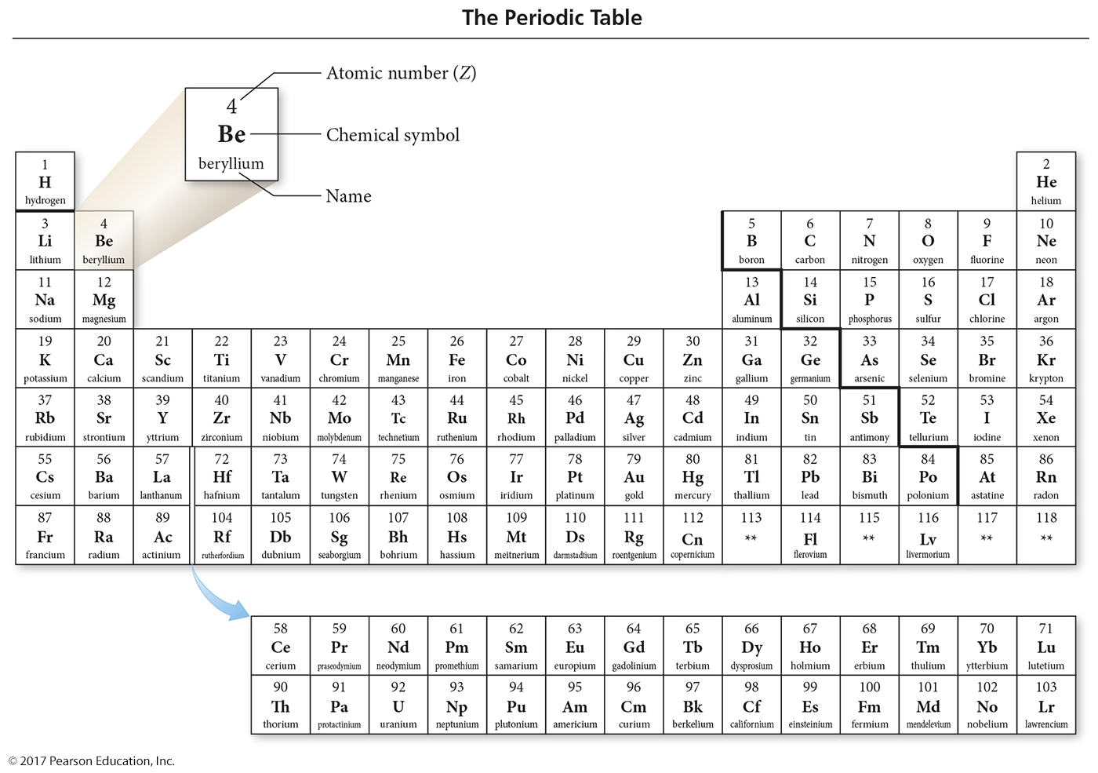
Periodic Table

Slide 40
Periodic Table
Each element is identified by a unique atomic number and with a unique chemical symbol.
The chemical symbol is either a one- or two-letter abbreviation listed directly below its atomic number on the periodic table.
The chemical symbol for helium is He.
The chemical symbol for carbon is C.
The chemical symbol for nitrogen is N.

Slide 41
Isotopes: Varied Number of Neutrons
All atoms of a given element have the same number of protons; however, they do not necessarily have the same number of neutrons.
For example, all neon atoms contain 10 protons, but they may contain 10, 11, or 12 neutrons. All three types of neon atoms exist, and each has a slightly different mass.
Atoms with the same number of protons but a different number of neutrons are called isotopes.

Slide 42
Isotopes: Varied Number of Neutrons
The relative amount of each different isotope in a naturally occurring sample of a given element is roughly constant.
These percentages are called the natural abundance of the isotopes.
Advances in mass spectrometry have allowed accurate measurements that reveal small but significant variations in the natural abundance of isotopes for many elements.

Slide 43
Isotopes: Varied Number of Neutrons
The sum of the number of neutrons and protons in an atom is its mass number and is represented by the symbol A.
A = number of protons (p) + number of neutrons (n)
X is the chemical symbol, A is the mass number, and Z is the atomic number.

Slide 44
Isotopes: Varied Number of Neutrons
A second common notation for isotopes is the chemical symbol (or chemical name) followed by a dash and the mass number of the isotope.

Slide 45
Isotopes: Varied Number of Neutrons

Slide 46
Ions: Losing and Gaining Electrons
The number of electrons in a neutral atom is equal to the number of protons in its nucleus (designated by its atomic number Z).
In a chemical change, however, atoms can lose or gain electrons and become charged particles called ions.
Positively charged ions, such as Na⁺, are called cations.
Negatively charged ions, such as F–, are called anions.

Slide 47
Finding Patterns: The Periodic Law and the Periodic Table
In 1869, Mendeleev noticed that certain groups of elements had similar properties.
He found that when elements are listed in order of increasing mass, these similar properties recurred in a periodic pattern.
To be periodic means to exhibit a repeating pattern.

Slide 48
The Periodic Law
Mendeleev summarized these observations in the periodic law:
When the elements are arranged in order of increasing mass, certain sets of properties recur periodically.

Slide 49
Periodic Table
Mendeleev organized the known elements in a table.
He arranged the rows so that elements with similar properties fall in the same vertical columns.

Slide 50
Periodic Table
Mendeleev’s table contained some gaps, which allowed him to predict the existence (and even the properties) of yet undiscovered elements.
Mendeleev predicted the existence of an element he called eka-silicon.
In 1886, eka-silicon was discovered by German chemist Clemens Winkler (1838–1904), who named it germanium.

Slide 51
Modern Periodic Table
In the modern table, elements are listed in order of increasing atomic number rather than increasing relative mass.
The modern periodic table also contains more elements than Mendeleev’s original table because more have been discovered since his time.

Slide 52
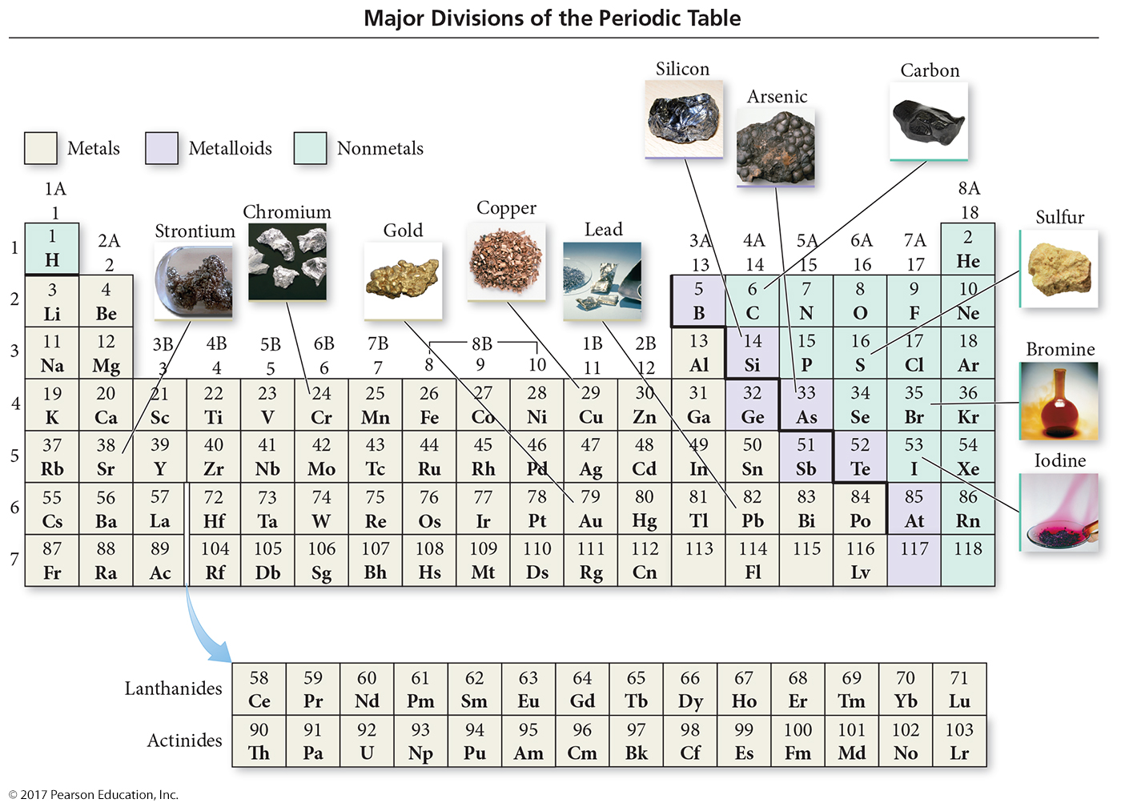
Modern Periodic Table

Slide 53
Classification of Elements
Elements in the periodic table are classified as the following:
Metals
Nonmetals
Metalloids

Slide 54
Metals
Metals, on the lower-left side and middle of the periodic table, share some common properties.
Good conductors of heat and electricity
Can be pounded into flat sheets (malleability)
Can be drawn into wires (ductility)
Often shiny
Tend to lose electrons when they undergo chemical changes
Chromium, copper, strontium, and lead are typical metals.

Slide 55
Nonmetals
Nonmetals lie on the upper-right side of the periodic table.
There are a total of 17 nonmetals:
Five are solids at room temperature (C, P, S, Se, and I).
One is a liquid at room temperature (Br).
Eleven are gases at room temperature (H, He, N, O, F, Ne, Cl, Ar, Kr, Xe, and Rn).

Slide 56
Nonmetals
Nonmetals as a whole tend to have these properties:
Poor conductors of heat and electricity
Not ductile and not malleable
Gain electrons when they undergo chemical changes
Oxygen, carbon, sulfur, bromine, and iodine are nonmetals.

Slide 57
Metalloids
Metalloids are sometimes called semimetals.
They are elements that lie along the zigzag diagonal line that divides metals and nonmetals.
They exhibit mixed properties.
Several metalloids are also classified as semiconductors because of their intermediate (and highly temperature-dependent) electrical conductivity.

Slide 58
Periodic Table
The periodic table can also be divided into
main-group elements, whose properties tend to be largely predictable based on their position in the periodic table.
transition elements or transition metals, whose properties tend to be less predictable based simply on their position in the periodic table.

Slide 59
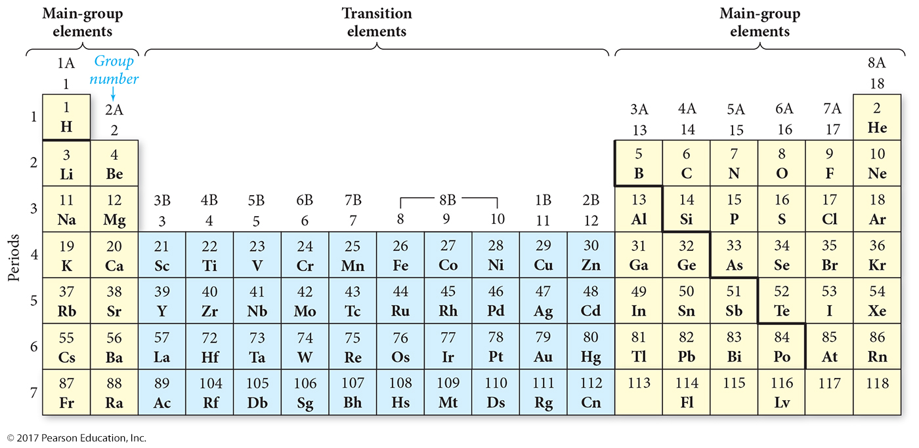
Periodic Table

Slide 60
Periodic Table
The periodic table is divided into vertical columns and horizontal rows.
Each vertical column is called a group (or family).
Each horizontal row is called a period.
There are a total of 18 groups and 7 periods.
The groups are numbered 1–18 (or the A and B grouping).

Slide 61
Periodic Table
Main-group elements are in columns labeled with a number and the letter A (1A–8A or groups 1, 2, and 13–18).
Transition elements are in columns labeled with a number and the letter B (or groups 3–12).

Slide 62
Noble Gas
The elements within a group usually have similar properties.
The group 8A elements, called the noble gases, are mostly unreactive.
The most familiar noble gas is probably helium, used to fill buoyant balloons. Helium is chemically stable—it does not combine with other elements to form compounds—and is therefore safe to put into balloons.
Other noble gases are neon (often used in electronic signs), argon (a small component of our atmosphere), krypton, and xenon.

Slide 63
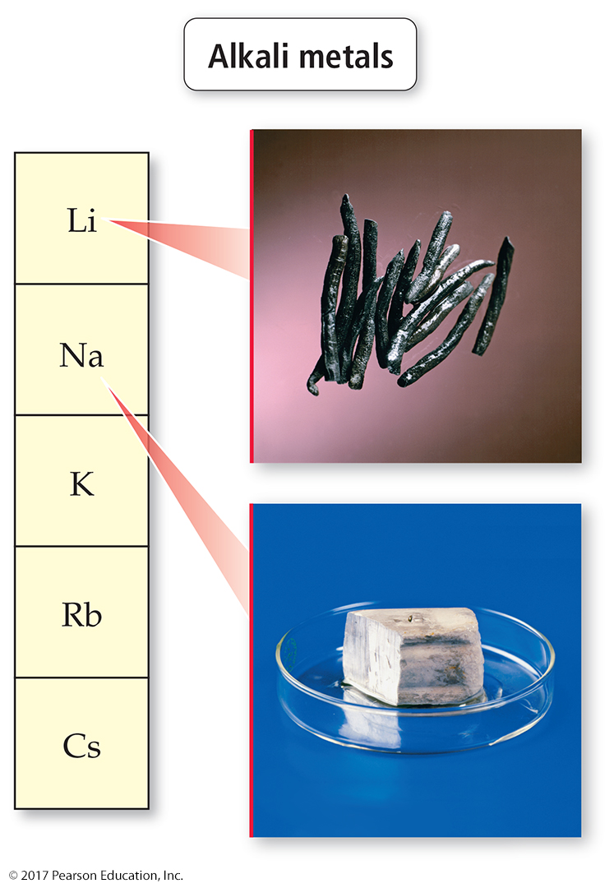
Alkali
The group 1A elements, called the alkali metals, are all reactive metals.
A marble-sized piece of sodium explodes violently when dropped into water.
Lithium, potassium, and rubidium are also alkali metals.

Slide 64
Alkaline Earth Metals
The group 2A elements are called the alkaline earth metals.
They are fairly reactive but not quite as reactive as the alkali metals.
Calcium, for example, reacts fairly vigorously with water.
Other alkaline earth metals include magnesium (a common low-density structural metal), strontium, and barium.

Slide 65
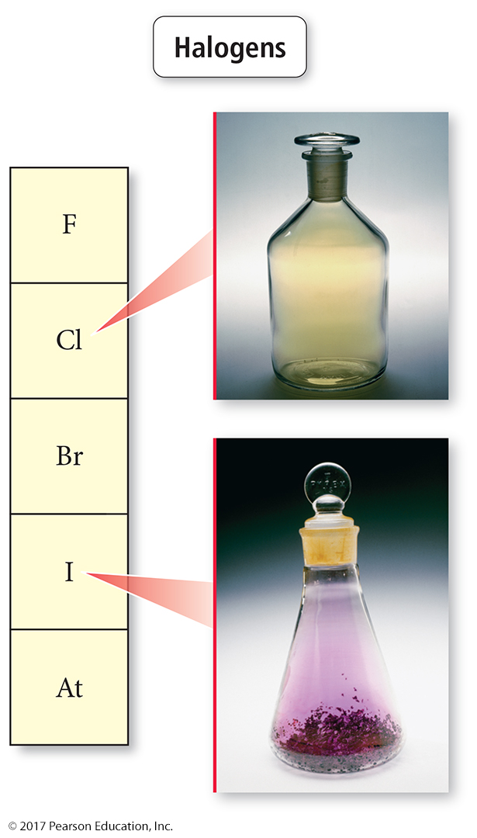
Halogens
The group 7A elements, the halogens, are very reactive nonmetals.
They are always found in nature as a salt.
Fluorine, a pale-yellow gas
Chlorine, a greenish-yellow gas with a pungent odor
Bromine, a red-brown liquid that easily evaporates into a gas
Iodine, a purple solid

Slide 66
Ions and the Periodic Table
A main-group metal tends to lose electrons, forming a cation with the same number of electrons as the nearest noble gas.
A main-group nonmetal tends to gain electrons, forming an anion with the same number of electrons as the nearest noble gas.

Slide 67
Ions and the Periodic Table
In general, the alkali metals (group 1A) have a tendency to lose one electron and form 1+ ions.
The alkaline earth metals (group 2A) tend to lose two electrons and form 2+ ions.
The halogens (group 7A) tend to gain one electron and form 1– ions.
The oxygen family nonmetals (group 6A) tend to gain two electrons and form 2– ions.

Slide 68
Ions and the Periodic Table
For the main-group elements that form cations with a predictable charge, the charge is equal to the group number.
For main-group elements that form anions with a predictable charge, the charge is equal to the group number minus eight.
Transition elements may form various different ions with different charges.

Slide 69
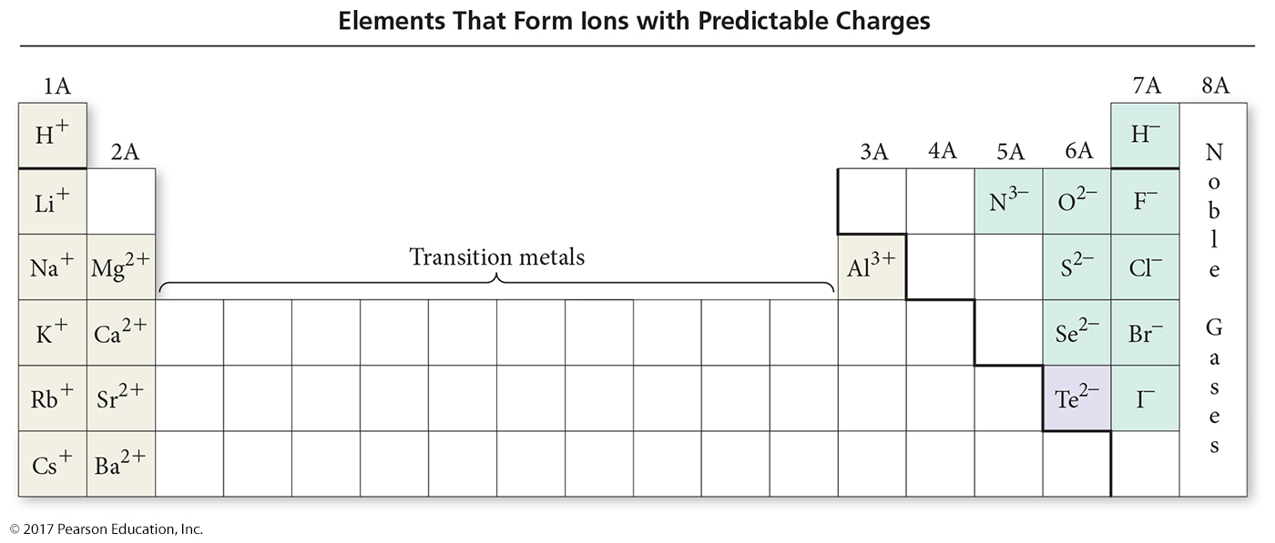
Ions and the Periodic Table

Slide 70
Atomic Mass: The Average Mass of an Element’s Atoms
Atomic mass is sometimes called atomic weight or standard atomic weight.
The atomic mass of each element is directly beneath the element’s symbol in the periodic table.
It represents the average mass of the isotopes that compose that element, weighted according to the natural abundance of each isotope.

Slide 71
Example: Atomic Mass
Naturally occurring chlorine consists of 75.77% chlorine-35 atoms (mass 34.97 amu) and 24.23% chlorine-37 atoms (mass 36.97 amu). Calculate its atomic mass.
Solution:
Convert the percent abundance to decimal form and multiply each with its isotopic mass.
Cl-37 = 0.2423(36.97 amu) = 8.9578 amu
Cl-35 = 0.7577(34.97 amu) = 26.4968 amu
Atomic Mass Cl = 8.9578 + 26.4968 = 35.45 amu

Slide 72
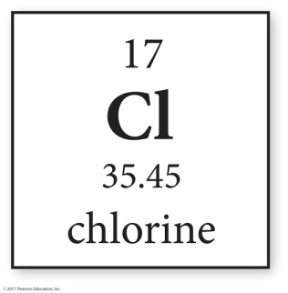
Atomic Mass
In general, we calculate the atomic mass with the following equation:

Slide 73
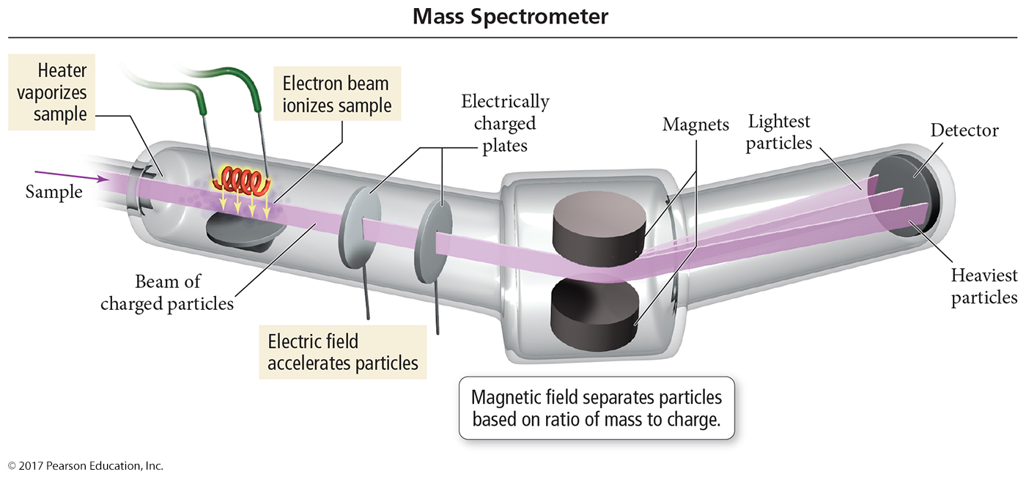
Mass Spectrometry

Slide 74
Molar Mass: Counting Atoms by Weighing Them
As chemists, we often need to know the number of atoms in a sample of a given mass. Why? Because chemical processes happen between particles.
Therefore, if we want to know the number of atoms in anything of ordinary size, we count them by weighing.

Slide 75
The Mole: A Chemist’s “Dozen”
When we count large numbers of objects, we often use units such as
1 dozen objects = 12 objects.
1 gross objects = 144 objects.
The chemist’s “dozen” is the mole (abbreviated mol). A mole is the measure of material containing 6.02214 × 10²³ particles:
1 mole = 6.02214 × 10²³ particles
This number is Avogadro’s number.

Slide 76
The Mole
First thing to understand about the mole is that it can specify Avogadro’s number of anything.
For example, 1 mol of marbles corresponds to 6.02214 × 10²³ marbles.
1 mol of sand grains corresponds to 6.02214 × 10²³ sand grains.
One mole of anything is 6.02214 × 10²³ units of that thing.

Slide 77
The Mole
The second, and more fundamental, thing to understand about the mole is how it gets its specific value.
The value of the mole is equal to the number of atoms in exactly 12 grams of pure C-12.
12 g C = 1 mol C atoms = 6.022 × 10²³ C atoms

Slide 78
Converting between Number of Moles and Number of Atoms
Converting between number of moles and number of atoms is similar to converting between dozens of eggs and number of eggs.
For atoms, you use the conversion factor 1 mol atoms = 6.022 × 10²³ atoms.
The conversion factors take the following forms:

Slide 79
Converting between Mass and Amount (Number of Moles)
To count atoms by weighing them, we need one other conversion factor—the mass of 1 mol of atoms.
The mass of 1 mol of atoms of an element is the molar mass.
An element’s molar mass in grams per mole is numerically equal to the element’s atomic mass in atomic mass units (amu).

Slide 80
Converting between Mass and Moles
The lighter the atom, the less mass in 1 mol of atoms.

Slide 81
Converting between Mass and Moles
The molar mass of any element is the conversion factor between the mass (in grams) of that element and the amount (in moles) of that element. For carbon,

Slide 82
Conceptual Plan
We now have all the tools to count the number of atoms in a sample of an element by weighing it.
First, we obtain the mass of the sample.
Then, we convert it to the amount in moles using the element’s molar mass.
Finally, we convert it to the number of atoms using Avogadro’s number.
The conceptual plan for these kinds of calculations takes the following form:

