Slide 1
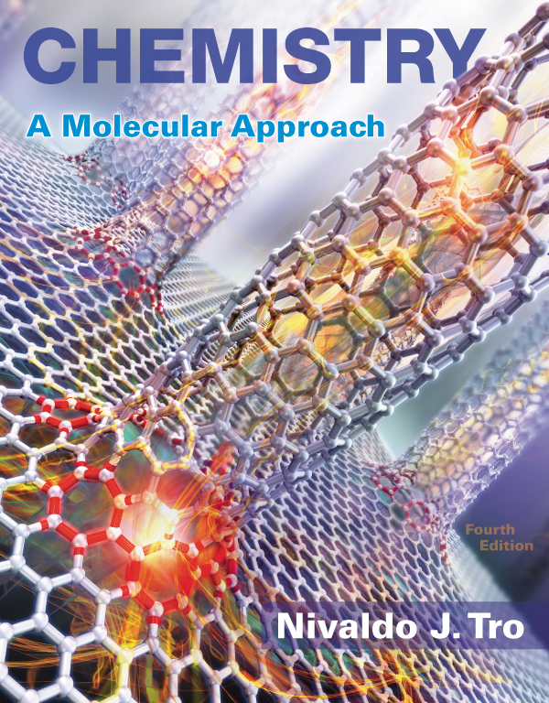
Lecture Presentation
Chapter 4
Chemical Quantities and
Aqueous Reactions

Slide 2
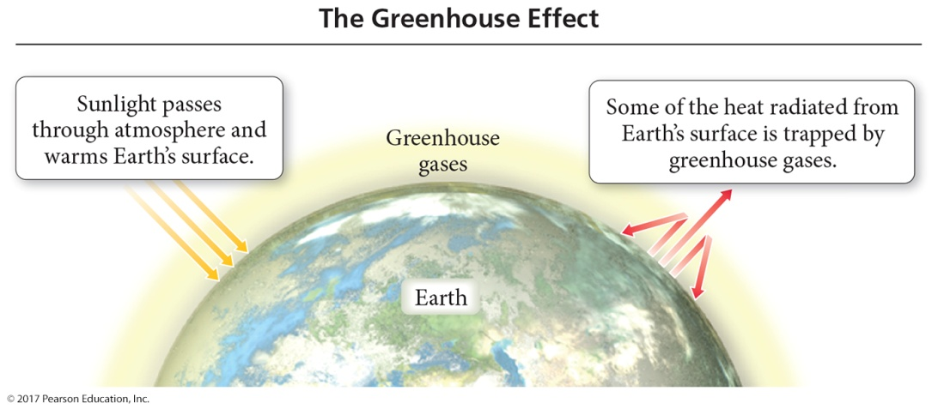
The Greenhouse Effect
The greenhouse gases in the atmosphere
  allow sunlight to enter the atmosphere.
  warm Earth’s surface.
  prevent some of the heat generated by the sunlight from escaping.
  The balance between incoming and outgoing energy from the sun determines Earth’s average temperature.

Slide 3
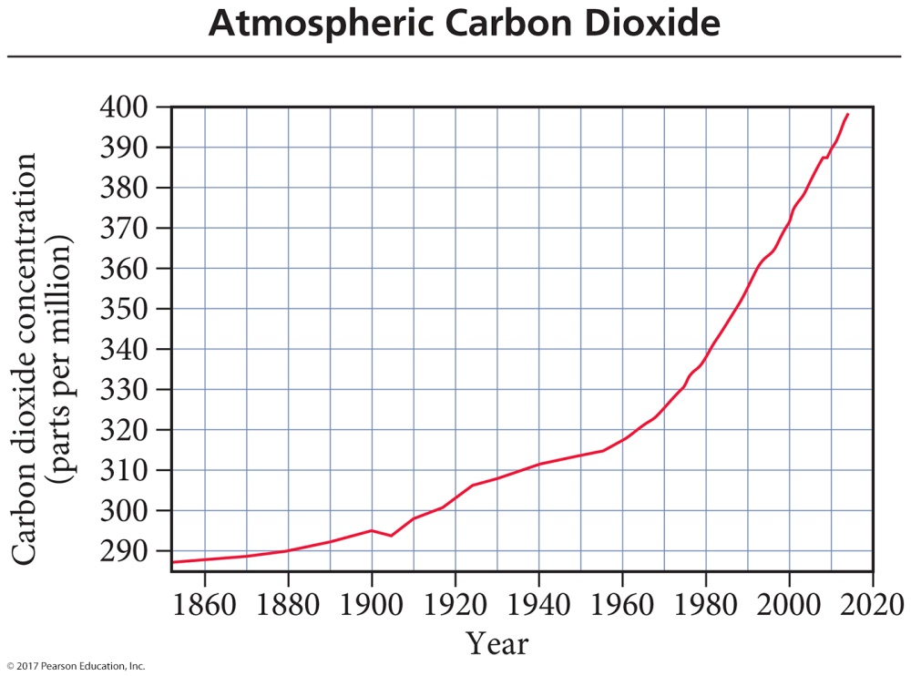
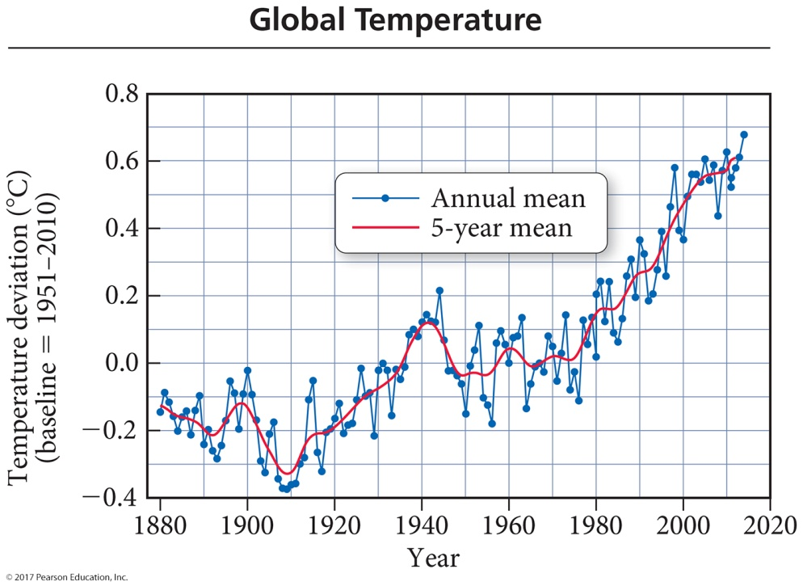
Global Warming
Scientists have measured an average 0.7 °C rise in atmospheric temperature since 1860.
During the same period, atmospheric CO₂ levels have risen 38%.
Are the two trends causal?

Slide 4
Global Warming
One source of CO₂ is the combustion reactions of fossil fuels we use to get energy.
Another source of CO₂ is volcanic action.
  How can we judge whether global warming is natural or due to our use of fossil fuels?
  2 C₈H₁₈(l) + 25 O₂(g) 16 CO₂(g) + 18 H₂O(g)

Slide 5
Reaction Stoichiometry: How Much Carbon Dioxide?
The balanced chemical equations for fossil-fuel combustion reactions provide the exact relationships between the amount of fossil fuel burned and the amount of carbon dioxide emitted.
  2 C₈H₁₈(l) + 25 O₂(g) 16 CO₂(g) + 18 H₂O(g)
  16 CO₂ molecules are produced for every
  2 molecules of octane burned.

Slide 6
Quantities in Chemical Reactions
The amount of every substance used and made in a chemical reaction is related to the amounts of all the other substances in the reaction.
  Law of conservation of mass
  Balancing equations by balancing atoms
The study of the numerical relationship between chemical quantities in a chemical reaction is called stoichiometry.

Slide 7
Reaction Stoichiometry
The coefficients in a chemical reaction specify the relative amounts in moles of each of the substances involved in the reaction.
2 C₈H₁₈(l) + 25 O₂(g) → 16 CO₂(g) + 18 H₂O(g)
  2 molecules of C₈H₁₈ react with 25 molecules of O₂ to form 16 molecules of CO₂ and 18 molecules of H₂O.
  2 moles of C₈H₁₈ react with 25 moles of O₂ to form 16 moles of CO₂ and 18 moles of H₂O.
2 mol C₈H₁₈ : 25 mol O₂ : 16 mol CO₂ : 18 mol H₂O

Slide 8

Making Pizza
The number of pizzas you can make depends on the amount of the ingredients you use.
  This relationship can be expressed mathematically.
1 crust : 5 oz sauce : 2 cups cheese : 1 pizza
We can compare the amount of pizza that can be made from 10 cups of cheese:
  2 cups cheese : 1 pizza, then,
1 crust + 5 oz tomato sauce + 2 cups cheese → 1 pizza

Slide 9
Making Molecules: Mole-to-Mole Conversions
We use the ratio from the balanced chemical equation in the same way that we used the ratio from the pizza recipe.
    The ratio of the coefficients acts as a conversion factor between the amount in moles of the reactants and products.
    The ratio acts as a conversion factor between the amount in moles of the reactant, C₈H₁₈, and the amount in moles of the product, CO₂.
  2 C₈H₁₈(l) + 25 O₂(g) → 16 CO₂(g) + 18 H₂O(g)
stoichiometric ratio: 2 moles C₈H₁₈ : 16 moles CO₂

Slide 10

Mole-to-Mole Conversions
Suppose we burn 22.0 moles of C₈H₁₈; how many moles of CO₂ form?
  2 C₈H₁₈(l) + 25 O₂(g) → 16 CO₂(g) + 18 H₂O(g)
stoichiometric ratio: 2 moles C₈H₁₈ : 16 moles CO₂
The combustion of 22.0 moles of C₈H₁₈ adds 176 moles of CO₂ to the atmosphere.

Slide 11
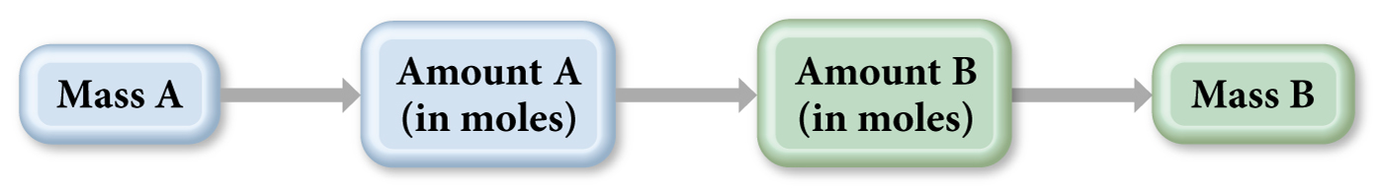
Making Molecules: Mass-to-Mass Conversions
The world burned the equivalent of 3.7×10¹⁵ g of gasoline (octane) in 2013. We can estimate the mass of CO₂ produced based on the flow chart below.
We use molar mass as a conversion factor between the mass given and amount in moles.
We use coefficients as the conversion factor between the reactant, C₈H₁₈, and the amount in moles of the product, CO₂, and then molar mass as the conversion factor to get the mass of CO₂ produced.

Slide 12
Mass-to-Mass Conversions
If we burn 3.7×10¹⁵ g C₈H₁₈, how many grams of CO₂ form?
  2 C₈H₁₈(l) + 25 O₂(g) → 16 CO₂(g) + 18 H₂O(g)
The combustion 3.7×10¹⁵ g C₈H₁₈ adds 1.1×10¹⁶ g CO₂ to the atmosphere.
molar mass: C₈H₁₈ 114.22 g/mol, CO₂ 44.01 g/mol
stoichiometric ratio: 2 moles C₈H₁₈ : 16 moles CO₂

Slide 13


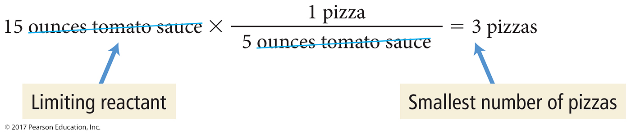
Limiting Reactant, Theoretical Yield, Percent Yield
Recall our pizza recipe:
1 crust + 5 oz tomato sauce + 2 cups cheese → 1 pizza
If we have 4 crusts, 10 cups of cheese, and 15 oz tomato sauce, how many pizzas can we make?
We have enough crusts to make
We have enough cheese to make
We have enough tomato sauce to make

Slide 14
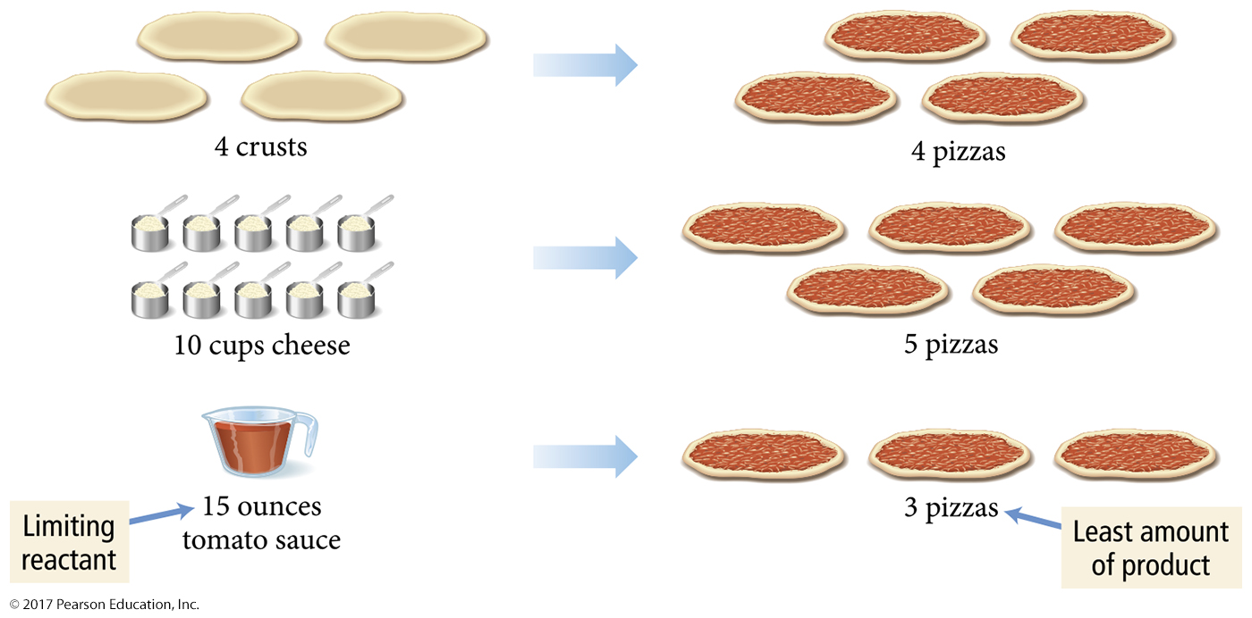
Limiting Reactant
We have enough crusts for four pizzas, enough cheese for five pizzas, but enough tomato sauce for only three pizzas.
  We can make only three pizzas. The tomato sauce limits how many pizzas we can make.

Slide 15
Theoretical Yield
Tomato sauce is the limiting reactant, the reactant that makes the least amount of product.
    The limiting reactant is also known as the limiting reagent.
The maximum number of pizzas we can make depends on this ingredient. In chemical reactions, we call this the theoretical yield.
    This is the amount of product that can be made in a chemical reaction based on the amount of limiting reactant.
    The ingredient that makes the least amount of pizza determines how many pizzas you can make
    (theoretical yield).

Slide 16
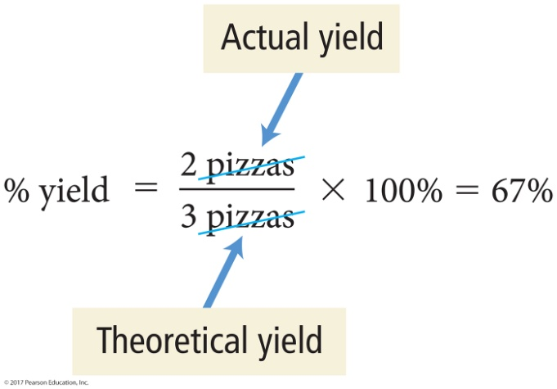
Percent Yield
Assume that while making pizzas, we burn a pizza, drop one on the floor, or other uncontrollable events happen so that we make only two pizzas. The actual amount of product made in a chemical reaction is called the
actual yield.
We can determine the efficiency of making pizzas by calculating the percentage of the maximum number of pizzas we actually make. In chemical reactions, we call this the percent yield.

Slide 17
In a Chemical Reaction
For reactions with multiple reactants, it is likely that one of the reactants will be completely used before the others.
When this reactant is used up, the reaction stops and no more product is made.
The reactant that limits the amount of product is called the limiting reactant.
  It is sometimes called the limiting reagent.
  The limiting reactant gets completely consumed.
Reactants not completely consumed are called excess reactants.
The amount of product that can be made from the limiting reactant is called the theoretical yield.

Slide 18
Summarizing Limiting Reactant and Yield
The limiting reactant (or limiting reagent) is the reactant that is completely consumed in a chemical reaction and limits the amount of product.
The reactant in excess is any reactant that occurs in a quantity greater than is required to completely react with the limiting reactant.

Slide 19

Summarizing Limiting Reactant and Yield
The theoretical yield is the amount of product that can be made in a chemical reaction based on the amount of limiting reactant.
The actual yield is the amount of product actually produced by a chemical reaction.
The percent yield is calculated as follows:

Slide 20
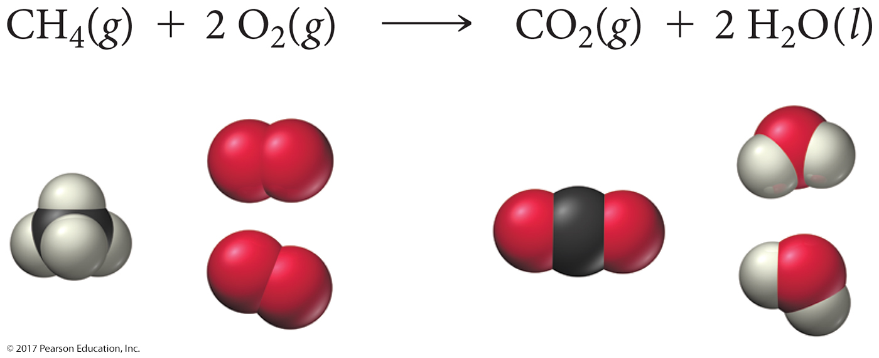
Calculating Limiting Reactant, Theoretical Yield, and Percent Yield
Recall our balanced equation for the combustion of methane:
CH₄(g) + 2 O₂(g) → CO₂(g) + 2 H₂O(g)
  Our balanced equation for the combustion of methane implies that every one molecule of CH₄ reacts with two molecules of O₂.

Slide 21
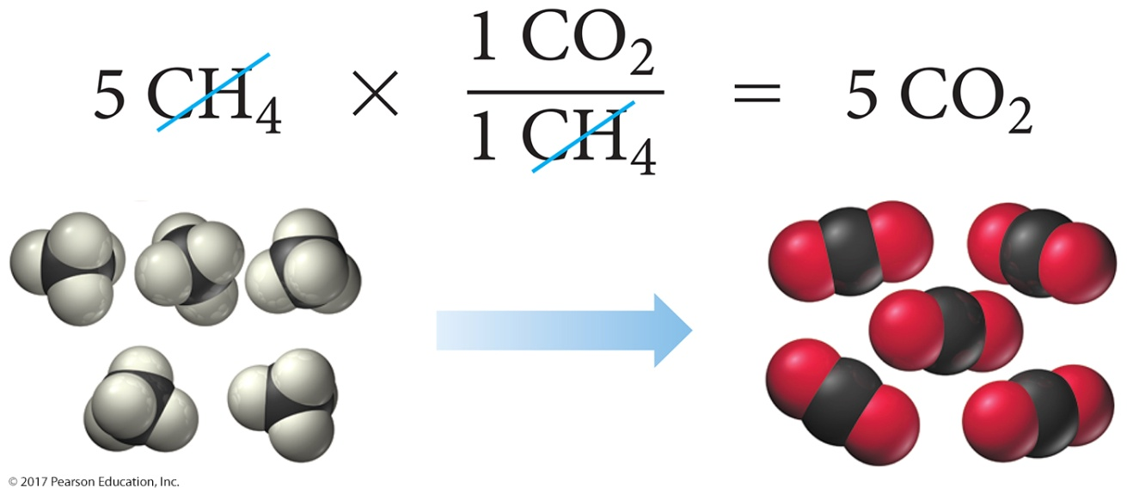
Combustion of Methane
If we have five molecules of CH₄ and eight molecules of O₂, which is the limiting reactant?
CH₄(g) + 2 O₂(g) → CO₂(g) + 2 H₂O(g)
  First we calculate the number of CO₂ molecules that can be made from five CH₄ molecules.

Slide 22
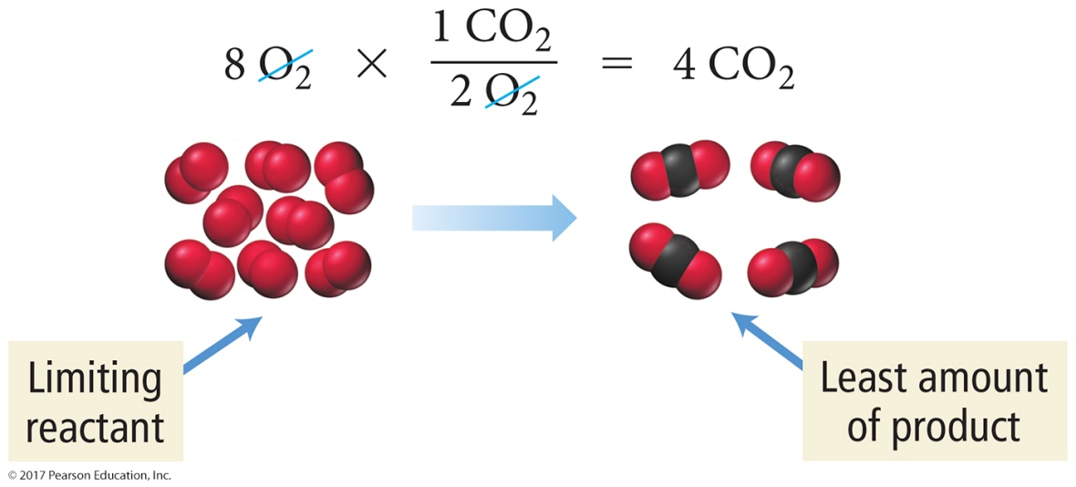
Combustion of Methane
  Then we calculate the number of CO₂ molecules that can be made from eight O₂ molecules.
  We have enough CH₄ to make five CO₂ molecules and four CO₂ molecules.
  Therefore, O₂ is the limiting reactant, and
  four CO₂ molecules is the theoretical yield.
  CH₄ is in excess.

Slide 23
Calculating Limiting Reactant, Theoretical Yield, and Percent Yield from Reactant Masses
When working in the lab, we normally measure reactant quantities in grams.
To find the limiting reactant and theoretical yield, we must first convert grams to moles.

Slide 24
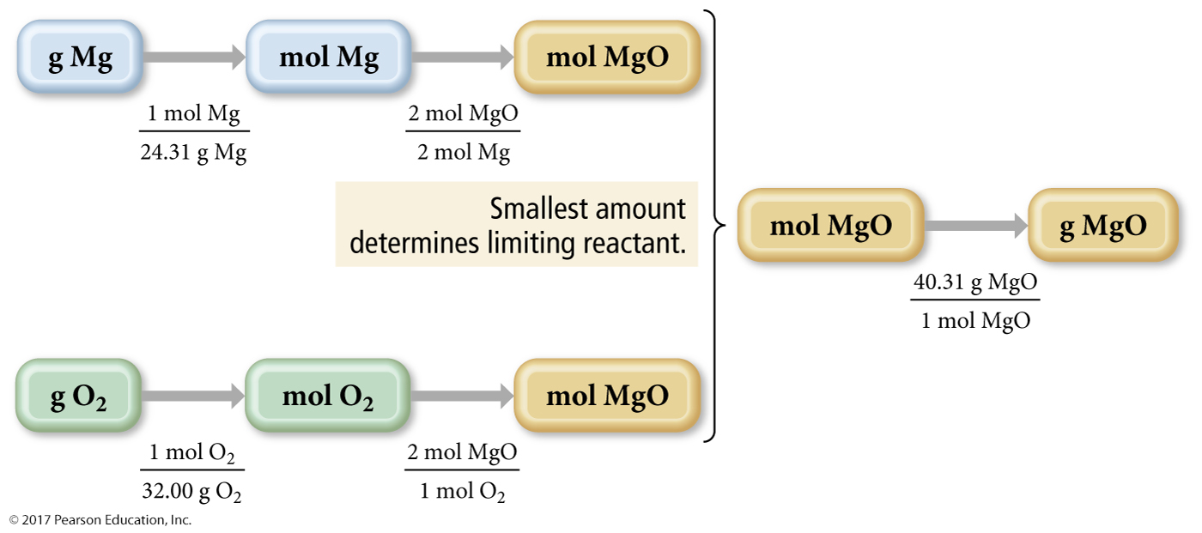
Calculating Limiting Reactant, Theoretical Yield, and Percent Yield from Reactant Masses
A reactant mixture contains 42.5 g Mg and 33.8 g O₂. What is the limiting reactant and theoretical yield?
2 Mg(s) + O₂(g) → 2 MgO(s)

Slide 25
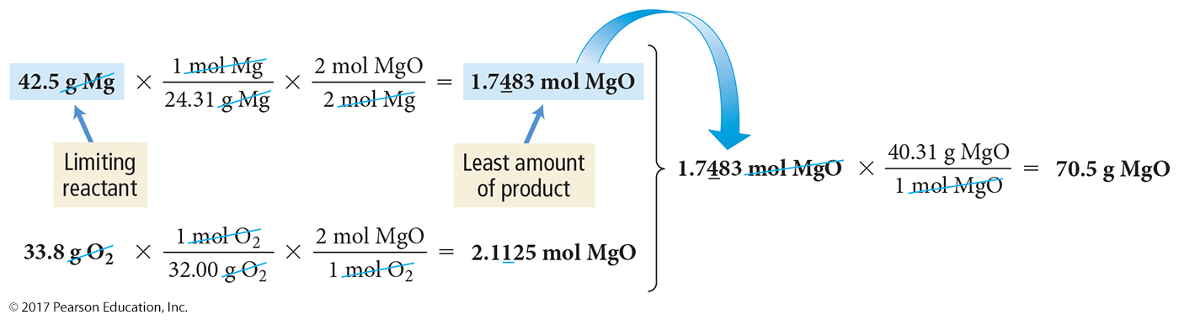
Calculating Limiting Reactant, Theoretical Yield, and Percent Yield from Reactant Masses

Slide 26
Solution Concentration and Solution Stoichiometry
When table salt is mixed with water, it seems to disappear or become a liquid; the mixture is homogeneous.
      The salt is still there, as you can tell from the taste or simply boiling away the water.
Homogeneous mixtures are called solutions.
The majority component is the solvent.
The minority component is the solute.
A solution in which water is the solvent is an aqueous solution.

Slide 27
Solution Concentration
Because solutions are mixtures, the composition can vary from one sample to another.
  Pure substances have constant composition.
  Saltwater samples from different seas or lakes have different amounts of salt.
So, to describe solutions accurately, we quantify the amount of solute relative to solvent, or concentration of solution.

Slide 28
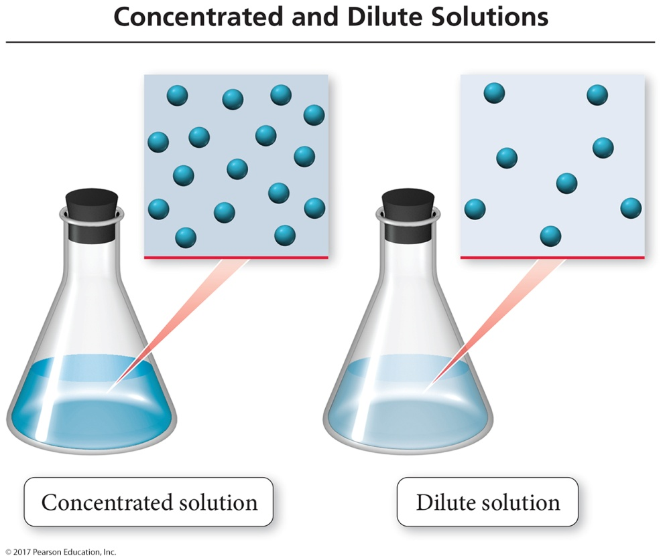
Solution Concentration
Solutions are often described quantitatively, as dilute or concentrated.
Dilute solutions have a small amount of solute compared to solvents.
Concentrated solutions have a large amount of solute compared to solvents.

Slide 29

Solution Concentration: Molarity
A common way to express solution concentration is molarity (M).
  Molarity is the amount of solute (in moles) divided by the volume of solution (in liters).

Slide 30
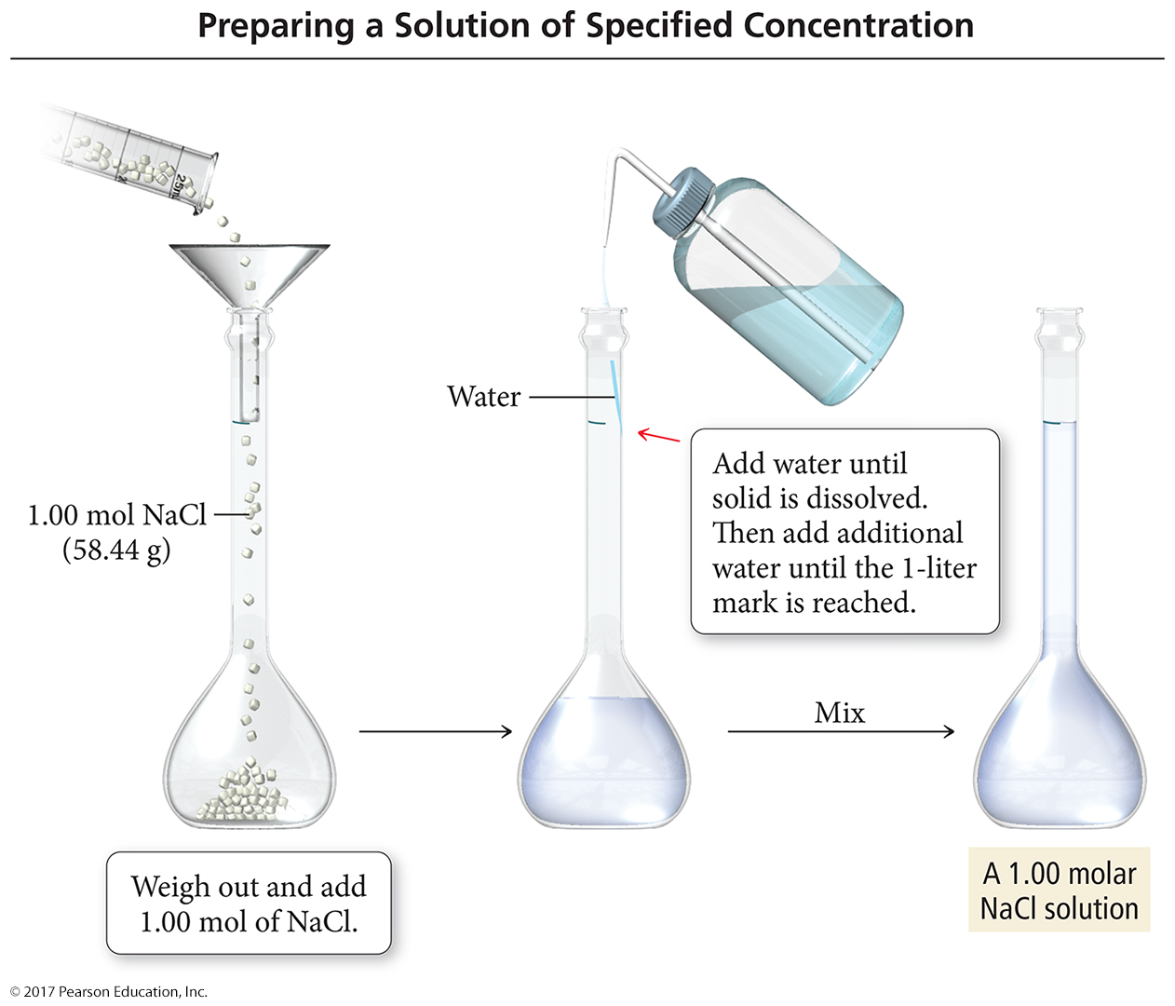
Preparing 1 L of a 1.00 M NaCl Solution

Slide 31
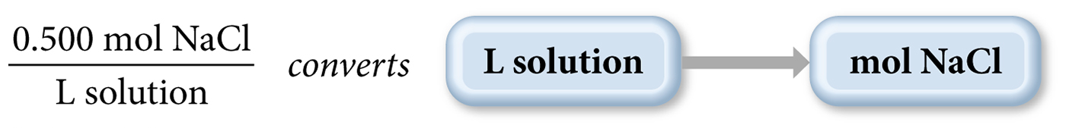
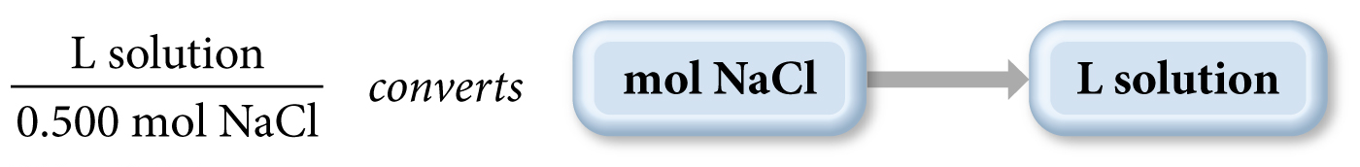
Using Molarity in Calculations
We can use the molarity of a solution as a conversion factor between moles of the solute and liters of the solution.
  For example, a 0.500 M NaCl solution contains 0.500 mol NaCl for every liter of solution.

Slide 32
Solution Dilution
Often, solutions are stored as concentrated
stock solutions.
To make solutions of lower concentrations from these stock solutions, more solvent
is added.
  The amount of solute doesn’t change, just the volume of solution:
  moles solute in solution 1 = moles solute in solution 2
The concentrations and volumes of the stock and new solutions are inversely proportional:
M₁∙V₁ = M₂∙V₂

Slide 33
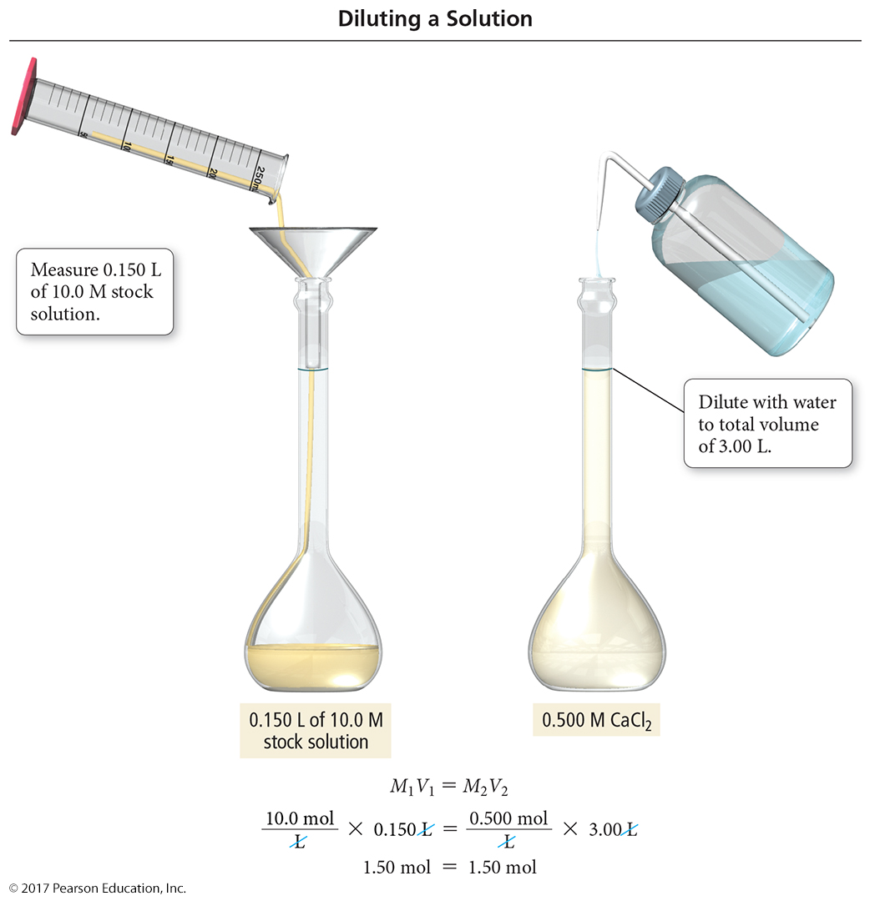
Preparing 3.00 L of 0.500 M CaCl₂ from a 10.0 M Stock Solution

Slide 34
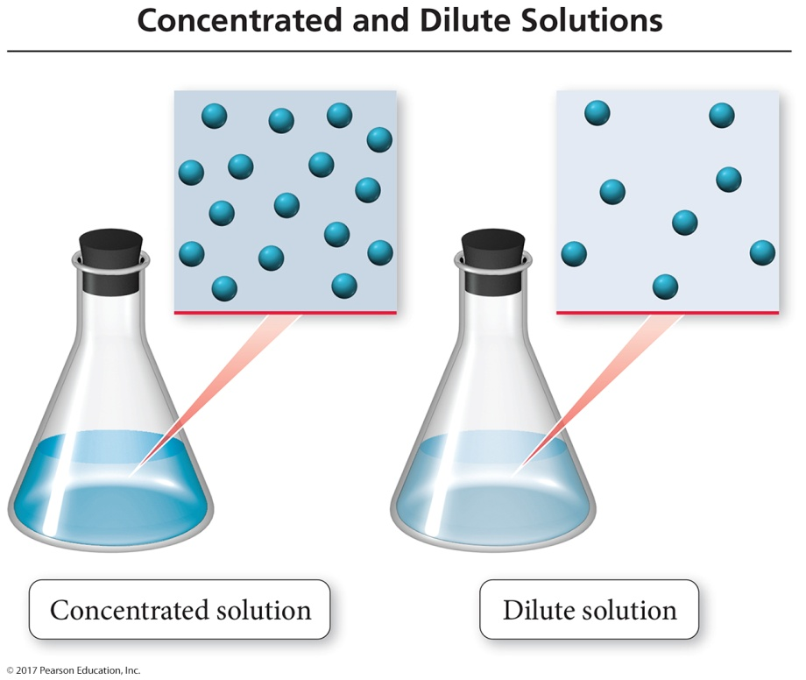
Solution Stoichiometry
Because molarity relates the moles of solute to the liters of solution, it can be used to convert between amount of reactants and/or products in a chemical reaction.
  The general conceptual plan for these kinds of calculations begins with the volume of a reactant or product.

Slide 35
Types of Aqueous Solutions and Solubility
Consider two familiar aqueous solutions: saltwater and sugar water.
  Saltwater is a homogeneous mixture of NaCl and H₂O.
  Sugar water is a homogeneous mixture of C₁₂H₂₂O₁₁ and H₂O.
As you stir either of these two substances into the water, it seems to disappear.
  How do solids such as salt and sugar dissolve in water?

Slide 36
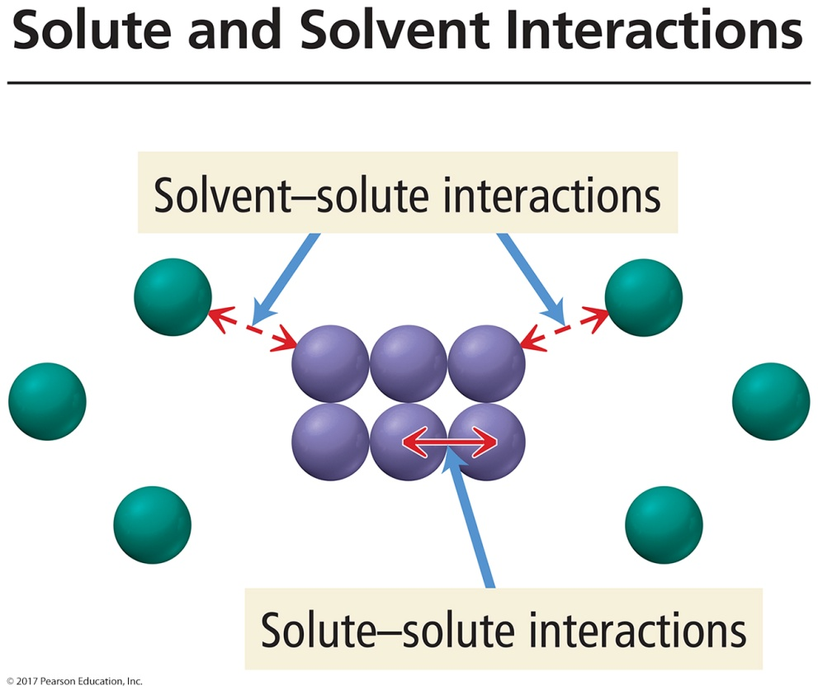
What Happens When a Solute Dissolves?
There are attractive forces between the solute particles holding them together.
There are also attractive forces between the solvent molecules.
When we mix the solute with the solvent, there are attractive forces between the solute particles and the solvent molecules.
If the attractions between solute and solvent are strong enough, the solute will dissolve.

Slide 37
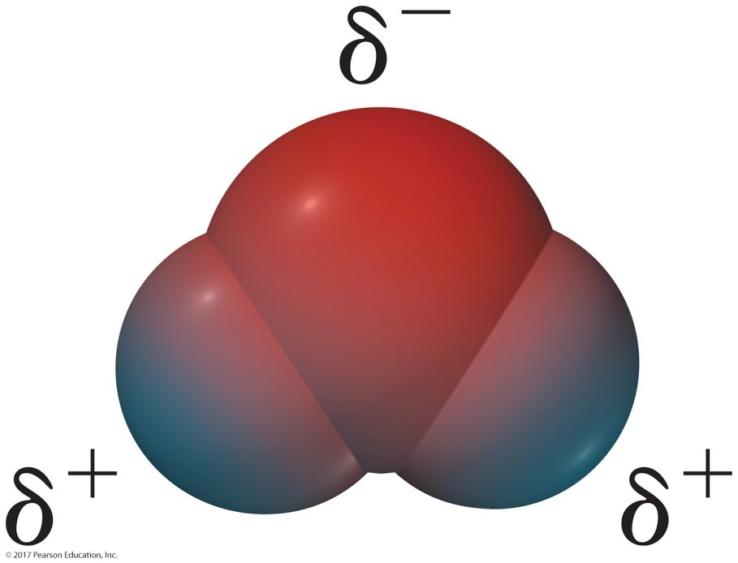
Charge Distribution in a Water Molecule
There is an uneven distribution of electrons within the water molecule.
  This causes the oxygen side of the molecule to have a partial negative charge (δ–) and the hydrogen side to have a partial positive
  charge (δ⁺).

Slide 38
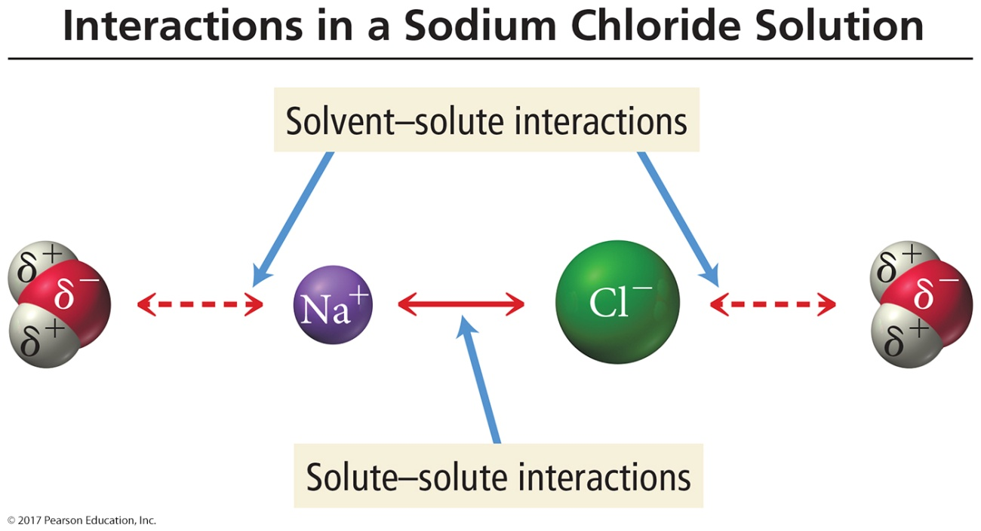
Solute and Solvent Interactions in a Sodium Chloride Solution
When sodium chloride is put into water, the attraction of Na⁺ and Cl– ions to water molecules competes with the attraction among the oppositely charged ions themselves.

Slide 39
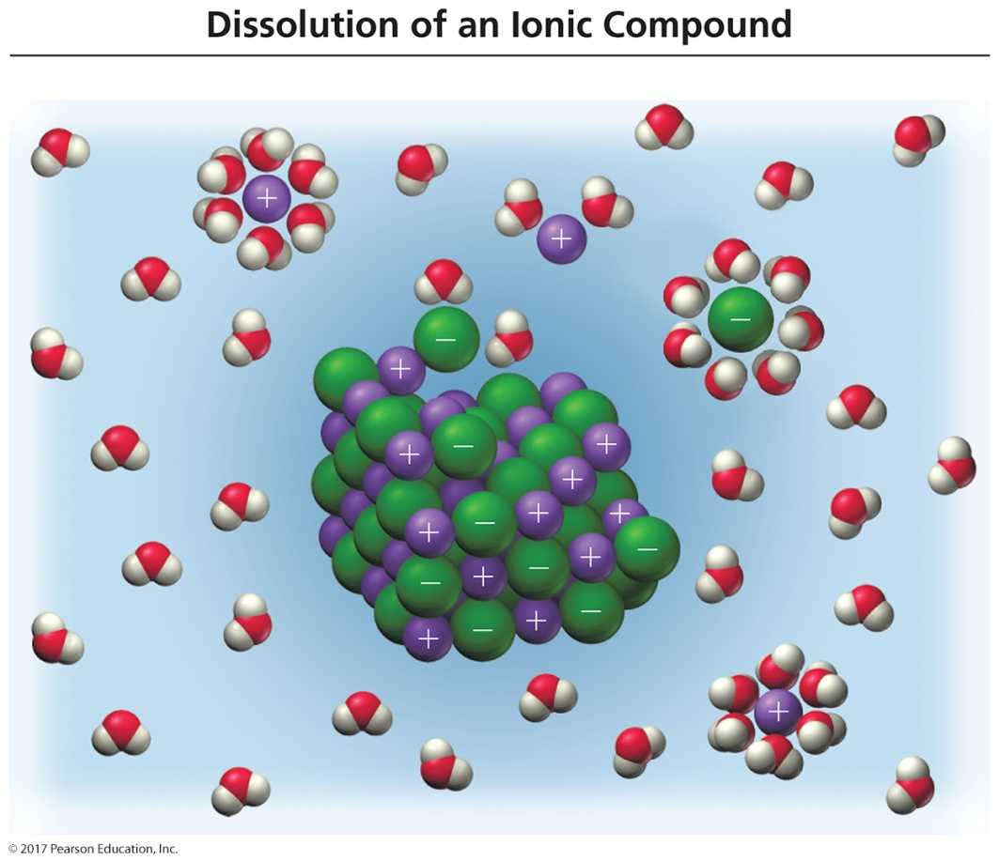
Dissolution of Ionic Compounds
Each ion is attracted to the surrounding water molecules and pulled off and away from the crystal.
When it enters the solution, the ion is surrounded by water molecules, insulating it from other ions.
The result is a solution with free-moving, charged particles able to conduct electricity.

Slide 40
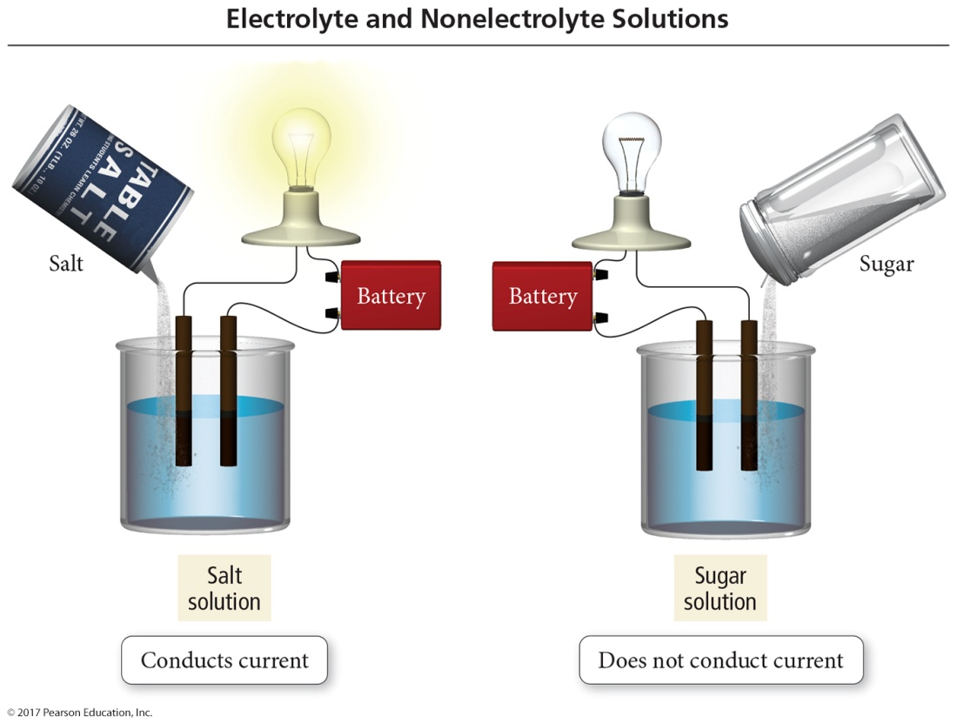
Electrolyte and Nonelectrolyte Solutions
Materials that dissolve in water to form a solution containing ions will conduct electricity. These are called electrolytes.
Materials that dissolve in water to form a solution with no ions will not conduct electricity. These are called nonelectrolytes.
A solution of salt (an electrolyte) conducts electrical current. A solution of sugar (a nonelectrolyte) does not.

Slide 41
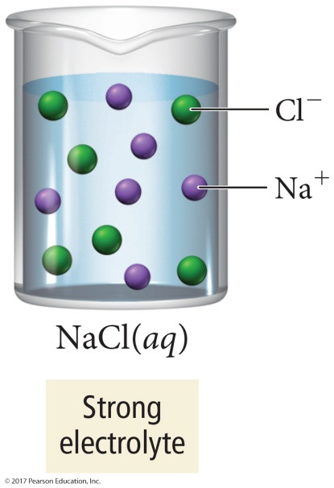
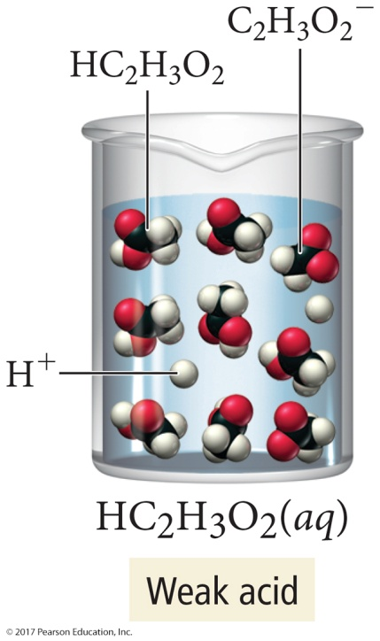
Electrolyte and Nonelectrolyte Solutions
Ionic substances, such as sodium chloride, that completely dissociate into ions when they dissolve in water, are
strong electrolytes.
Except for acids, most molecular compounds, for example sugar, dissolve in water as intact molecules, or nonelectrolytes.
Acids ionize to varying degrees in water. Those that completely ionize are strong acids. Those that don’t are weak acids.

Slide 42
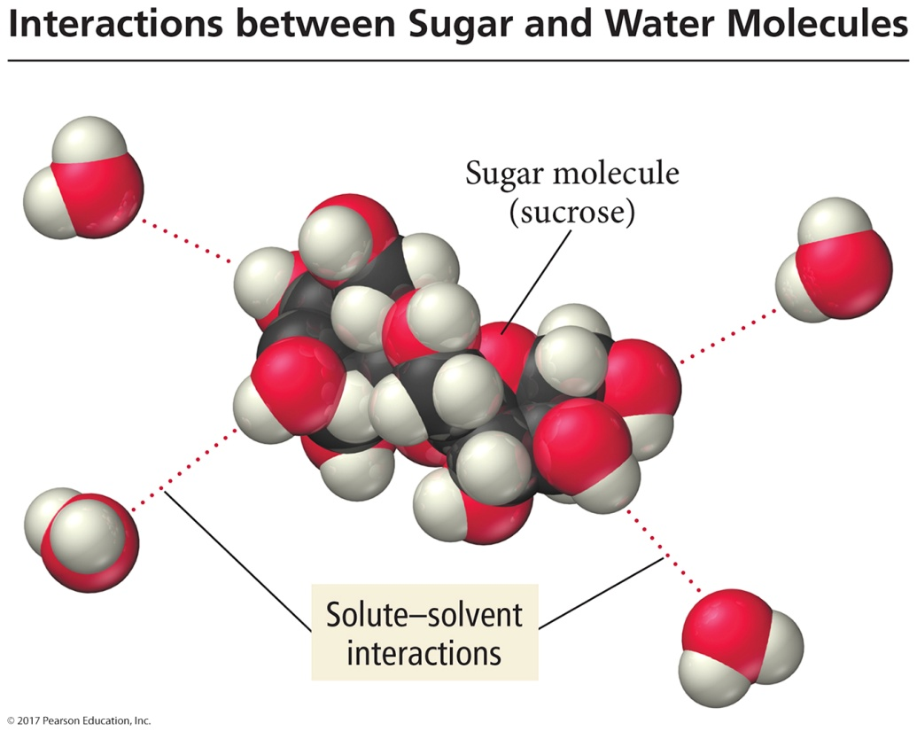
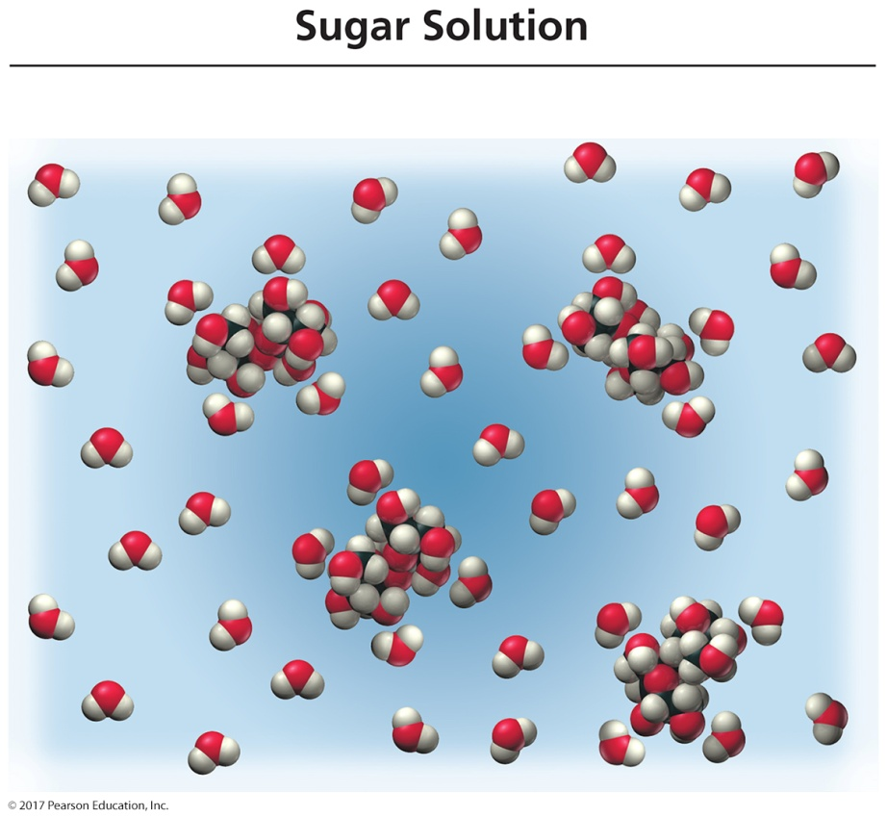
Sugar Dissolution in Water

Slide 43
Acids
Acids are molecular compounds that ionize when they dissolve in water.
  The molecules are pulled apart by their attraction for
  the water.
  When acids ionize, they form H⁺ cations and also anions.
The percentage of molecules that ionize varies from one acid to another.
Acids that ionize virtually 100% are called
strong acids.
HCl(aq) → H⁺(aq) + Cl⁻(aq)
Acids that only ionize a small percentage are called weak acids.
HF(aq) H⁺(aq) + F⁻(aq)

Slide 44
Strong and Weak Electrolytes
Strong electrolytes are materials that dissolve completely as ions.
  Ionic compounds and strong acids.
  Solutions are good conductors of electricity.
Weak electrolytes are materials that dissolve mostly as molecules but partially as ions.
  Weak acids.
  Solutions conduct electricity, but not well.

Slide 45
Dissociation and Ionization
When ionic compounds dissolve in water, the anions and cations are separated from each other. This is called dissociation.
  Na₂S(aq) → 2 Na⁺(aq) + S^{2–}(aq)
When compounds containing polyatomic ions dissociate, the polyatomic group stays together as one ion.
Na₂SO₄(aq) → 2 Na⁺(aq) + SO₄²⁻(aq)
When strong acids dissolve in water, the molecule ionizes into H⁺ and anions.
H₂SO₄(aq) → 2 H⁺(aq) + SO₄²⁻(aq)

Slide 46
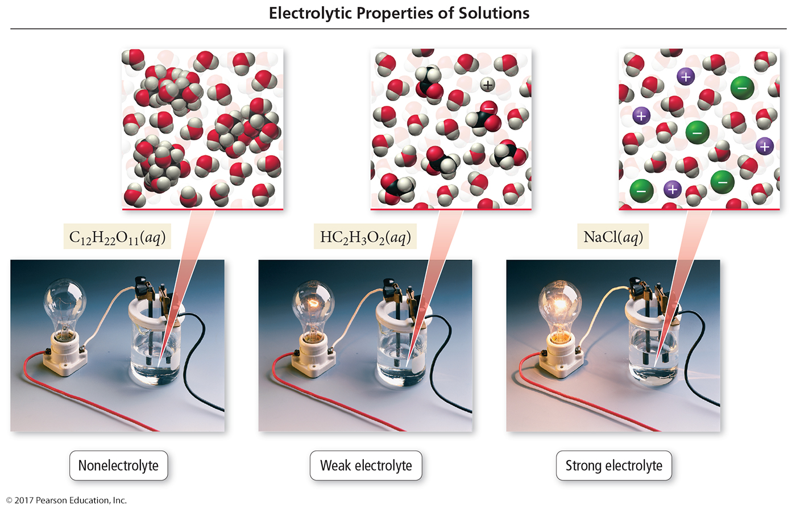
Classes of Dissolved Materials

Slide 47
The Solubility of Ionic Compounds
When an ionic compound dissolves in water, the resulting solution contains not the intact ionic compound itself but its component ions dissolved in water.
However, not all ionic compounds dissolve
in water. For example, AgCl remains solid and appears as a white powder at the bottom of
the water.
In general, a compound is termed soluble if it dissolves in water and insoluble if it does not.

Slide 48
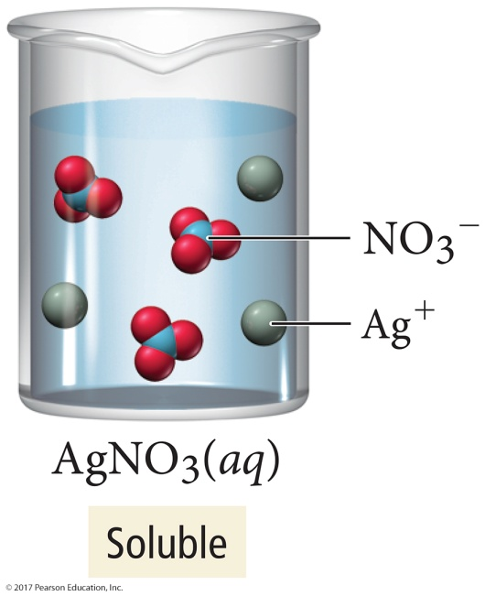
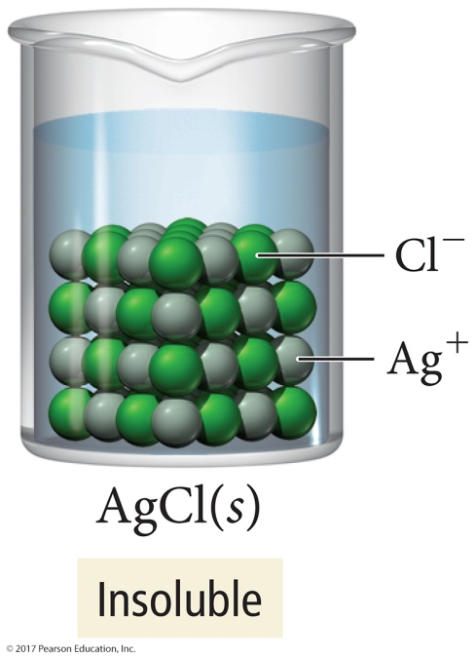
Solubility of Salts
If we mix solid AgNO₃ with water, it dissolves and forms a strong electrolyte solution.
Silver chloride, on the other hand, is almost completely insoluble.
  If we mix solid AgCl with water, virtually all of it remains as a solid within the liquid water.

Slide 49
When Will a Salt Dissolve?
Whether a particular compound is soluble or insoluble depends on several factors.
Predicting whether a compound will dissolve in water is not easy.
The best way to do it is to conduct experiments to test whether a compound will dissolve in water, and then develop some rules based on those experimental results.
  We call this method the empirical method.

Slide 50
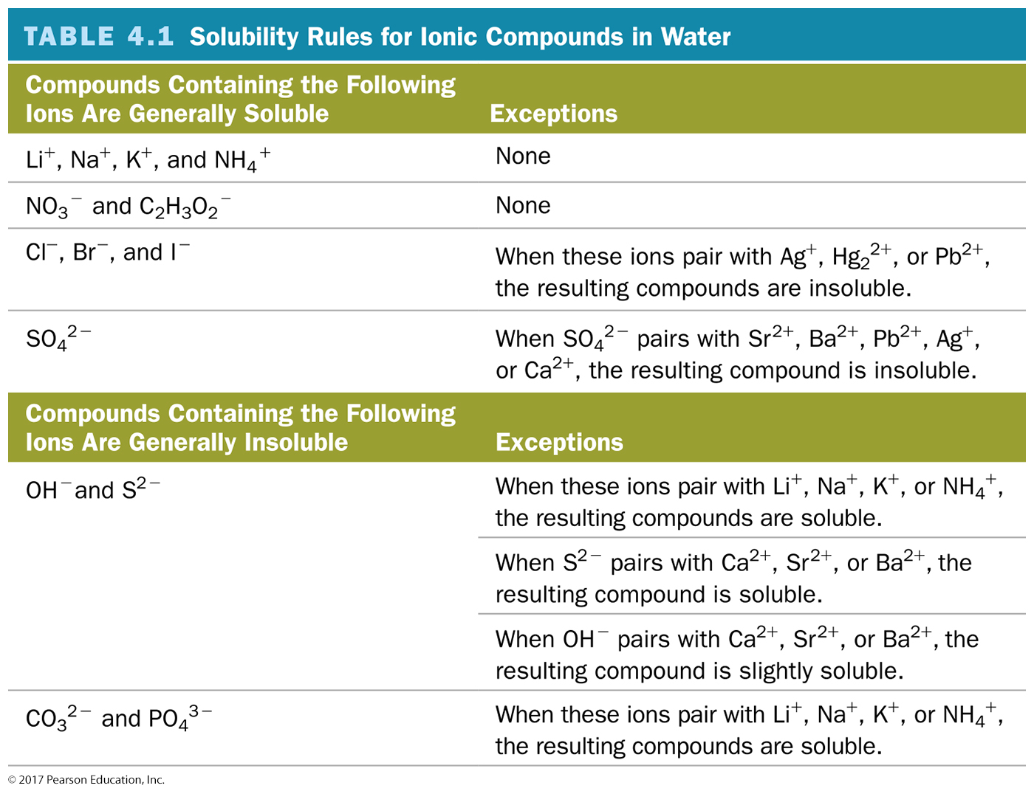
Solubility Rules

Slide 51
Precipitation Reactions
Precipitation reactions are reactions in which a solid forms when we mix two solutions.
  Reactions between aqueous solutions of ionic compounds produce an ionic compound that is insoluble in water.
  The insoluble product is called a precipitate.

Slide 52
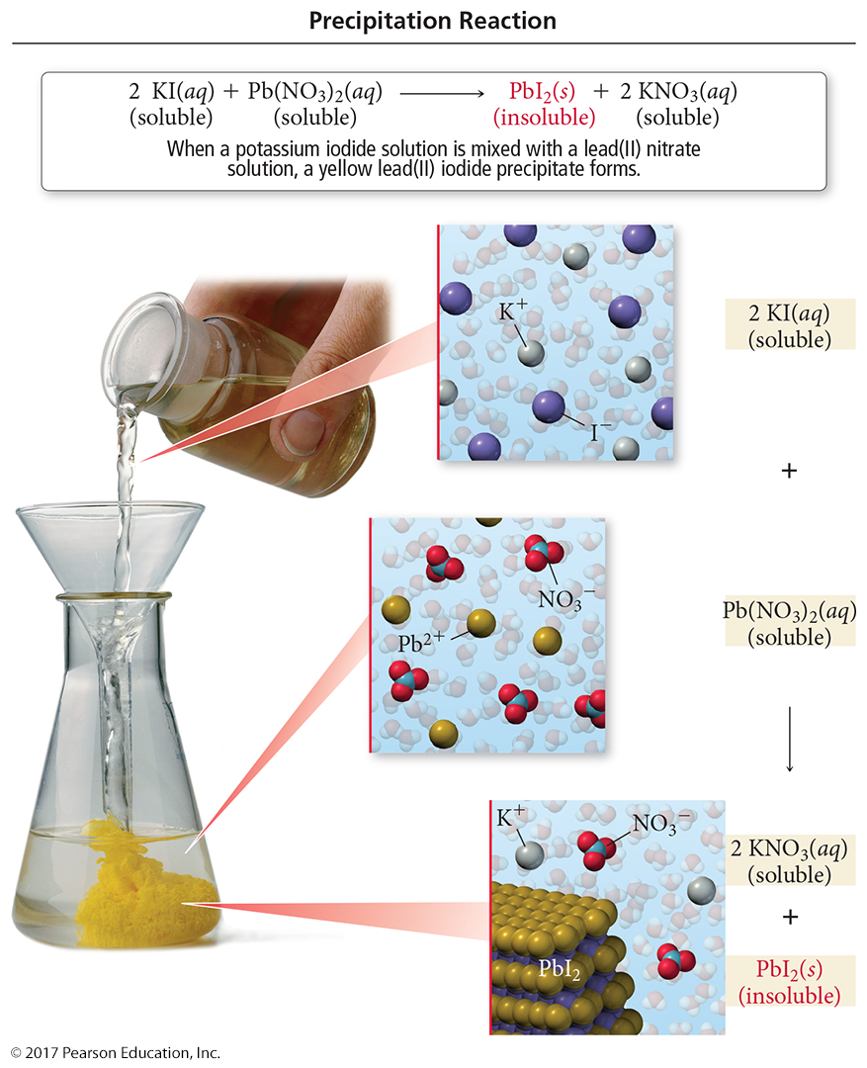
Precipitation of Lead(II) Iodide

Slide 53
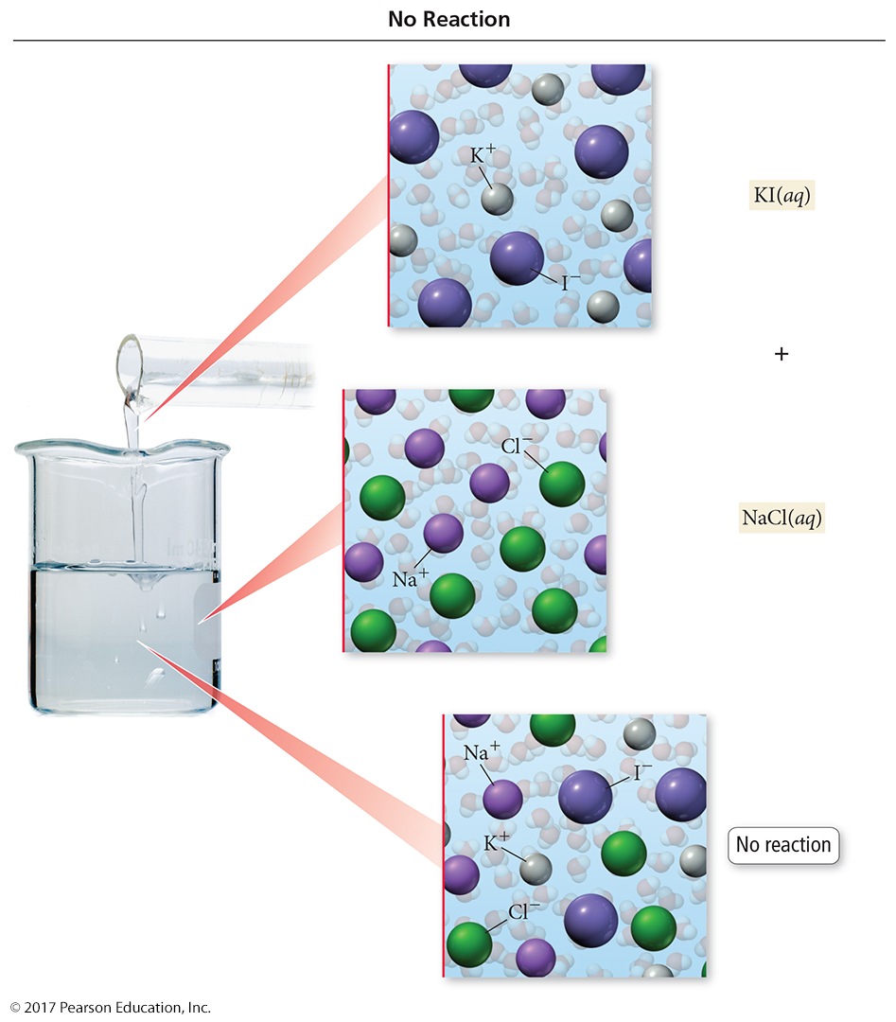
No Precipitation Means No Reaction
Precipitation reactions do not always occur when two aqueous solutions are mixed.
  Nothing happens when combining solutions of KI
  and NaCl.
KI(aq) + NaCl(aq) → No Reaction

Slide 54
Predicting Precipitation Reactions
Determine what ions each aqueous reactant has.
Determine formulas of possible products.
  Exchange ions.
    (+) ion from one reactant with (–) ion from other
  Balance charges of combined ions to get the formula of each product.
Determine solubility of each product in water.
  Use the solubility rules.
  If the product is insoluble or slightly soluble, it will precipitate.
If neither product will precipitate, write no reaction after the arrow.

Slide 55
Predicting Precipitation Reactions
5. If any of the possible products are insoluble, write their formulas as the products of the reaction using (s) after the formula to indicate solid. Write any soluble products with (aq) after the formula to indicate aqueous.
6. Balance the equation.
  Remember to change only coefficients, not subscripts.

Slide 56
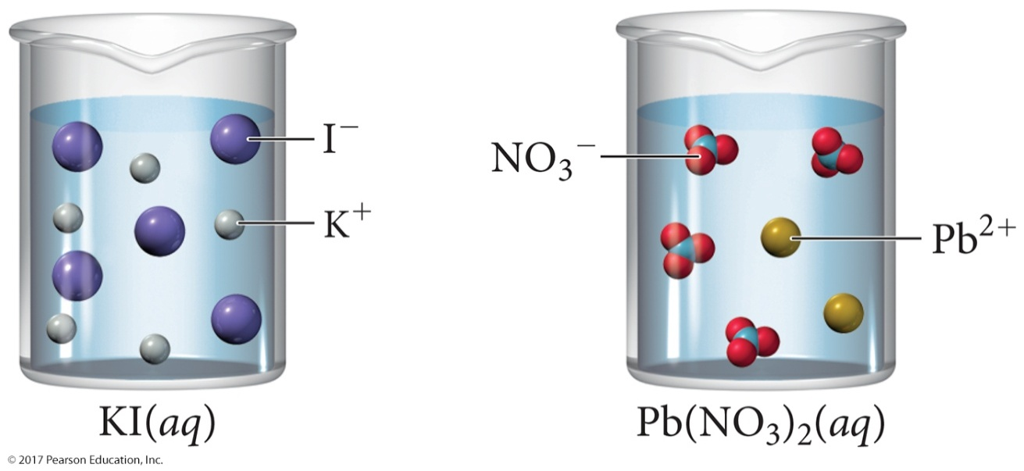
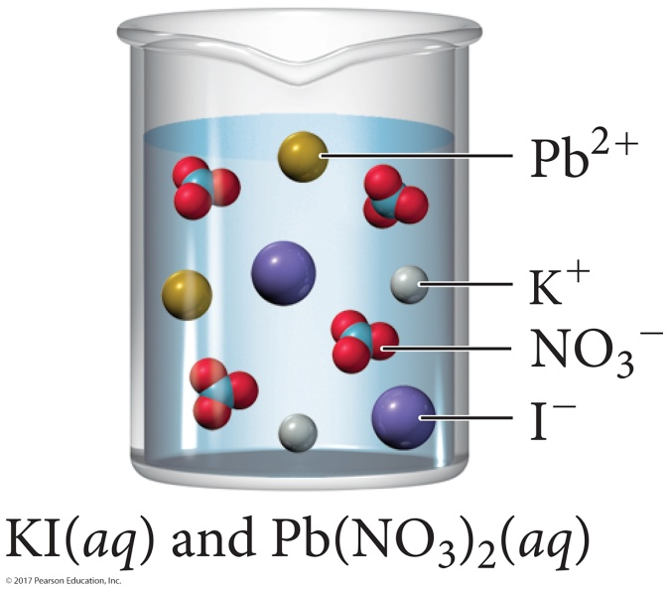
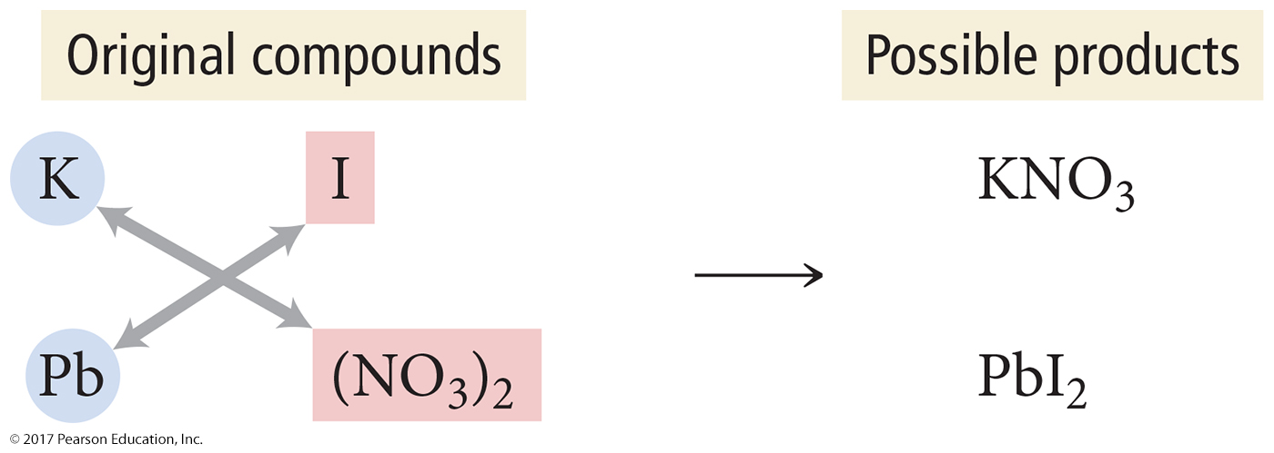
Predicting Precipitation Reactions

Slide 57
Representing Aqueous Reactions
An equation showing the complete neutral formulas for each compound in the aqueous reaction as if they existed as molecules is called a molecular equation.
2 KOH(aq) + Mg(NO₃)₂(aq) → 2 KNO₃(aq) + Mg(OH)₂(s)
In actual solutions of soluble ionic compounds, dissolved substances are present as ions. Equations that describe the nature of the dissolved species in solution are called complete ionic equations.

Slide 58
Rules for Writing a Complete Ionic Equation
Aqueous strong electrolytes (soluble salts, strong acids, strong bases) are written
as ions.
Insoluble substances, weak electrolytes, and nonelectrolytes are written in
molecule form.
  Solids, liquids, and gases are not dissolved, hence molecule form
2 K⁺_{(aq)} + 2 OH⁻_{(aq)} + Mg²⁺_{(aq)} + 2 NO₃⁻_{(aq)} →
2 K⁺_{(aq)} + 2 NO₃⁻_{(aq)} + Mg(OH)_{2(s)}

Slide 59
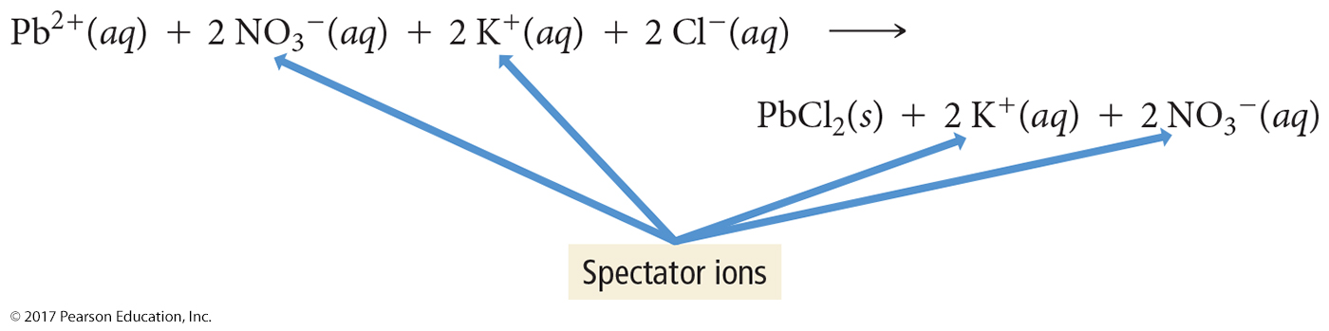
Ionic Equation
Notice that in the complete ionic equation, some of the ions in solution appear unchanged on both sides of the equation.
These ions are called spectator ions because they do not participate in the reaction (soluble salts, strong acids, and strong bases).

Slide 60
Net Ionic Equation
An ionic equation in which the spectator ions are removed is called a net ionic equation.
The net ionic equation is
2 OH⁻_{(aq)} + Mg²⁺_{(aq)} → Mg(OH)_{2(s)}
2 K⁺_{(aq)} + 2 OH⁻_{(aq)} + Mg²⁺_{(aq)} + 2 NO₃⁻_{(aq)} → 2 K⁺_{(aq)} + 2 NO₃⁻_{(aq)} + Mg(OH)_{2(s)}

Slide 61
Examples
Write the ionic and net ionic equation for each of the following:
1. K₂SO₄(aq) + 2 AgNO₃(aq) → 2 KNO₃(aq) + Ag₂SO₄(s)
2 K⁺(aq) + SO₄²⁻(aq) + 2 Ag⁺(aq) + 2 NO₃⁻(aq) →
2 K⁺(aq) + 2 NO₃⁻(aq) + Ag₂SO₄(s)
2 Ag⁺(aq) + SO₄²⁻(aq) → Ag₂SO₄(s)
2 Na⁺(aq) + CO₃²⁻(aq) + 2 H⁺(aq) + 2 Cl⁻(aq) →
2 Na⁺(aq) + 2 Cl⁻(aq) + CO₂(g) + H₂O(l)
CO₃²⁻(aq) + 2 H⁺(aq) → CO₂(g) + H₂O(l)
2. Na₂CO₃(aq) + 2 HCl(aq) → 2 NaCl(aq) + CO₂(g) + H₂O(l)

Slide 62
Acid–Base and Gas-Evolution Reactions
Two other important classes of reactions that occur in aqueous solution are
  1. acid–base reactions and
  2. gas-evolution reactions.
Acid–base reaction:
  An acid–base reaction is also called a neutralization reaction.
  An acid reacts with a base, and the two neutralize each other, producing water (or in some cases a weak electrolyte).

Slide 63
Acid–Base and Gas-Evolution Reactions
In a gas-evolution reaction, a gas is produced, resulting in bubbling.
In both acid–base and gas-evolution reactions, as in precipitation reactions, the reactions occur when the anion from one reactant combines with the cation of
the other.
Many gas-evolution reactions are also
acid–base reactions.

Slide 64
Acid–Base Reactions
Arrhenius Definitions:
  Acid: Substance that produces H⁺ in aqueous solution. HCl(aq) H⁺(aq) + Cl–(aq)
In solution, H⁺ bonds with water to produce the hydronium ion, H₃O+.
Polyprotic acids contain more than one ionizable proton and release them sequentially.
The first ionizable proton is strong while subsequent ionizable protons are weak.
Base: Substance that produces OH– ions in aqueous solution.
  NaOH(aq) Na⁺(aq) + OH–(aq)

Slide 65
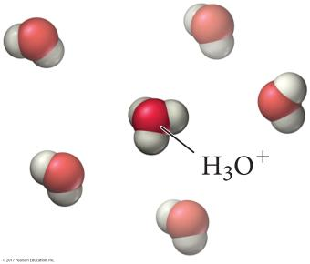
Acid–Base Reactions
These reactions are called neutralization reactions because the acid and base neutralize each other’s properties.
2 HNO₃(aq) + Ca(OH)₂(aq) → Ca(NO₃)₂(aq) + 2 H₂O(l)
The net ionic equation for an acid–base reaction is
H⁺(aq) + OH–(aq) → H₂O(l)
  As long as the salt that forms is soluble in water.

Slide 66
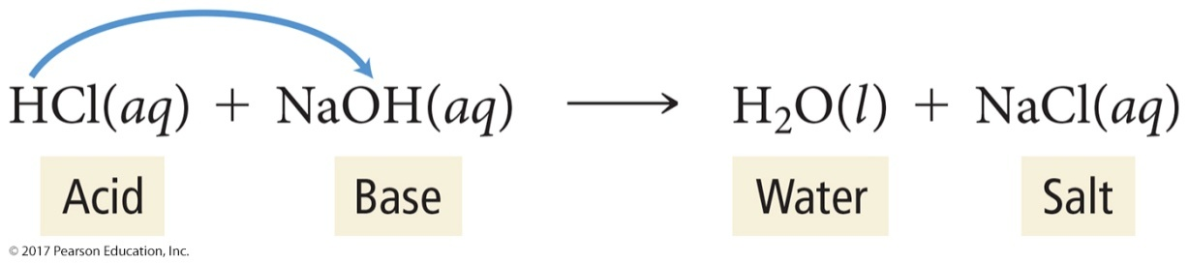
Acids and Bases in Solution
Acids ionize in water to form H⁺ ions.
  More precisely, the H⁺ from the acid molecule is donated to a water molecule to form hydronium ion, H₃O⁺.
    Most chemists use H⁺ and H₃O⁺ interchangeably.
Bases dissociate in water to form OH– ions.
  Bases, such as NH₃, that do not contain OH⁻ ions, produce OH– by pulling H⁺ off water molecules.
In the reaction of an acid with a base, the H⁺ from the acid combines with the OH– from the base to
make water.
The cation from the base combines with the anion from the acid to make the salt.

Slide 67
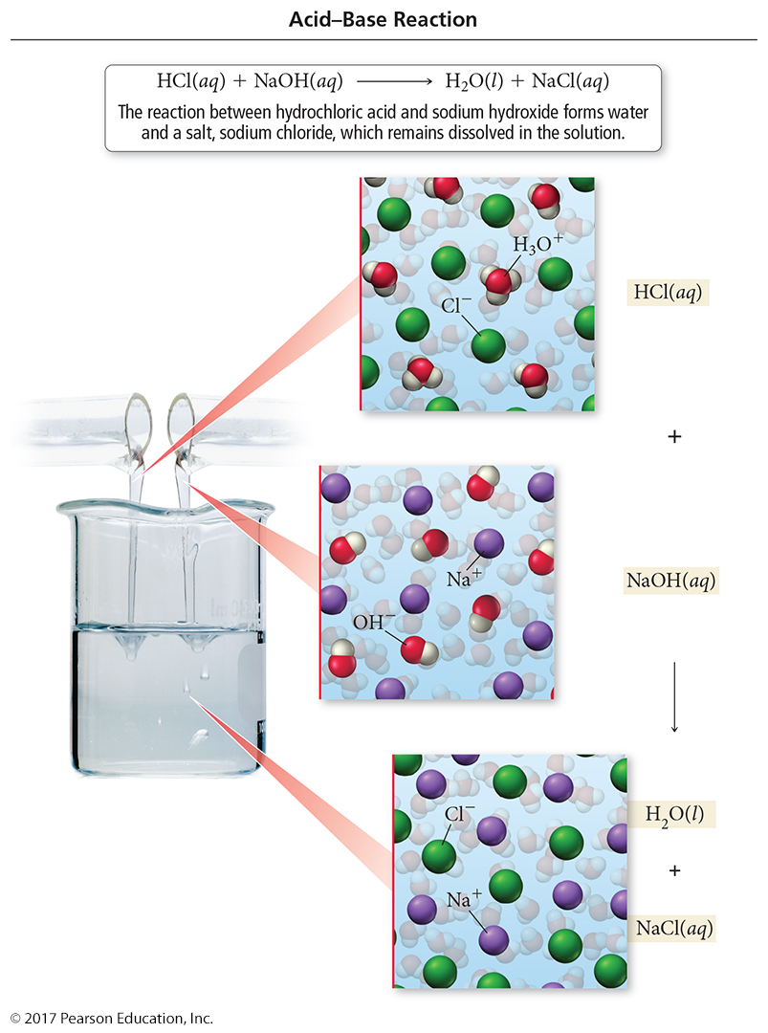
Acid–Base Reaction
HCl(aq) + NaOH(aq) → NaCl(aq) + H₂O(l)

Slide 68
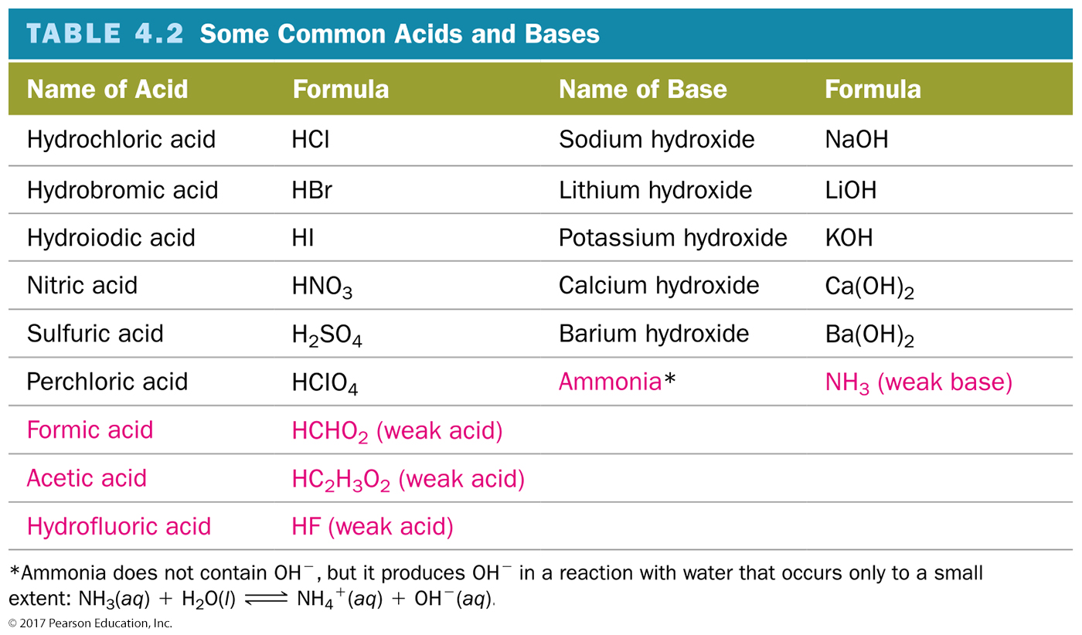
Some Common Acids and Bases

Slide 69
Predict the Product of the Reactions
HCl(aq) + Ba(OH)₂(aq) →
2. H₂SO₄(aq) + LiOH(aq) →
(H⁺ + Cl⁻) + (Ba²⁺ + OH⁻) → (H⁺ + OH⁻) + (Ba²⁺ + Cl⁻)
HCl(aq) + Ba(OH)₂(aq) → H₂O(l) + BaCl₂
2 HCl(aq) + Ba(OH)₂(aq) → 2 H₂O(l) + BaCl₂(aq)
(H⁺ + SO₄²⁻) + (Li⁺ + OH⁻) → (H⁺ + OH⁻) + (Li⁺ + SO₄²⁻)
H₂SO₄(aq) + LiOH(aq) → H₂O(l) + Li₂SO₄
H₂SO₄(aq) + 2 LiOH(aq) → 2 H₂O(l) + Li₂SO₄(aq)

Slide 70
Acid–Base Titrations
A titration is a laboratory procedure where a substance in a solution of known concentration (titration) is reacted with another substance in a solution of unknown concentration (analyte).
The equivalence point is the point in the titration when the H⁺ and OH– from reactants are in their stoichiometric ratio and are completely reacted.
An indicator is a dye whose color depends on the acidity or basicity of solution.

Slide 71
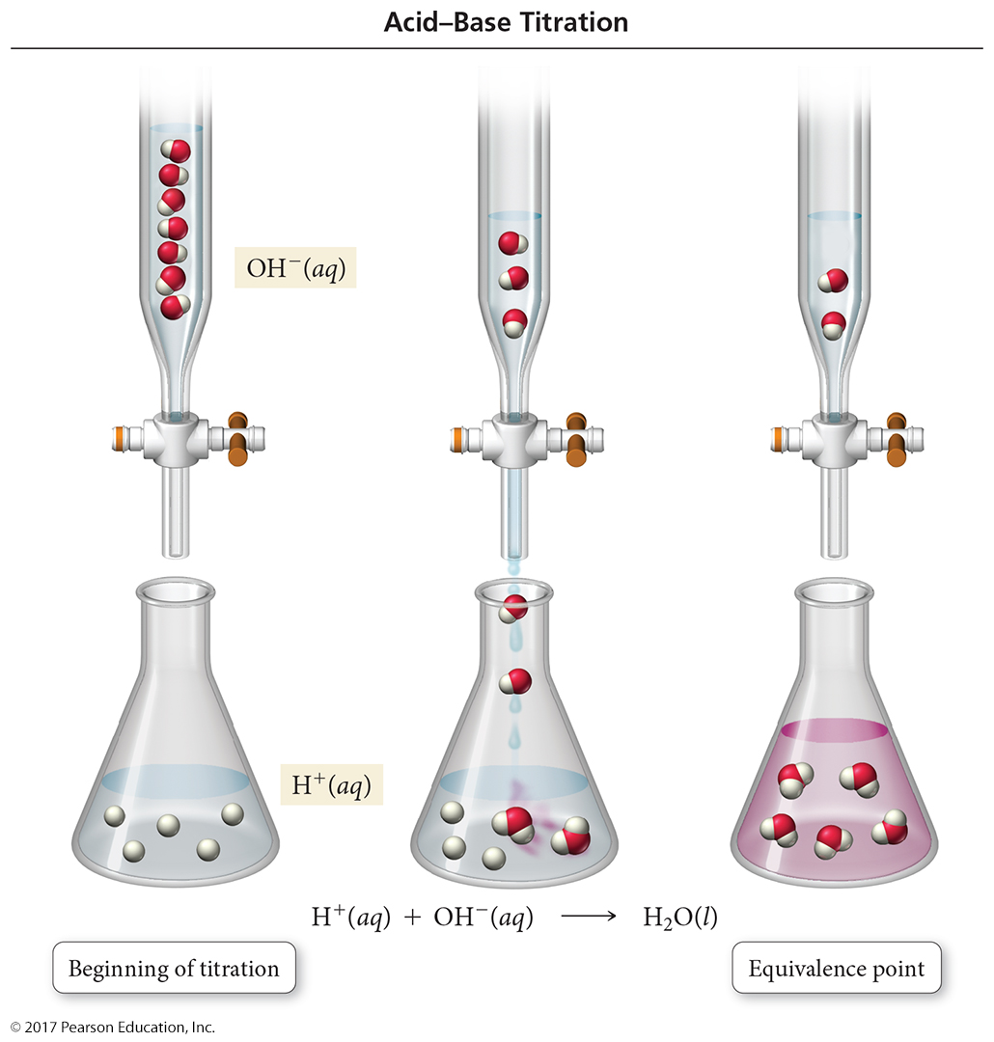
Acid–Base Titration

Slide 72

Titration
    In this titration, NaOH is added to a dilute HCl solution. When the NaOH and HCl reach stoichiometric proportions (the equivalence point), the phenolphthalein indicator changes color to pink.

Slide 73
Gas-Evolving Reactions
Some reactions form a gas directly from the ion exchange.
K₂S(aq) + H₂SO₄(aq) → K₂SO₄(aq) + H₂S(g)
Other reactions form a gas by the subsequent decomposition of one of the ion exchange products into a gas and water.
NaHCO₃(aq) + HCl(aq) → NaCl(aq) + H₂CO₃(aq)
H₂CO₃(aq) → H₂O(l) + CO₂(g)

Slide 74
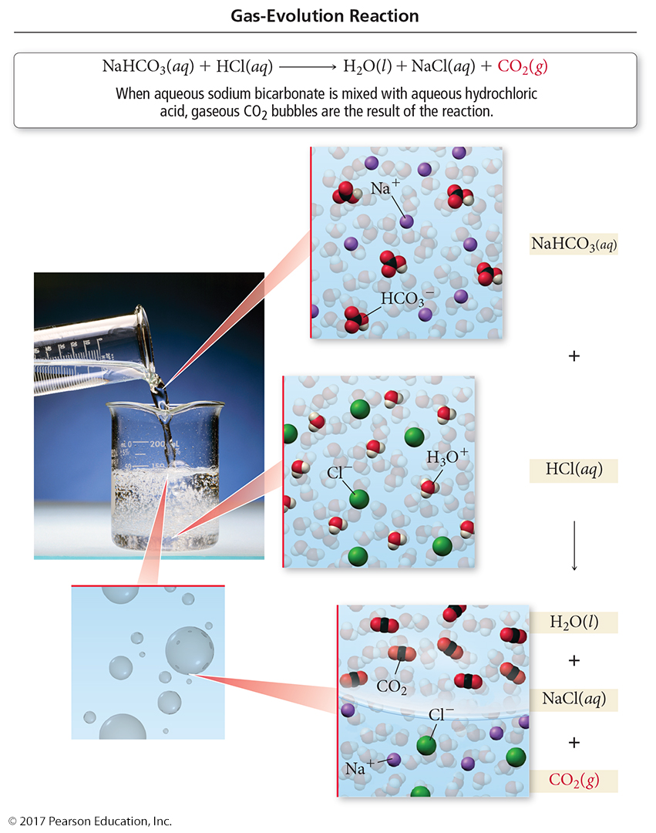
Gas-Evolution Reaction

Slide 75
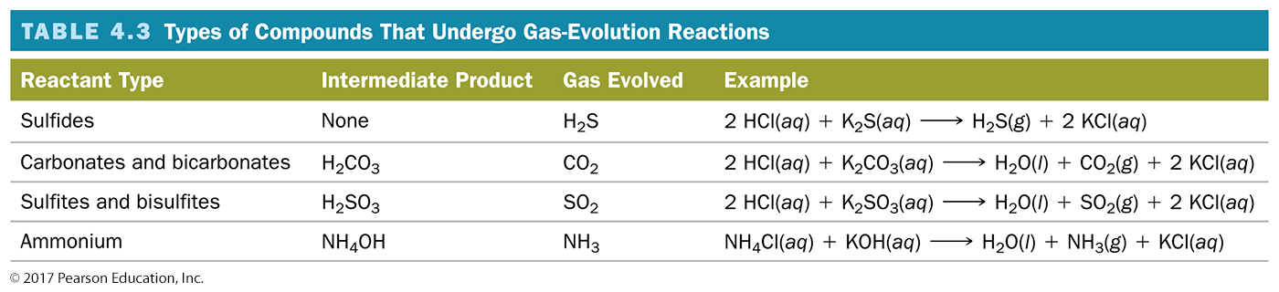
Types of Compounds That Undergo Gas-Evolution Reactions

Slide 76
Oxidation–Reduction Reactions
The reactions in which electrons are transferred from one reactant to the other are called oxidation-reduction reactions, or redox reactions.
Many redox reactions involve the reaction of a substance with oxygen.
4 Fe(s) + 3 O₂(g) → 2 Fe₂O₃(s) (rusting)
2 C₈H₁₈(l) + 25 O₂(g)
16 CO₂(g) +18 H₂O(g) (combustion)
2 H₂(g) + O₂(g) 2 H₂O(g)

Slide 77
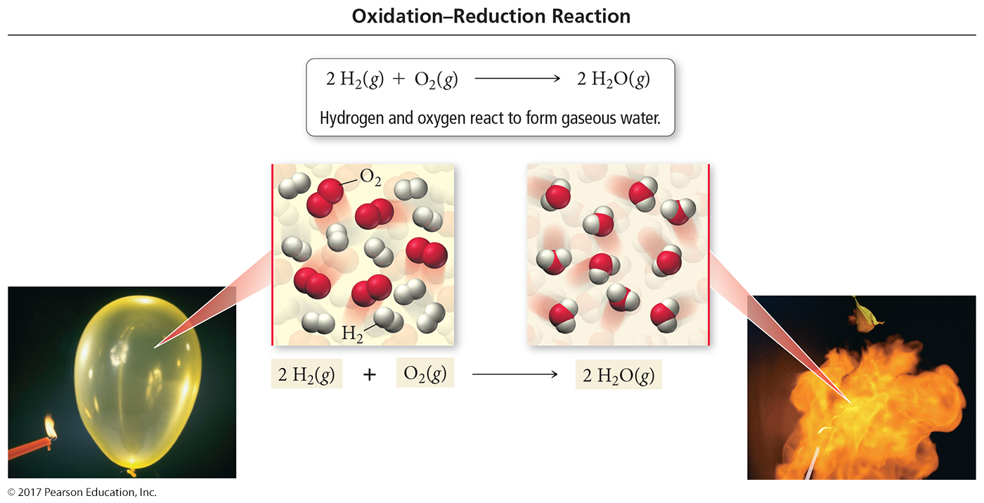
Combustion as Redox
2 H₂(g) + O₂(g) → 2 H₂O(g)

Slide 78
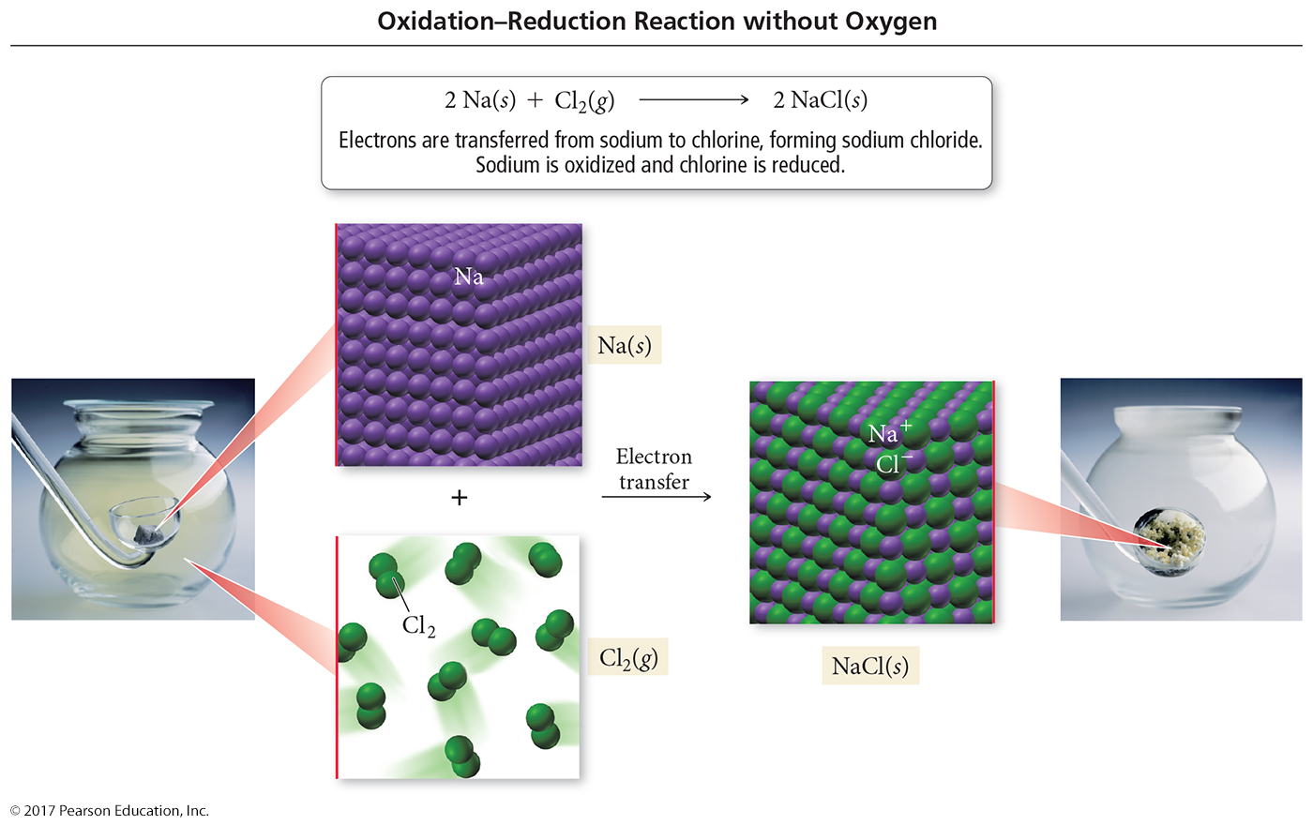
Redox without Combustion
2 Na(s) + Cl₂(g) → 2 NaCl(s)

Slide 79
Reactions of Metals with Nonmetals
Consider the following reactions:
4 Na(s) + O₂(g) → 2 Na₂O(s)
2 Na(s) + Cl₂(g) → 2 NaCl(s)
The reactions involve a metal reacting with a nonmetal.
In addition, both reactions involve the conversion of free elements into ions.
4 Na(s) + O₂(g) → 2 Na⁺₂O^{2–} (s)
2 Na(s) + Cl₂(g) → 2 Na⁺Cl–(s)

Slide 80
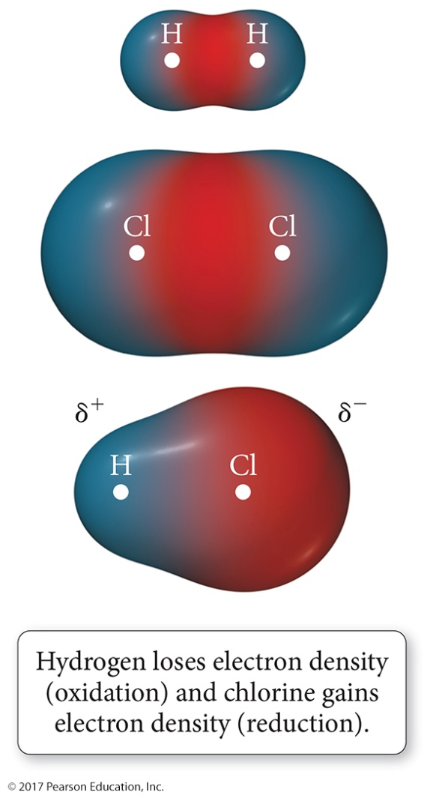
Redox Reaction
Electron transfer does not need to be a complete transfer for the reaction to qualify as oxidation–reduction. Example: H₂(g) + Cl₂(g) 2 HCl(g)
There is uneven sharing of electrons when hydrogen bonds to chlorine, resulting in an increase of electron density (reduction) for chlorine and a decrease in electron density
(oxidation) for hydrogen.

Slide 81
Oxidation and Reduction
To convert a free element into an ion, the atom must gain or lose electrons.
  If one atom loses electrons, another atom must
  accept them.
Reactions where electrons are transferred from one atom to another are redox reactions.
Atoms that lose electrons are being oxidized, while atoms that gain electrons are being reduced.
2 Na(s) + Cl₂(g) → 2 Na⁺Cl–(s)
Na → Na⁺ + 1 e– (oxidation)
Cl₂ + 2 e– → 2 Cl– (reduction)

Slide 82
Oxidation States
For reactions that are not metal + nonmetal or do not involve O₂, we need a method for determining how the electrons are transferred.
Chemists assign a number to each element in a reaction called an oxidation state that allows them to determine the electron flow in the reaction.
Even though they look like them,
oxidation states are not ion charges!
  Oxidation states are imaginary charges assigned based on a set of rules.
  Ion charges are real, measurable charges.

Slide 83
Rules for Assigning Oxidation States
The following rules are in order of priority:
Free elements have an oxidation state = 0.
  Na = 0 and Cl₂ = 0 in 2 Na(s) + Cl₂(g)
Monatomic ions have an oxidation state equal to their charge.
  In NaCl Na = +1 and Cl = −1
(a) The sum of the oxidation states of all the atoms in a compound is 0.
  Na = +1 and Cl = −1 in NaCl, (+1) + (−1) = 0

Slide 84
Rules for Assigning Oxidation States
(b) The sum of the oxidation states of all the atoms in a polyatomic ion equals the charge on the ion.
  N = +5 and O = −2 in NO₃–, (+5) + 3(−2) = −1
4. (a) Group I metals have an oxidation state of +1 in all of their compounds.
  Na = +1 in NaCl
(b) Group II metals have an oxidation state of +2 in all of their compounds.
  Mg = +2 in MgCl₂

Slide 85
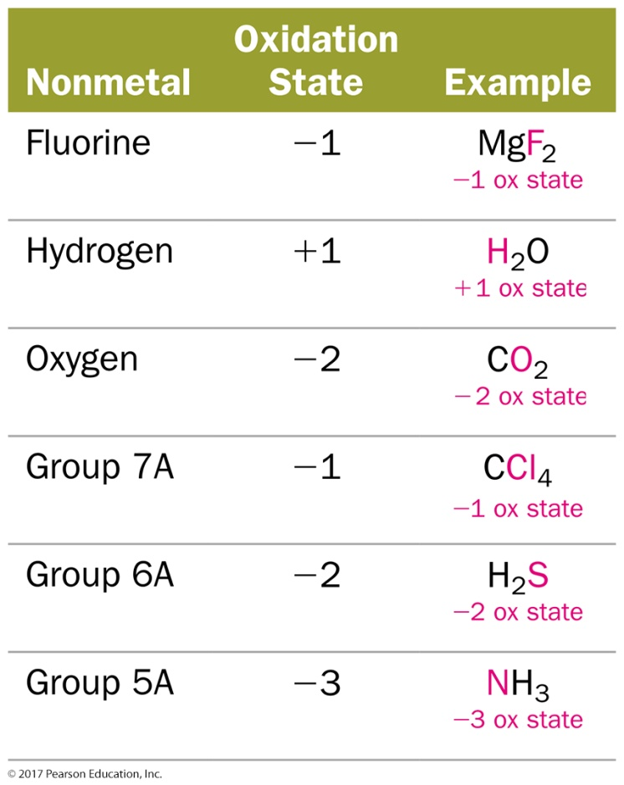
Rules for Assigning Oxidation States
5. In their compounds, nonmetals have oxidation states according to the table below.
  Nonmetals higher on the table take priority.

Slide 86
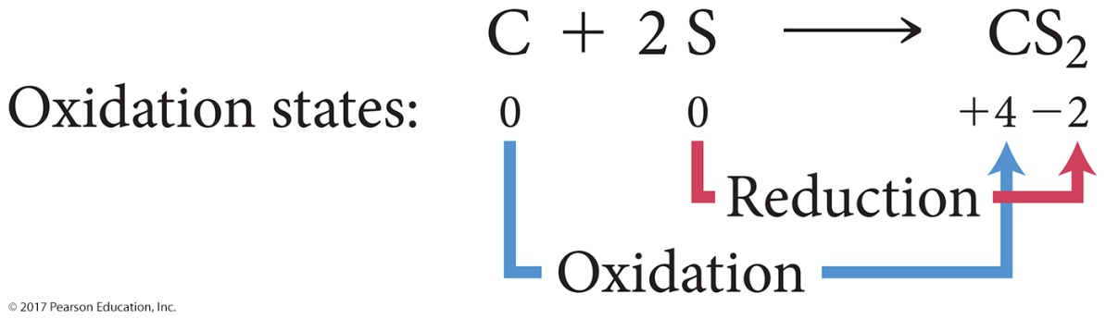
Identifying Redox Reactions
Oxidation: An increase in oxidation state
Reduction: A decrease in oxidation state
  Carbon changes from an oxidation state of 0 to an oxidation state of +4.
    Carbon loses electrons and is oxidized.
  Sulfur changes from an oxidation state of 0 to an oxidation state of –2.
    Sulfur gains electrons and is reduced.

Slide 87
Redox Reactions
Oxidation and reduction must occur simultaneously.
  If an atom loses electrons another atom must take them.
The reactant that causes reduction in another reactant is called the reducing agent.
  The reducing agent contains the element that is oxidized.
The reactant that causes oxidation in another reactant is called the oxidizing agent.
  The oxidizing agent contains the element that is reduced.
2 Na(s) + Cl₂(g) → 2 Na⁺Cl–(s)
Na is oxidized, while Cl is reduced.
Na is the reducing agent, and Cl₂ is the
oxidizing agent.

Slide 88
Combustion Reactions
Combustion reactions are characterized by the reaction of a substance with O₂ to form one or more oxygen-containing compounds, often including water.
  Combustion reactions also emit heat.
For example, as you saw earlier in this chapter, natural gas (CH₄) reacts with oxygen to form carbon dioxide and water:

Slide 89
Combustion
Ethanol, the alcohol in alcoholic beverages, also reacts with oxygen in a combustion reaction to form carbon dioxide and water.

